Slide 1
About this deck….
Hello!
This deck is provided along with a collection of resources to help you host a generative AI themed event that will inform, educate and delight.
Synopsis:
This presentation sizeable and very customizable deck explores how generative AI tools like Amazon Q Developer can revolutionize the software development lifecycle by assisting developers at every stage - from requirements gathering and design, to coding, testing, deployment, and maintenance. Through live demos showcasing Amazon Q's capabilities, attendees will see how these AI-powered tools can dramatically increase developer productivity by providing intelligent suggestions, automatically generating boilerplate code, fixing bugs, improving code quality, and simplifying complex tasks. The session highlights the paradigm shift generative AI brings to development workflows, enabling developers to focus more on innovation by offloading tedious, repetitive work to AI assistants. Developers will learn best practices for leveraging these cutting-edge tools effectively to unlock new levels of speed and creativity in their software projects.
Level: 100-300
(*The level can be adjusted by the presenter to meet the needs of the audience.)

Slide 2
Making happy developers
How generative AI tools can bring joy to developers, and make them more productive

Slide 3
What is the best thing about being a software developer?
Notes:
<audience interaction> Ask the audience what they like - hopefully it will match to these. We want to collect feedback/responses to make sure we are tracking those. Solving Problems with code Learning new technologies Fixing bugs

Slide 4
…and the not so good parts?
Notes:
What are the things that you know are important, but enjoy less? Documentation Writing tests Working on legacy code Creating Bugs!

Slide 5
How much time do developers spend coding?
Notes:
Software.com analyzed data from more than 250,000 developers worldwide over a 3 month period, and they found that:
The median time that developers spend writing or editing code in their IDE is less than an hour per day (52 mins)
Per work week, we spend less than 4 1/2 hours writing code.
Only 10% of developers spend more than 2 hours per day coding
So this begs the question, why aren’t we as developers able to spend more time writing code? Building? What challenges are we facing here?
<audience participation> How much time do you think you spend coding?

Slide 6
So what else do we do then?
Notes:
<audience participation> What other things are you doing.
<Again, listen and connect with the audience. Make sure we get details and add these to other data we collect from the session.>

Slide 7
The software development life cycle (SDLC)
Analysis
Design
Develop
Test
Deploy
Maintain
Notes:
Hopefully most of you will recognize this – the software development lifecycle, or sdlc
We you look cross the sdlc, we actually spend only a small percentage of time actually writing software. If you look at some of the other activities developers do, either fully or just as a distraction/participant in, you might recognize some of these.
Analysis and Design (research, options, design
How do you know what the right tools is to use?
How do you know if there might be better ways of solving the problems you have?
asking our peers
using existing standards or patterns we have access to or are told to use
internet search
Development (developing software, using libraries, working with SQL, doing data conversion)
Testing (security, unit, synthentic data)
Deployment (command line, clickops, iac, documenting code - creating images for docs, creating architectural diagrams)
Maintain (come up to speed/document code, debug and fix)
And then we do this, again and again (rinse, repeat)

Slide 8
“Difficult to see. Always in motion is the future.”
— Yoda
Notes:
So it turns out, writing code is only part of the craft of the developer.
On top of that, Developers operate in a constant state of change.

Slide 9
interpreted Languages
Compiled Languages
Developer Velocity
Assembly Language
Machine Code
Punch Cards
Levels of abstraction
Notes:
Over the years, developers have adapted to ever increasing levels of abstractions to make their life easier, more productive. This has also made development and our craft more accessible, allowing more people to enter the industry.
Developers are innovators and early adopters of new technologies.
But as developers, how do you assess new technologies or tools that come along all the time? What is your mental model that makes you decided to look into something or to say meh! How can this tool make me go faster? Does this tool solve interesting problems that I have? Does this make something much easier for me to do?
Notes: Assembly Language is a low level programming language that is translated into Machine Code by an Assembler. Machine Code itself consists of binaries and is executed directly by the machine.
Source: https://en.wikipedia.org/wiki/History_of_programming_languages

Slide 10
Low Code
Domain Specific Languages
Developer Velocity
Frameworks
(code generation)
Intellisense
Autocompletion Tools
IDE
Sophistication of tooling
Notes:
We have kind of been on this road for a while….since I have been involved, these are some of the developer productivity improvements I have seen.
Q: I am curious, what others have I missed that you feel have been a step change in productivity?
If we see how developer tools have evolved over time, we can see that the capabilities they provide fall on a spectrum. Increasingly we are moving top / right to enable developers to be more productive.
Code autocomplete?
Intellisense?
Framewokrs that provide opinionated generation tools
Domain specific languages that help abstract complexity and make complex task more simple?
Low Code tools?

Slide 11
Developer Velocity
Community knowledge bases
Search Engines
Pre-internet
Supporting infrastructure and systems
Notes:
There are other kinds of resources that developers use to help them be more effective. When we code, the code we produce rarely works first time – who recognises this? (hands up anyone who gets code to work first time?)
Developers face many typical day to day challenges in getting that code to work. Strategies that I have seen that are used to address them include
Brute force – I will prevail through n squared try/fail
Google search guru
Finding answers on the web in sites like Stack Overflow, Reddit, Blog Posts, and open source repositories

Slide 12

Notes:
This has kind of led to the common meme about what we probably do a lot of the time, is just repeat stuff that has been done before. We have become good and finding that, and then adapting it to what we need to do.
// Picture generated by Titan Image generator – meme creators everywhere are safe for the time being, but it was a good effort
What are the tasks you ALWAYS need help with?
When we code, we frequently use new libraries that we have not used before – who recognises this?
When we are looking at someone else's code, we can never find the information we need, right. – who recognises this?

Slide 13
What if I told you there was a better way?
Notes:
So there has got to be a better way right? As it turns out, there is.

Slide 14
Code is language
Notes:
I always joke that I speak many languages, English, <add your additional languages if you have any>, Python and Java.
The programming languages we use day in day out can be thought of in similar ways to the language we speak – they have grammar, syntax rules, oddities.

Slide 15

Amazon Q Developer transforms
the developer experience
Notes:
It turns out, there is. Over the past year, large language models have revolutionized how we can interact using words and language. It turns out that one of the really exciting areas where this can be super effective is in the various stages of the software development lifecycle.
Tools like Amazon Q Developer have emerged that work across the different stages, and represent the evolution of developer productivity.

Slide 16
Generative AI
Developer Velocity
Community knowledge bases
Search Engines
Pre-internet
Supporting infrastructure and systems
Notes:
Generative AI tools like Amazon Q Developer provide the evolution of developer tooling, helping us to increase velocity and reduce toil. Lets take a look at that in more detail next.

Slide 17
The craft of the developer…. reimagined

Slide 18

Analysis
Asking better questions
Find relevant information more quickly
Better preparation
“It depends”
Notes:
Developers can use generative AI tools to help them prepare for the analysis phase of development projects.
Some examples of this include:
When we pick up a new development task, we first have to find the information we need. Generartive AI can help us here, both generally and specifically. We can leverage generative AI tools together with approaches such as RAG (Retrieval Augmented Generation) to inject our companies tech docs, and help us find the information we need. This can be a real time saver.
Developers can use GenAI tools to better prepare for planning meetings, to ask the right questions. For example, they can use GenAI to understand functional and non functional requirements that they need to think about, or use these tools to explore different approaches and provide some initial ideas for the design stage – pros/cons
How many times have you used the phrase IT depends when speaking with your stakeholders during requirements gathering? I like to think that generative AI tools provide the ultimate response to It Depends -
Example/

Slide 19

Design
Better plan your approach to your task
Provide technical design options
Understand trade-offs
Rightsizing
Defining architecture and frameworks
Notes:
During the design phase, you need to start thinking more concretely about what you are going to the architecture and how the solution is going to look.
You need to find accurate, up-to-date information and guidance to help you understand potential solutions, which AWS services I could use, and how I could use them. You could spend hours reading through AWS documentation, reading through blog posts, searching on Google, so generative AI tools can really help you gain clarity.
This is where you begin to narrow down your choices based on the inputs you already have (functional and non functional requirements), and begin to find out the options you have, the trade-offs you need to think about, to help you make your design decisions.
You begin to define your architecture, select the frameworks you want to use, and start to think about your compute architecture and use this information to better right size your infrastructure and ask for sizing suggestions.
Example/

Slide 20
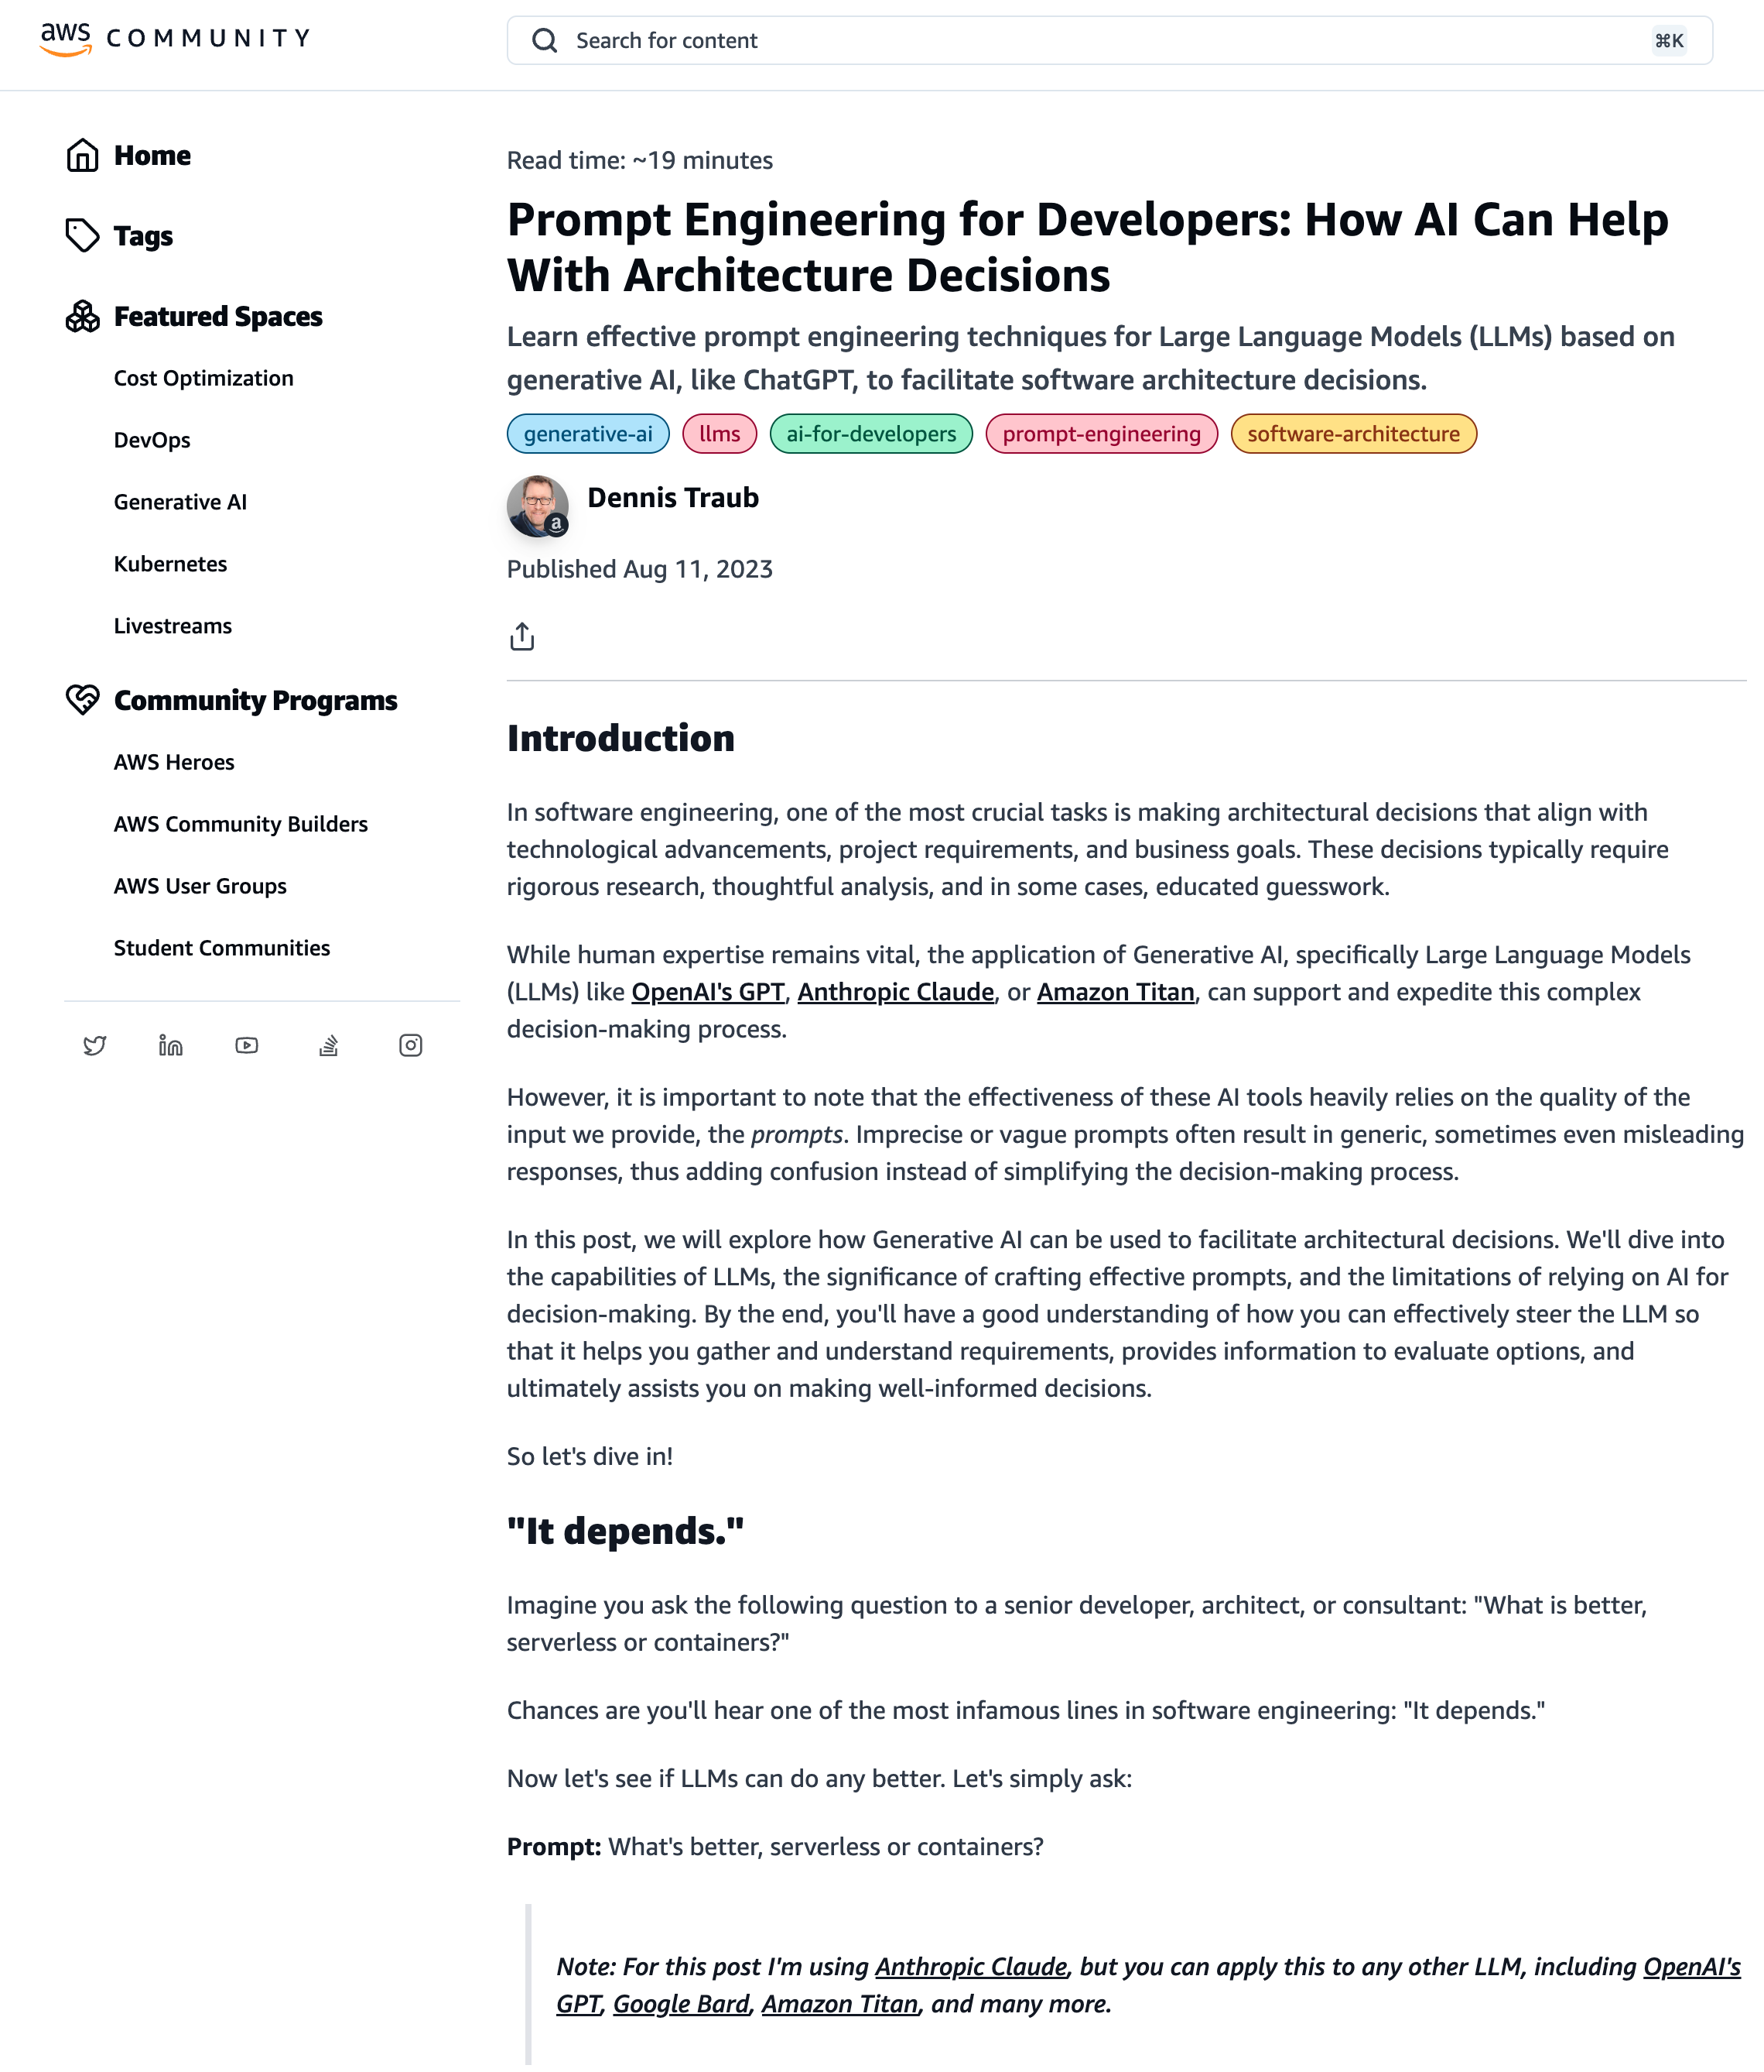

Explores how generative AI can be used to help architects in making architectural decisions that align with technological advancements, project requirements, and business goals
Notes:
Architects can have fun with these tools too.
This post from Dennis, looks at how architects can use these tools with decision making decision, for example, ensuring there is an alignment in the design against existing project or technical requirements.

Slide 21

Develop
Accelerate your development
Learning new concepts
Optimization
Debugging your code
Reference guides and cheat sheets
Notes:
Woohoo, we finally get to coding. Here is where generative AI tools are providing a lot of value to developers across a broad number of tasks they do.
Software Library Quickstart - Help you work with libraries and APIs that you might not be familiar with
Learn concepts – you might want to understand how to implement or use algorithms, maybe the difference between file formats, data conversion, working with regex,
Reference and Cheatsheets - writing better SQL, or maybe you want to finally gain expert level on git
Debug your code – as you code and you get errors, generative AI tools can help you get better answers so you can fix those bugs quicker
Optimising your code – your code works, but can you make it better? Optimising your code can help you towards cost and sustainability goals, and so may provide you with some good options.
Securing your code – gen AI tools can take a look at our code and help you identify potential vulnerabilities and bugs you might have missed.
Make your code more maintainable – now you can automate the task of documenting your functions as you go

Slide 22

Testing
All of your testing
Write unit tests
Security assessment
Synthetic and sample data
CLI testing tools
Notes:
Whether it is unit tests for your code, submitting your code for analysis to identify security vulnerabilities, or how you use generative AI to help you create synthetic data for your testing, generative AI can provide the support you need to enable developers to better test your applications.
You can also use tools like Amazon Q Developer cli against popular command line testing tools.

Slide 23

Deploy
Ship your applications
Write infrastructure as code
Create deployment scripts
Create my documentation
CLI deployment tools
Notes:
command line, clickops, iac, documenting code - creating images for docs, creating architectural diagrams

Slide 24

Maintain
Keeping things going
Learning legacy code bases
Troubleshooting
Upgrades and migrations
Code reviews
Notes:
Learning code bases - When I move into the design phase, I need to plan out my approach to a task. For that, I need to deeply understand my codebase and my applications’ architecture to understand the changes I need to make. I might need to ramp up on a codebase and a programming language that are new to me.
Migrate and upgrade

Slide 25
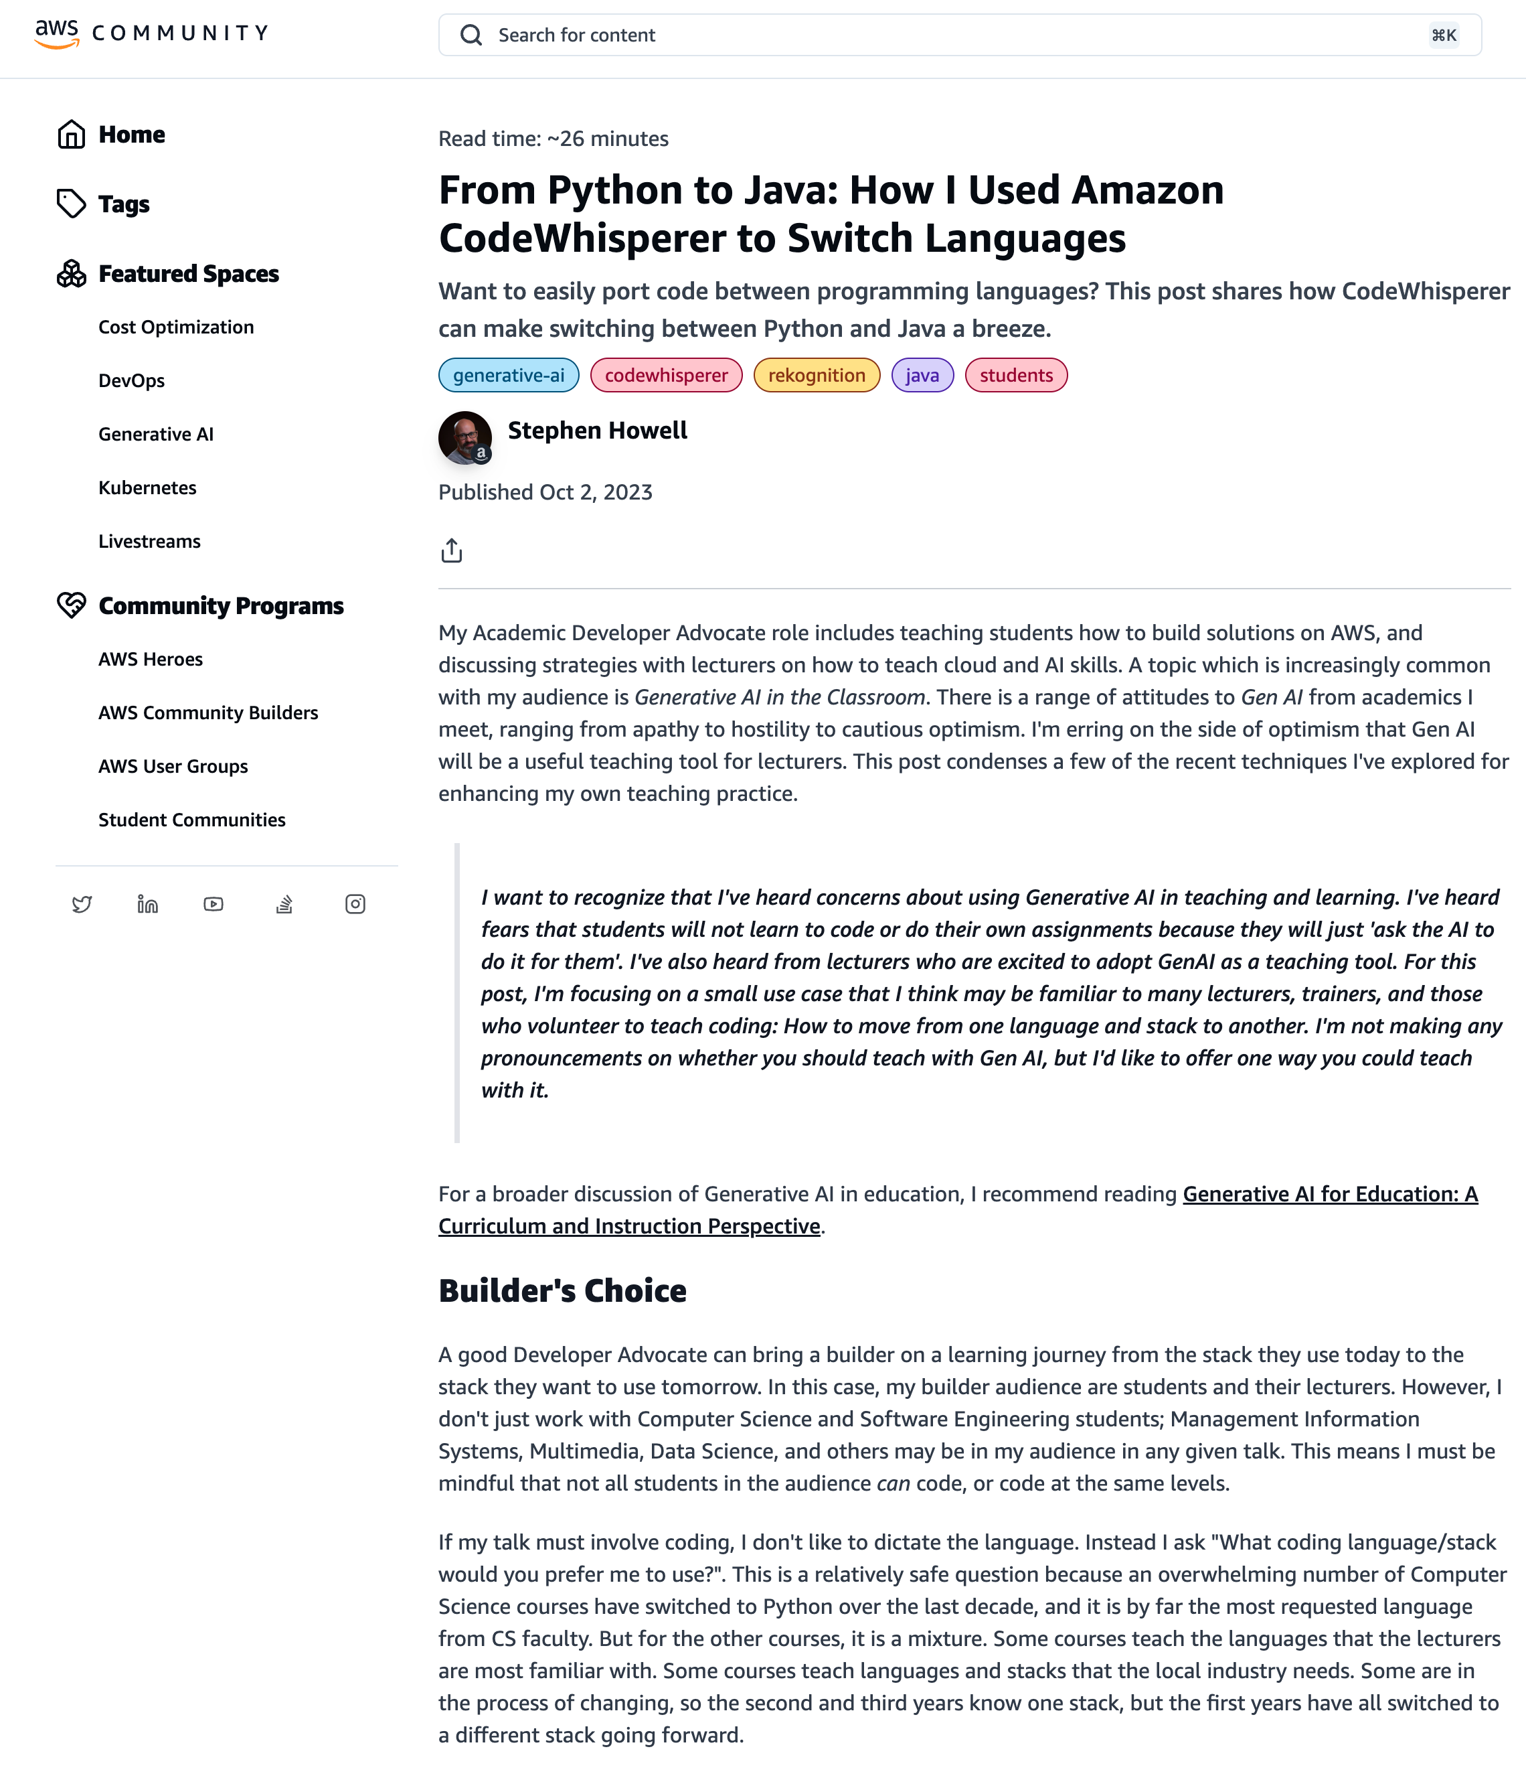

Want to easily port code between programming languages?
Notes:
You can use these tools to help you refactor your code, for example migrating from older versions of a language to a newer version, or from one language to another.
This blog posts from a colleague looks at how they used generative AI to help migrate from Python to Java.

Slide 26
Developer Journeys

Slide 27




Migrate and modernise things
Build new things
Fix things
Maintain things
Notes:
We will show you a few demos that show how these generative AI developer tools can help you with the tasks you have to do when you are working on.
<audience interaction> how many folks are doing new apps? What about maintenance? Migration or upgrades? Ok, what is missing from this list, I want to know more.
<choose the right one for your event, or cherry pick if you want to show a selection of things Q can help developers with>
<demo slides will be hidden, un-hide them as needed>

Slide 28
Building new applications using generative AI

Slide 29
Analysis
Requirements gathering
Help orientate me to the problem space
Narrow down what I need to think about
Build new things
Notes:
Ok so during the analysis phase of my application, as a developer I might be thinking about
Requirements gathering - Help determine functional and non functional requirements for my application
Understanding the problem space - Help orientate me to the problem space – I may not be familiar with a specific use case or technology area, these tools can help bridge your knowledge gap here
Narrow down what I need to think about
Developers can use generative AI tools to help them prepare for the analysis phase of development projects.
Some examples of this include:
When we pick up a new development task, we first have to find the information we need. Generartive AI can help us here, both generally and specifically.We can leverage generative AI tools together with approaches such as RAG (Retrieval Augmented Generation) to inject our companies tech docs, and help us find the information we need. This can be a real time saver.
Developers can use GenAI tools to better prepare for planning meetings, to ask the right questions. For example, they can use GenAI to understand functional and non functional requirements that they need to think about, or use these tools to explore different approaches and provide some initial ideas for the design stage – pros/cons
Example/

Slide 30
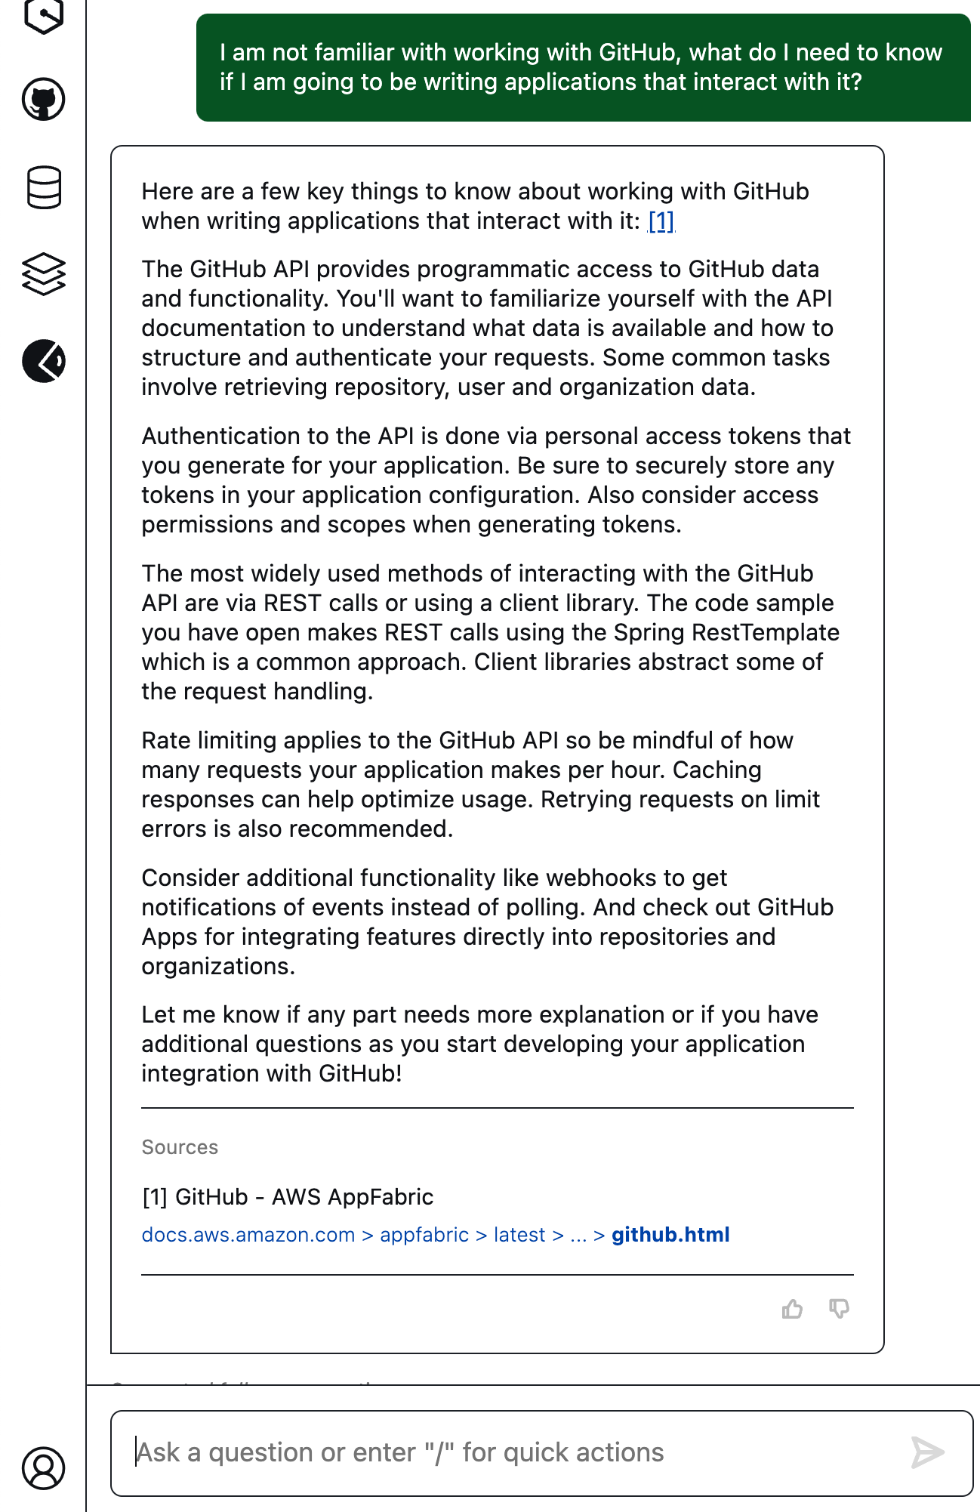
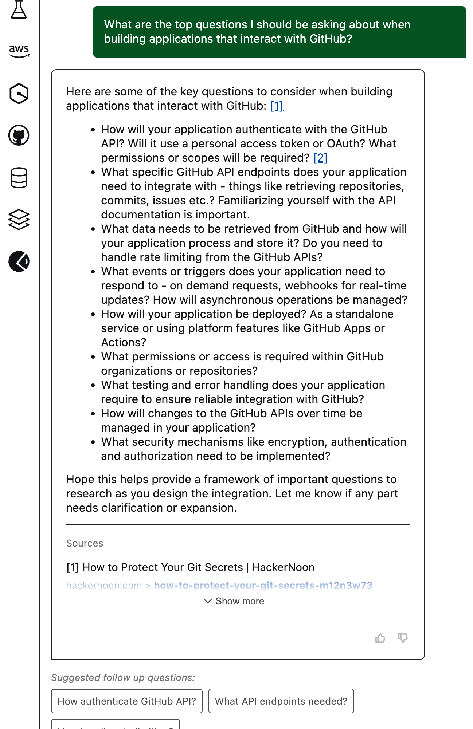
1
2
I am not familiar with working with GitHub, what do I need to know if I am going to be writing an application that interacts with it?
What are the top questions I should be asking when building applications that interact with GitHub
Notes:
As I have never written an application that interacts with this system, I can use Amazon Q Developer to provide me with some additional context and information – narrow down what I need to know. (1) and then also ask what are the most important questions that I need to be thinking about (2).
This is a great starter for 10, and has already saved me a lot of time.

Slide 31
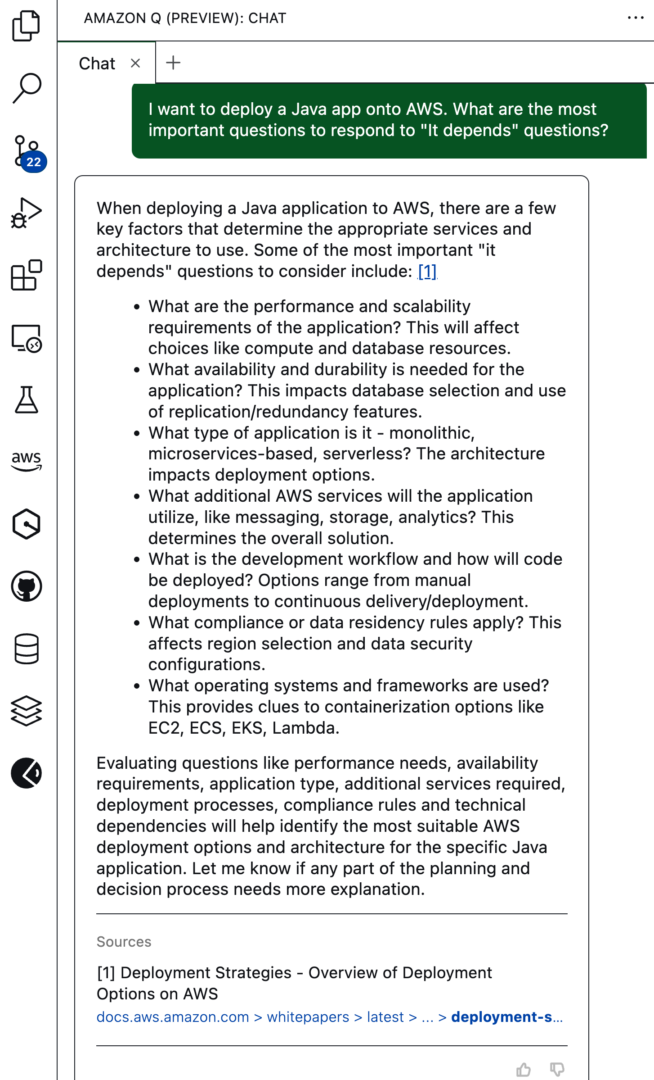
I want to deploy a Java app onto AWS. What are the most important questions to respond to "It depends" questions?
Notes:
I can use generative AI tools like Amazon Q Developer to help me prepare and anticipate requirements – how many times do you use IT DEPENDS? Well, now you can prepare and ask your customers the right questions. This is going to help you during your design phase.

Slide 32
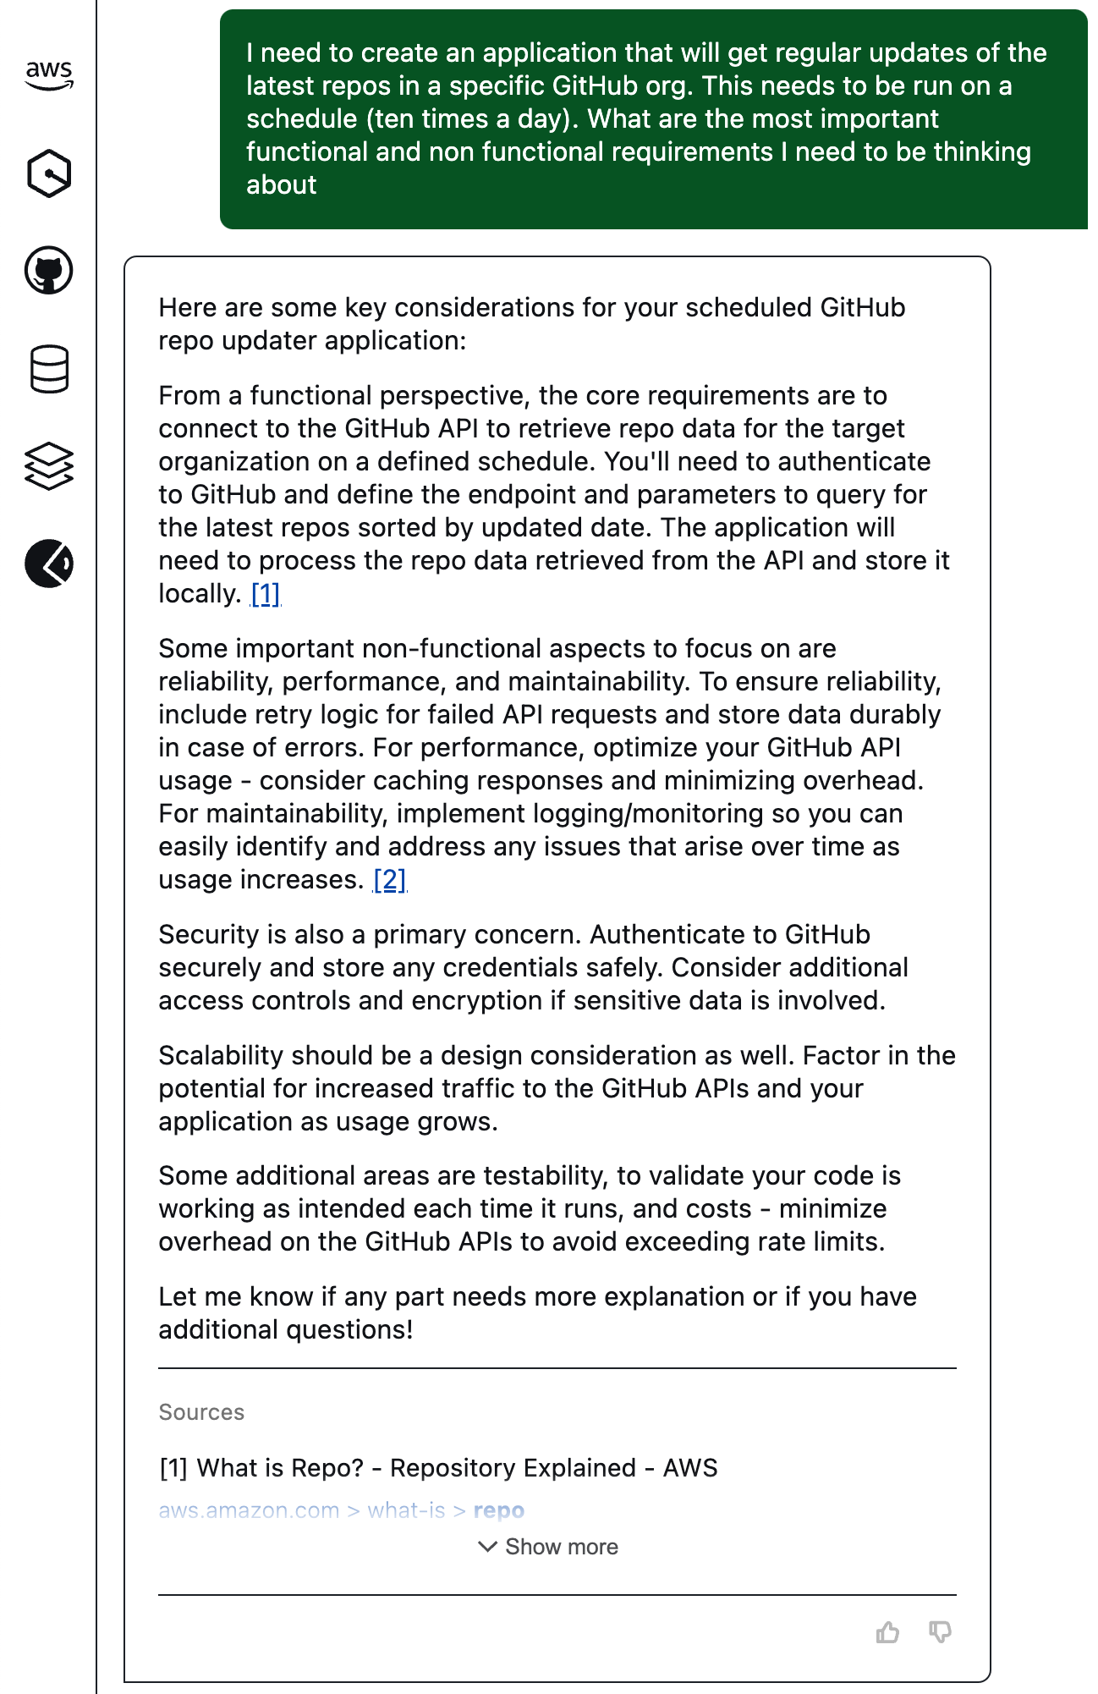
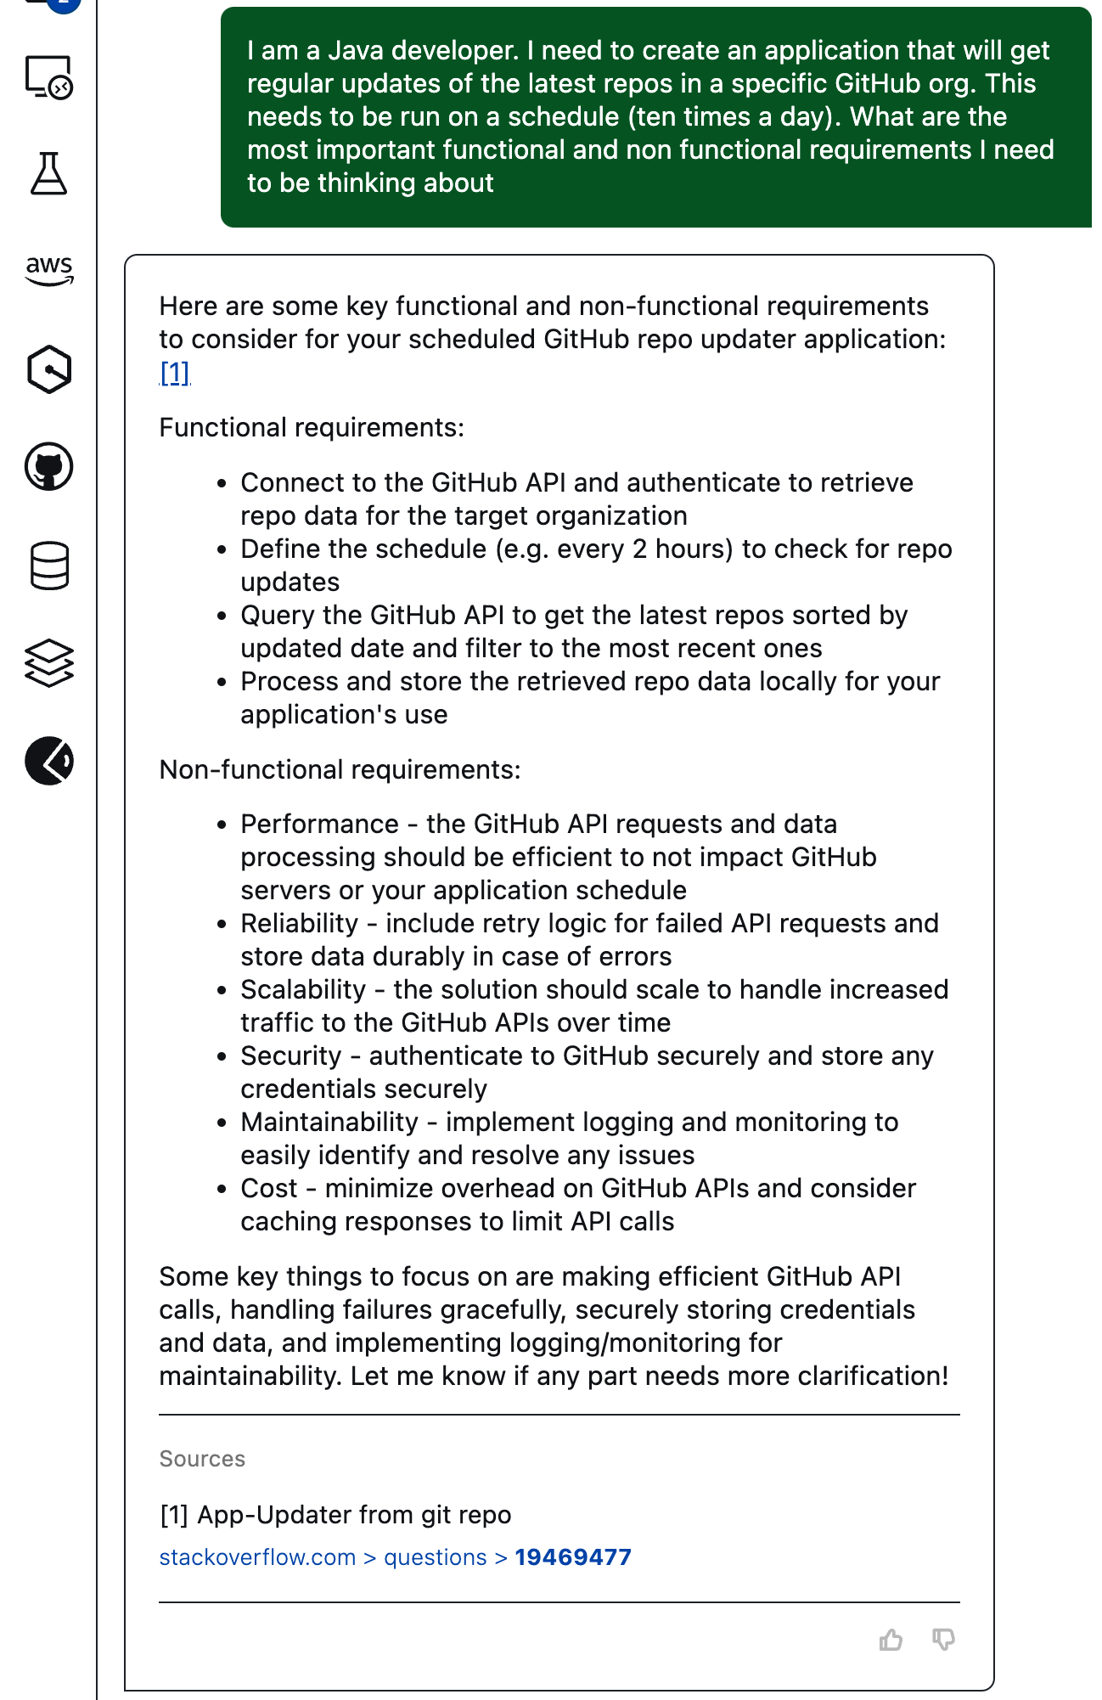
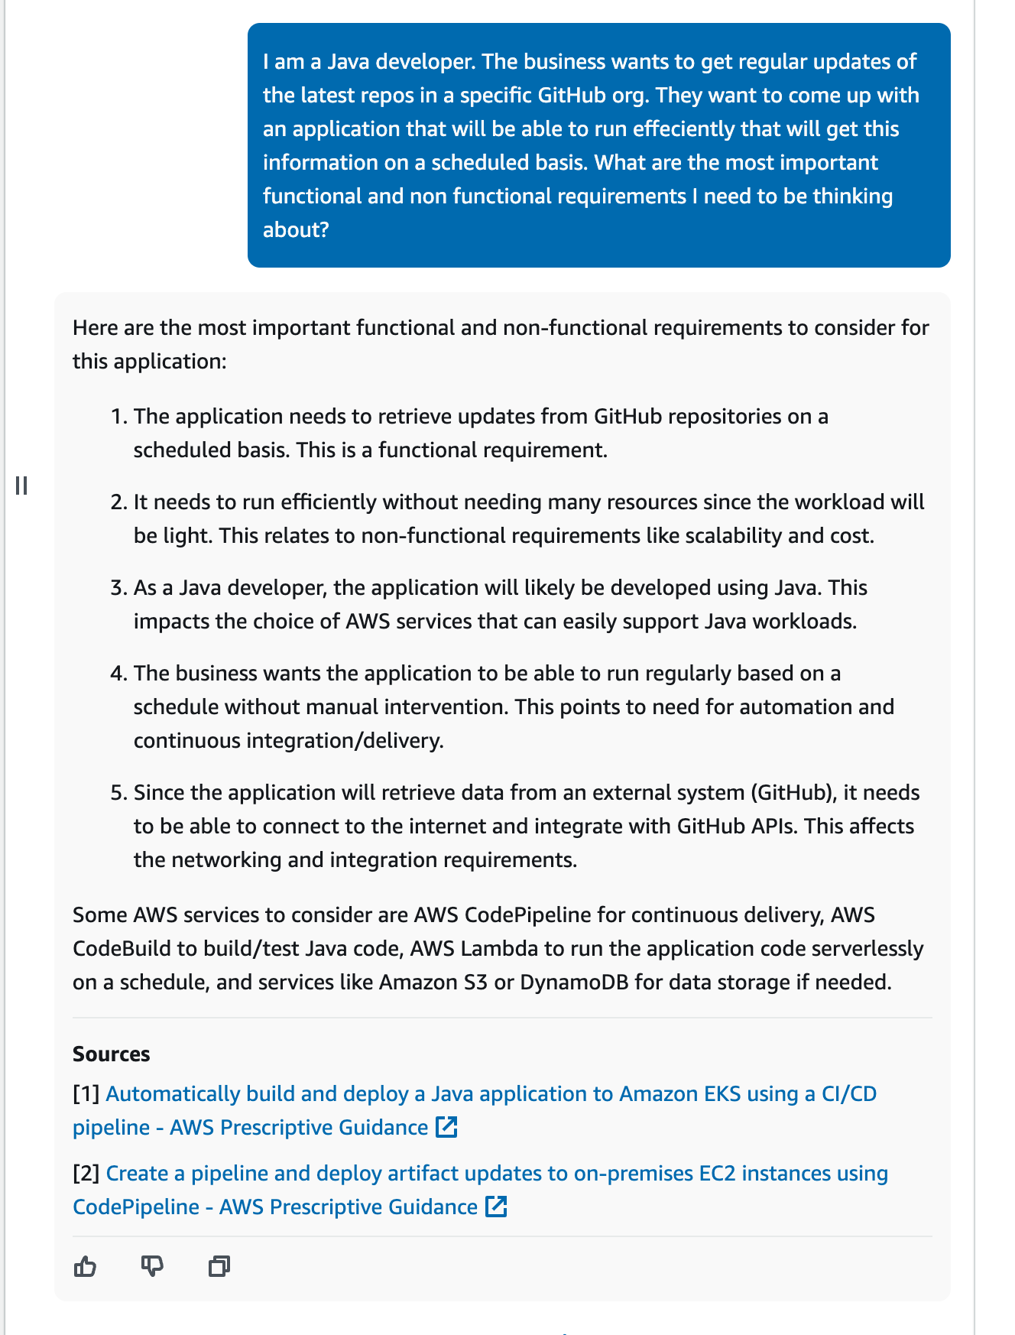
1
2
3
I am a Java developer. I need to create an application that will get regular updates of the latest repos in a specific GitHub org. This needs to run on a schedule (ten times a day). What are the most important functional and non functional requirements I need to be thinking about?
I need to create an application that will get regular updates from all repos of a specific GitHub Org. this needs to be run on a schedule (ten times a day). What are the most important functional and non functional requirements I need to be thinking about?
Notes:
I can ask Amazon Q Developer to help me with what I need to be thinking about based on some high level requirements of what my customer wants me to do. (1)
It is often helpful to rephrase and try and few alternatives (2) – do not always settle for the first response you get.
I can also switch to the Amazon Q Developer in the console, which is trained on more AWS opinionated content and may provide alternative responses (3)

Slide 33
Design
Narrow down technical choices
Define architecture frameworks and tools
Sizing and deployment options
Build new things
Notes:
During the design phase, you need to start thinking more concretely about what you are going to the architecture and how the solution is going to look.
Lets see how we can use generative AI to help narrow down our choices based on what we have already learned, and then start to look at tools, frameworks, and then deployment architecture and choices.
Example/

Slide 34
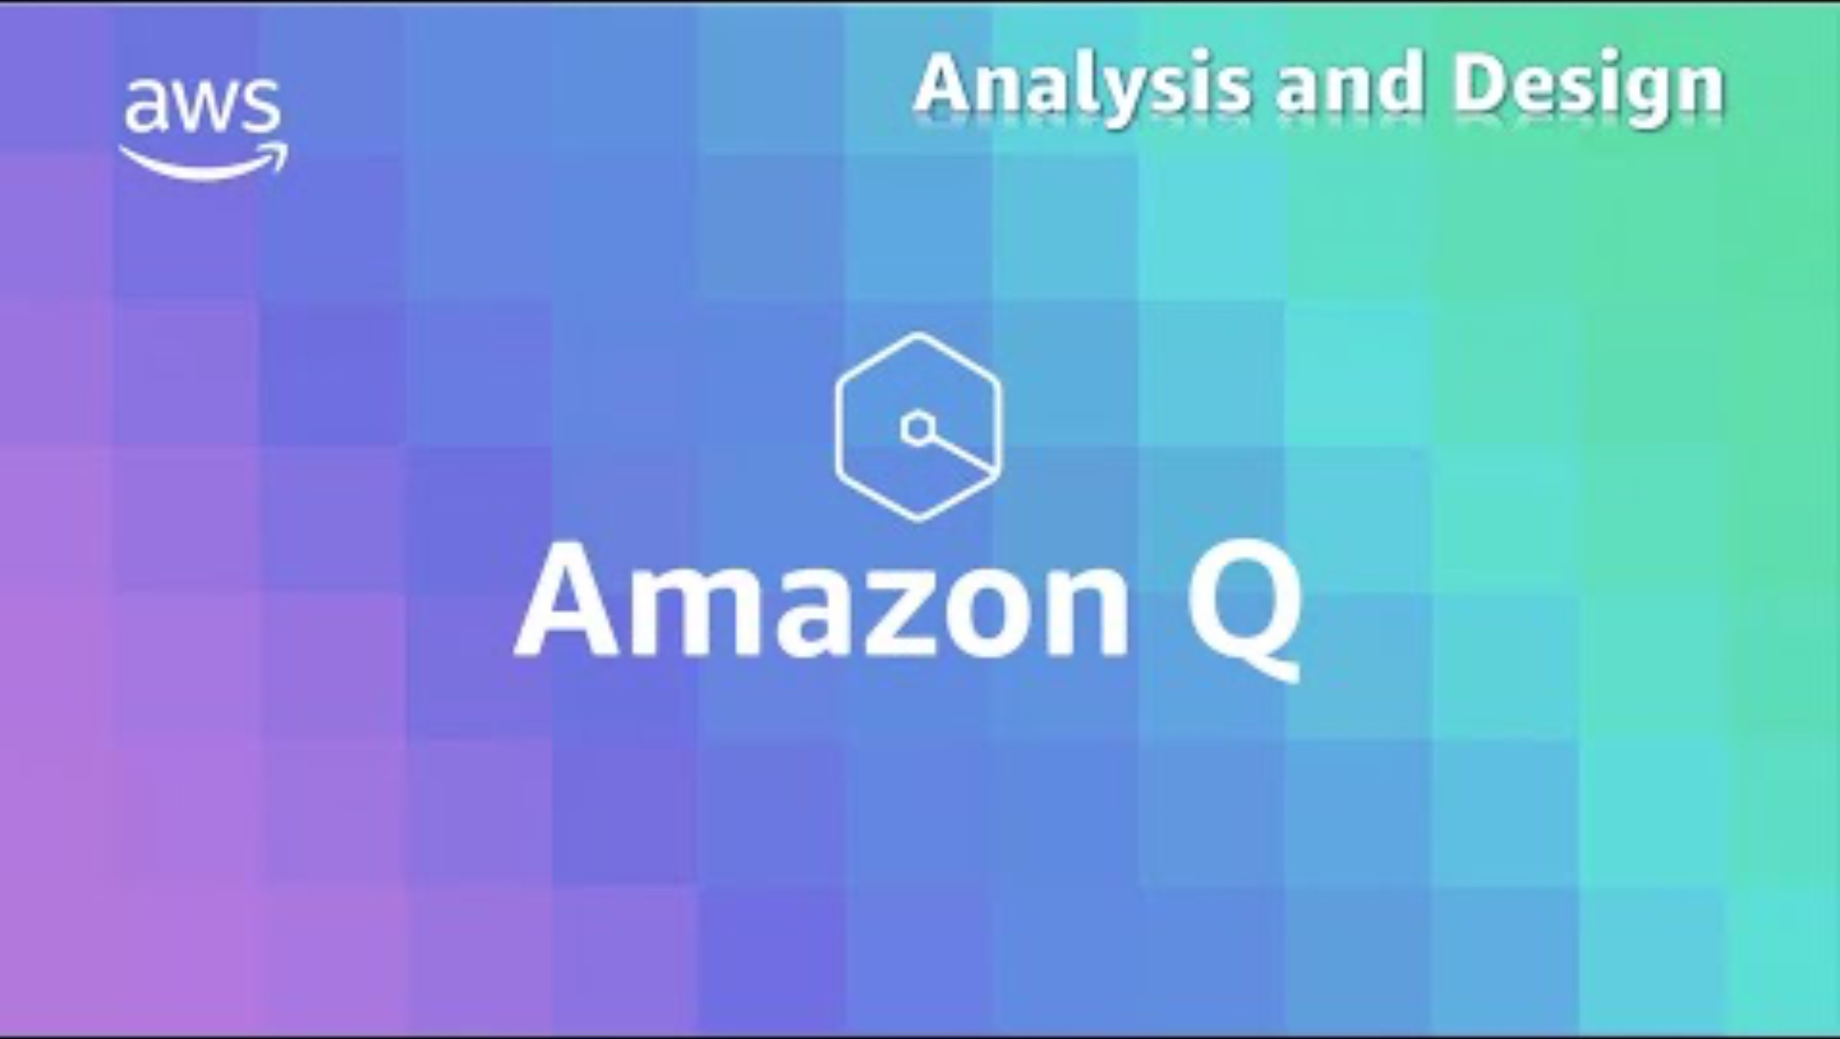
Notes:
[[VIDEO]] 7 min demo
This video shows the ANALYSIS and DESIGN phases in VSCode. You can play this video and walk through the different prompts. You can also do this live, and get additional input from the audience
YT link - https://youtu.be/o9WRrZr8NHo

Slide 35
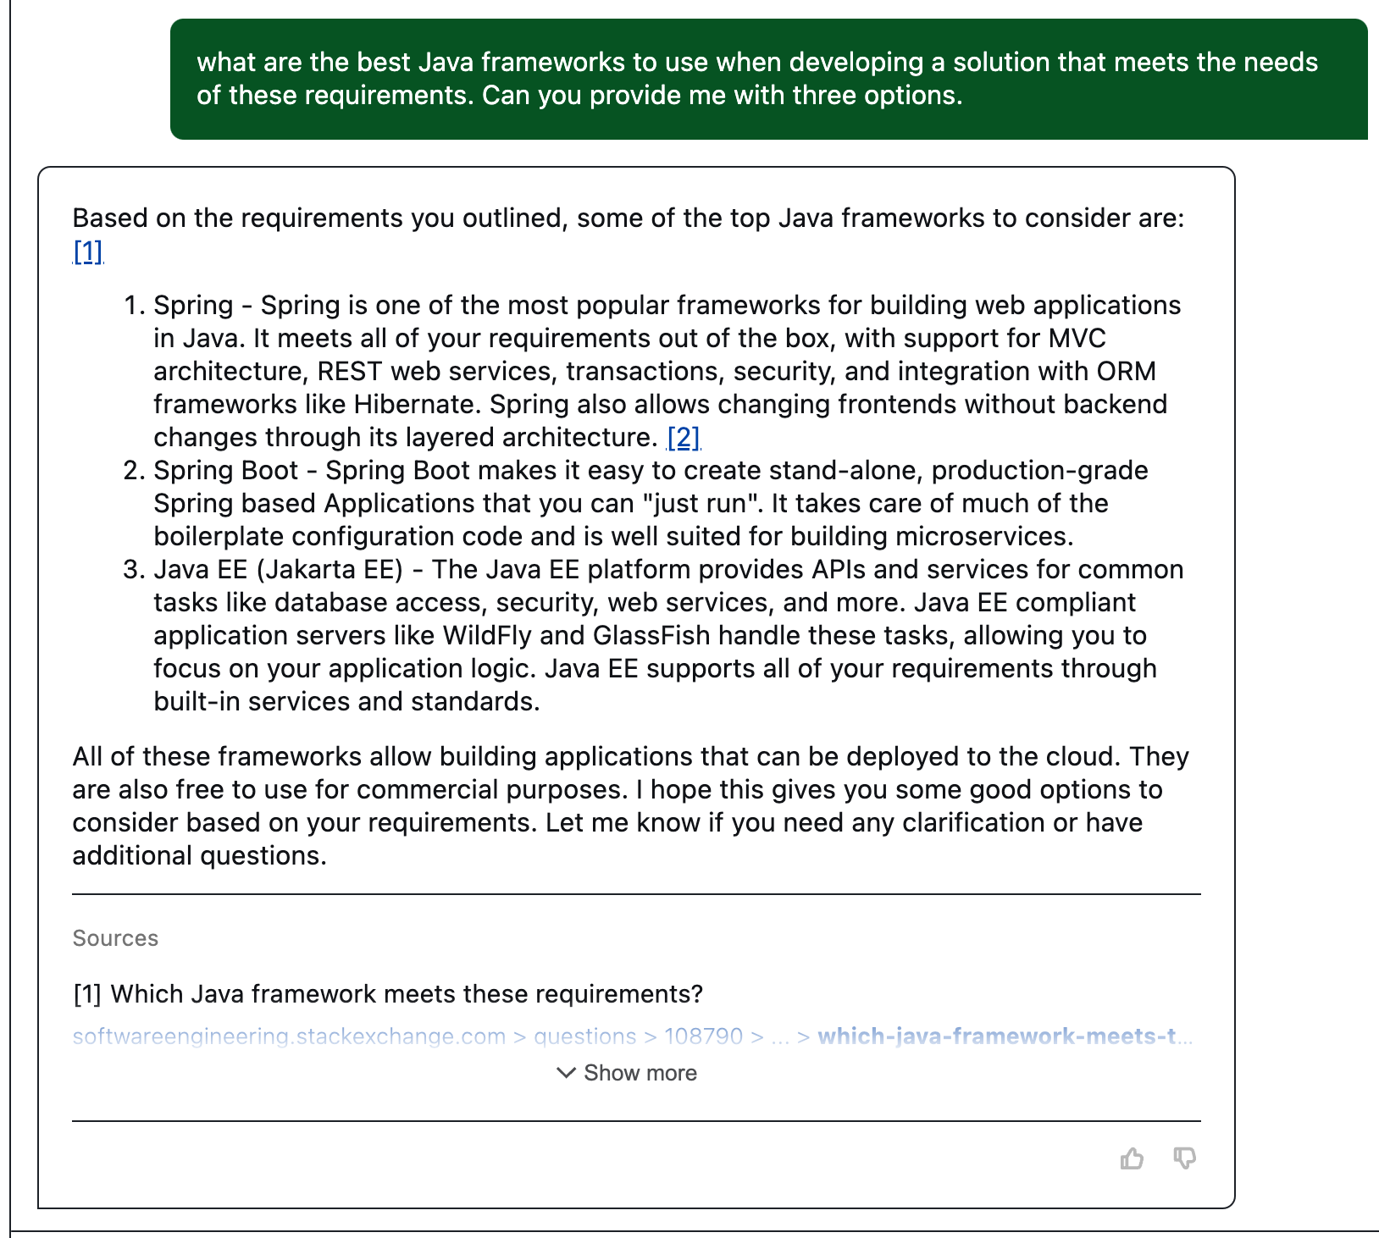
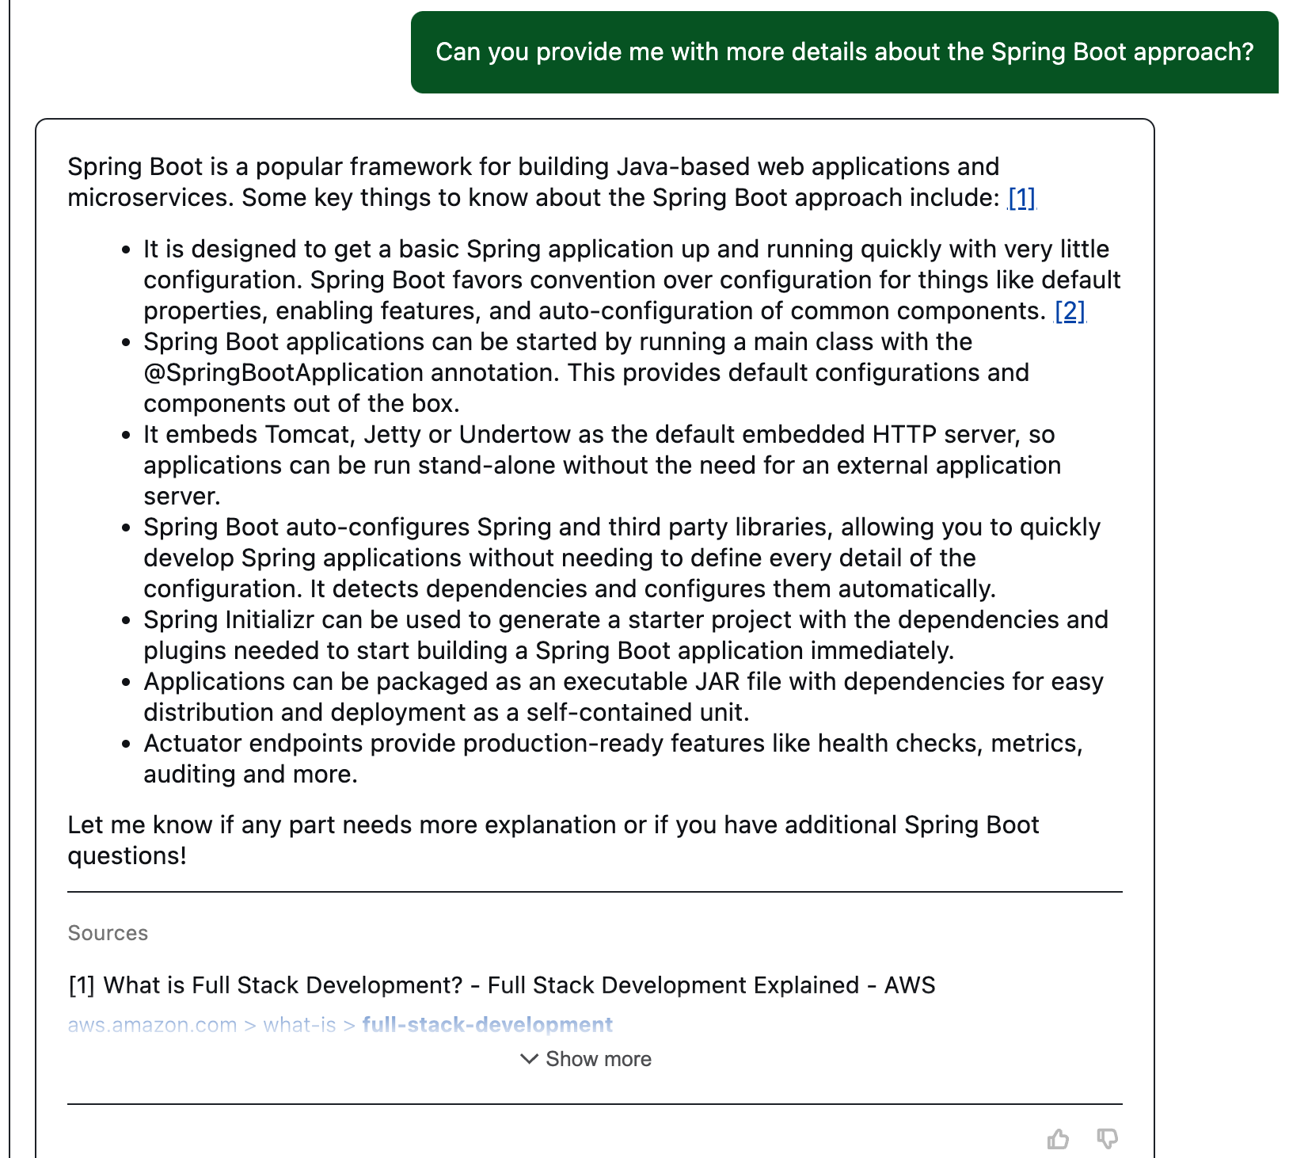
1
2
Can you provide me with more details about the Spring Boot approach
What are the best Java frameworks to use when developing a solution that meets the needs of these requirements. Can you provide me with three options.
Notes:
I want to narrow down the technical choices.
Amazon Q Developer still has understanding (context) of what we are talking about, so I am able to ask it more questions about what I need. (1)
I like the look of Spring Boot as I have heard about this one before, so I ask it some additional details about this framework (2)

Slide 36
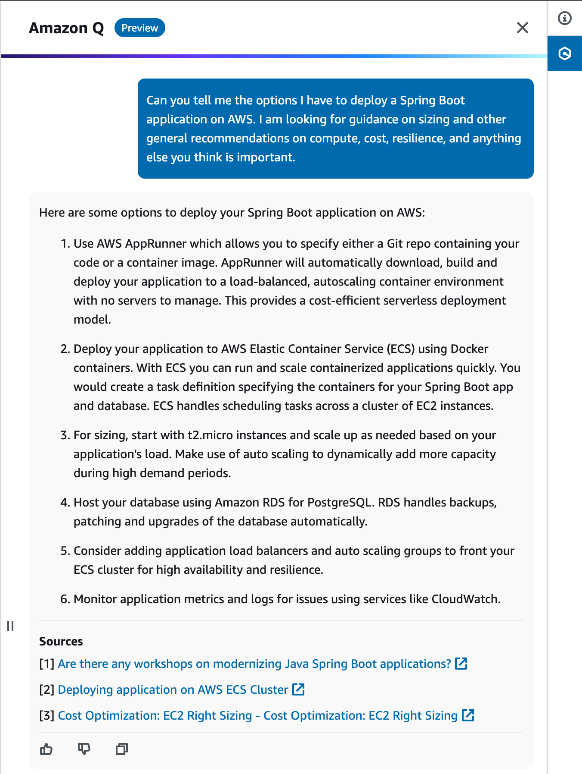
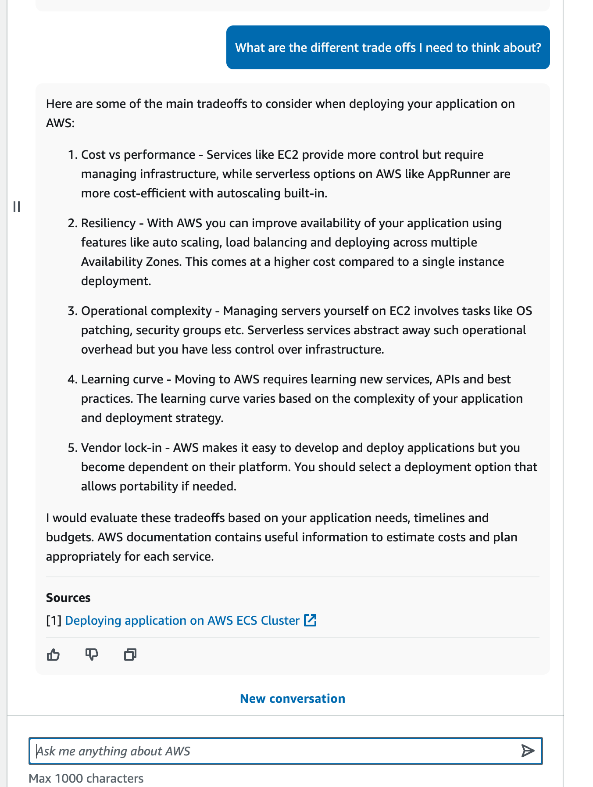
1
2
What are the different trade offs I need to think about?
Can you tell me the options I have to deploy a Spring Boot application on AWS. I am looking for guidance on sizing and other general recommendations on compute, cost, resilience, and anything else you think is important
Notes:
I can switch to my AWS Expert, Amazon Q Developer in the console, and now begin to ask some additional questions around the best ways of deploy and sizing Spring Boot applications on AWS.

Slide 37
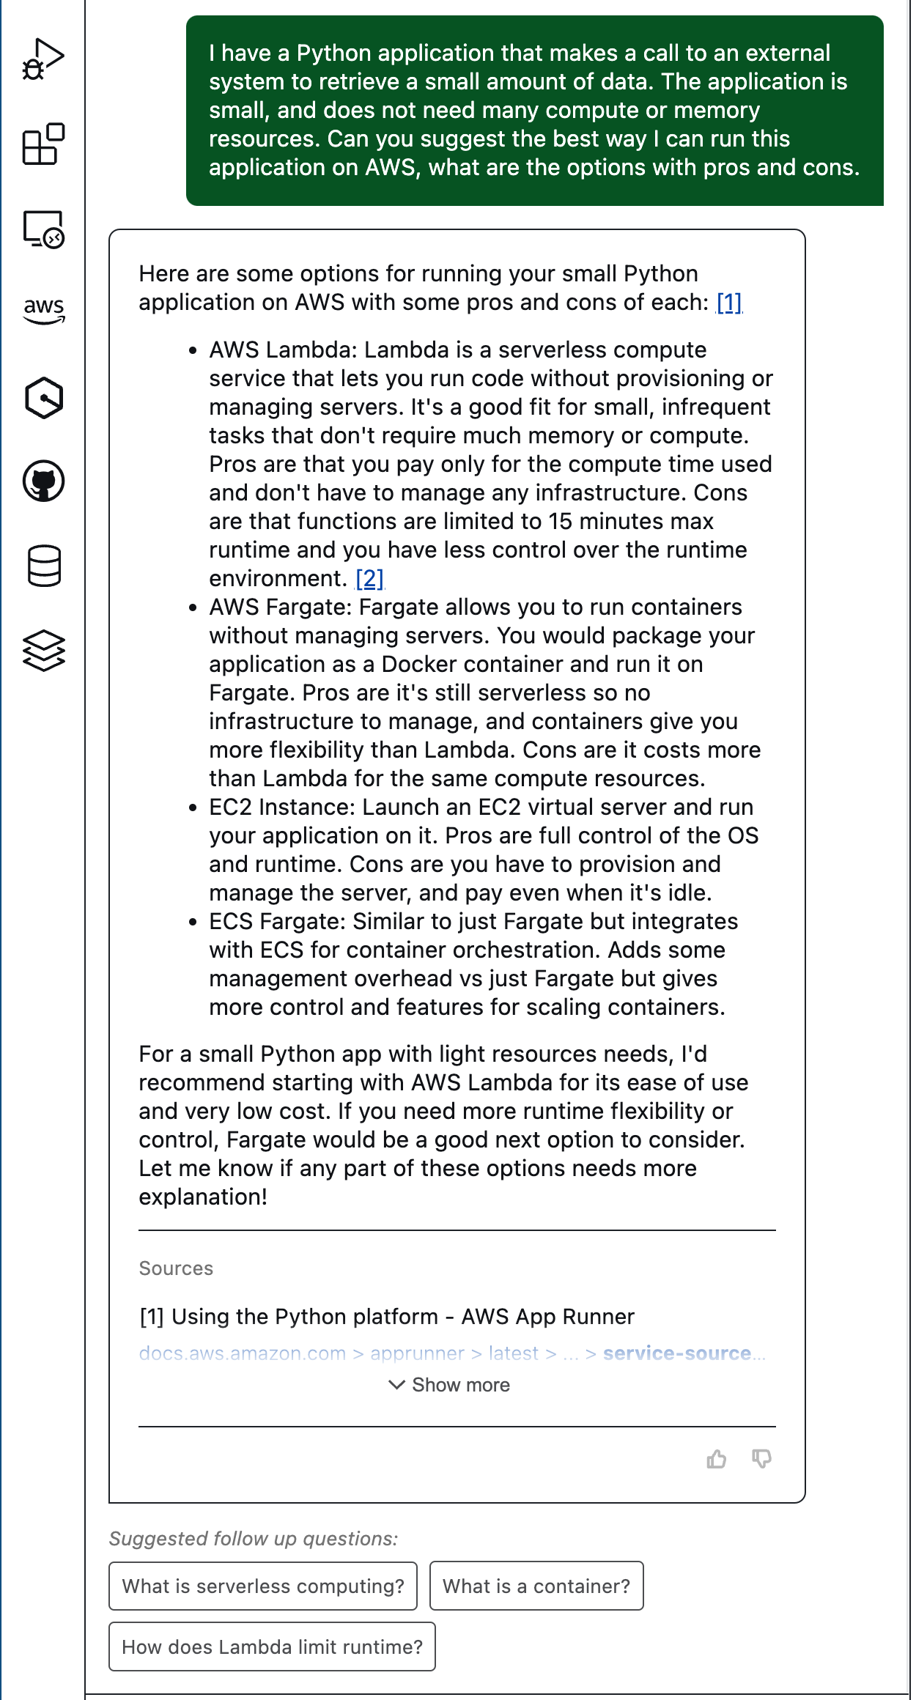
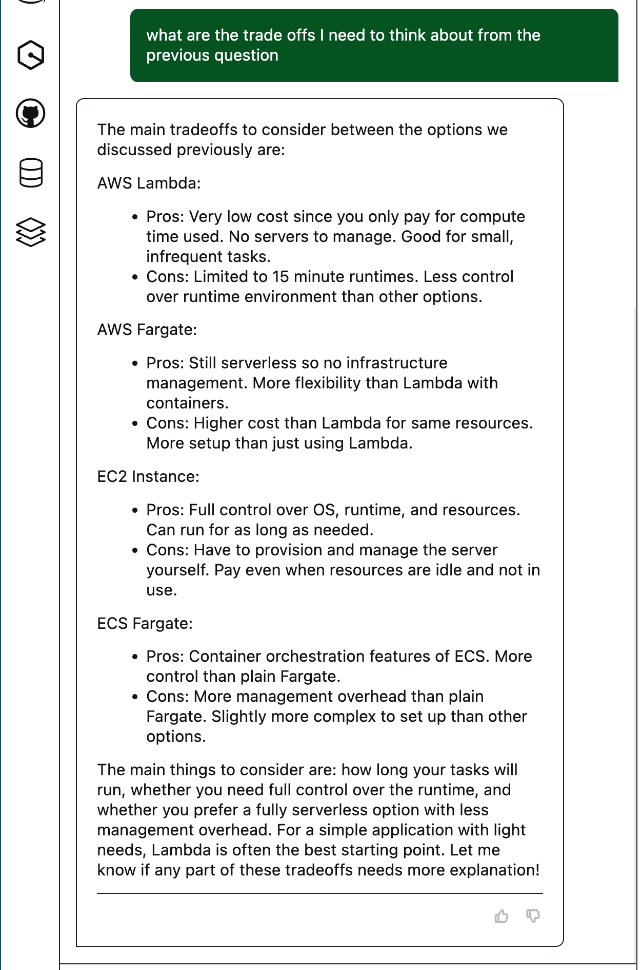
1
3
2
Notes:
I can now try and ask it for some recommendations around how to deploy this onto AWS, so I can begin to work towards how I am going develop my application.

Slide 38
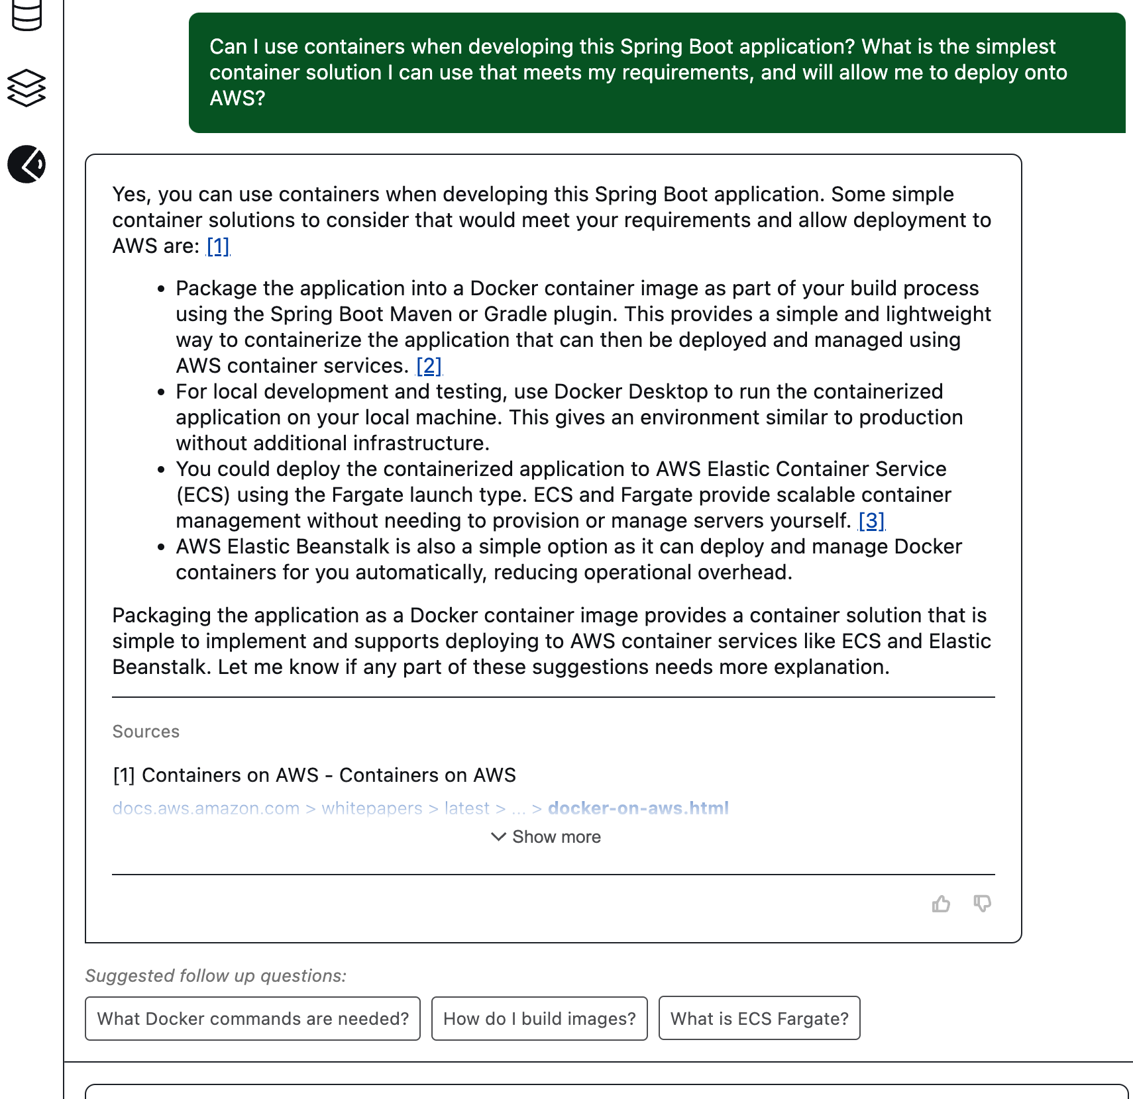
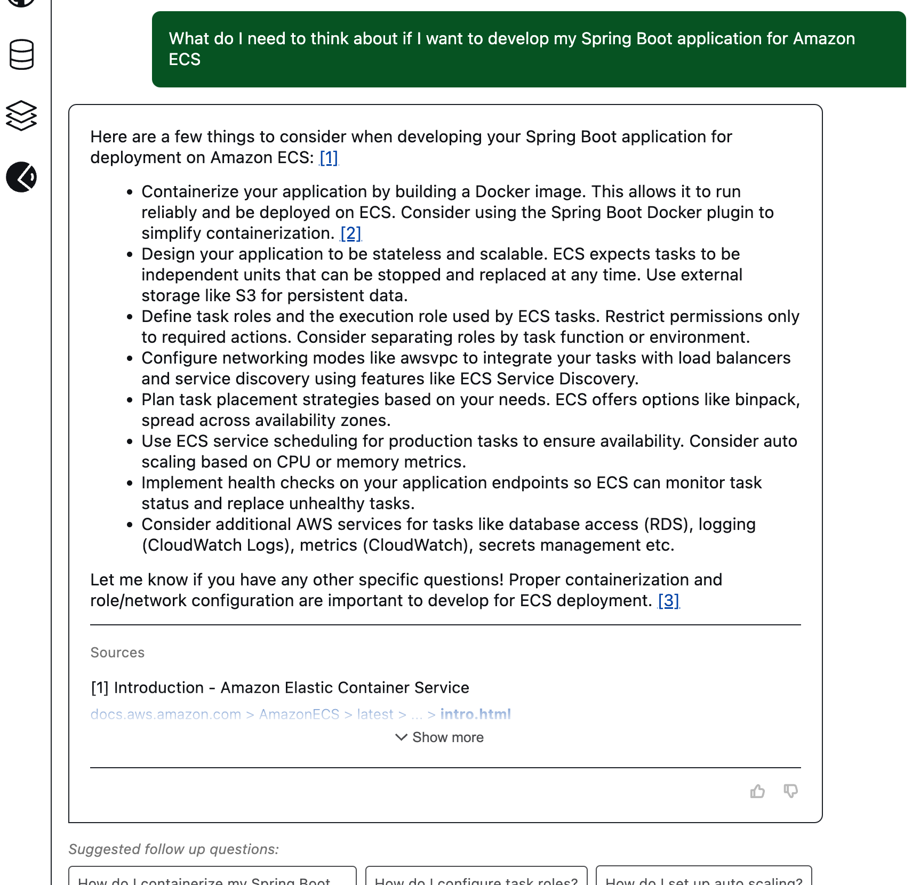
1
2
Can I use containers when developing this Spring Boot application? What is the simplest container solution I can use that meets my requirements, and will allow me to deploy to AWS
What do I need to think about if I want to develop my Spring Boot application for Amazon ECS
Notes:
Having looked at the previous responses, I want to get more info about containers.
I begin by asking whether I can use containers for this solution based on my requirements (1) As you can see, I also provide some additional context as I want to deploy this on AWS.
I then ask to dive deeper into the one option that looks most interesting to me, Amazon ECS and Q Developer is able to provide some additional information to help me (2)
I think I am good to go now, lets get some coding done at last.

Slide 39
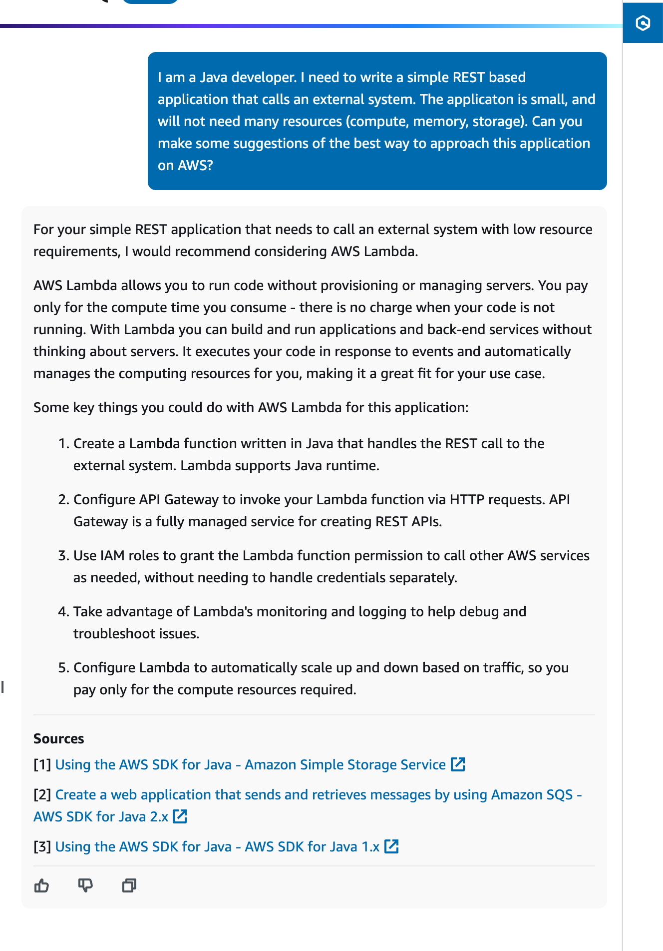
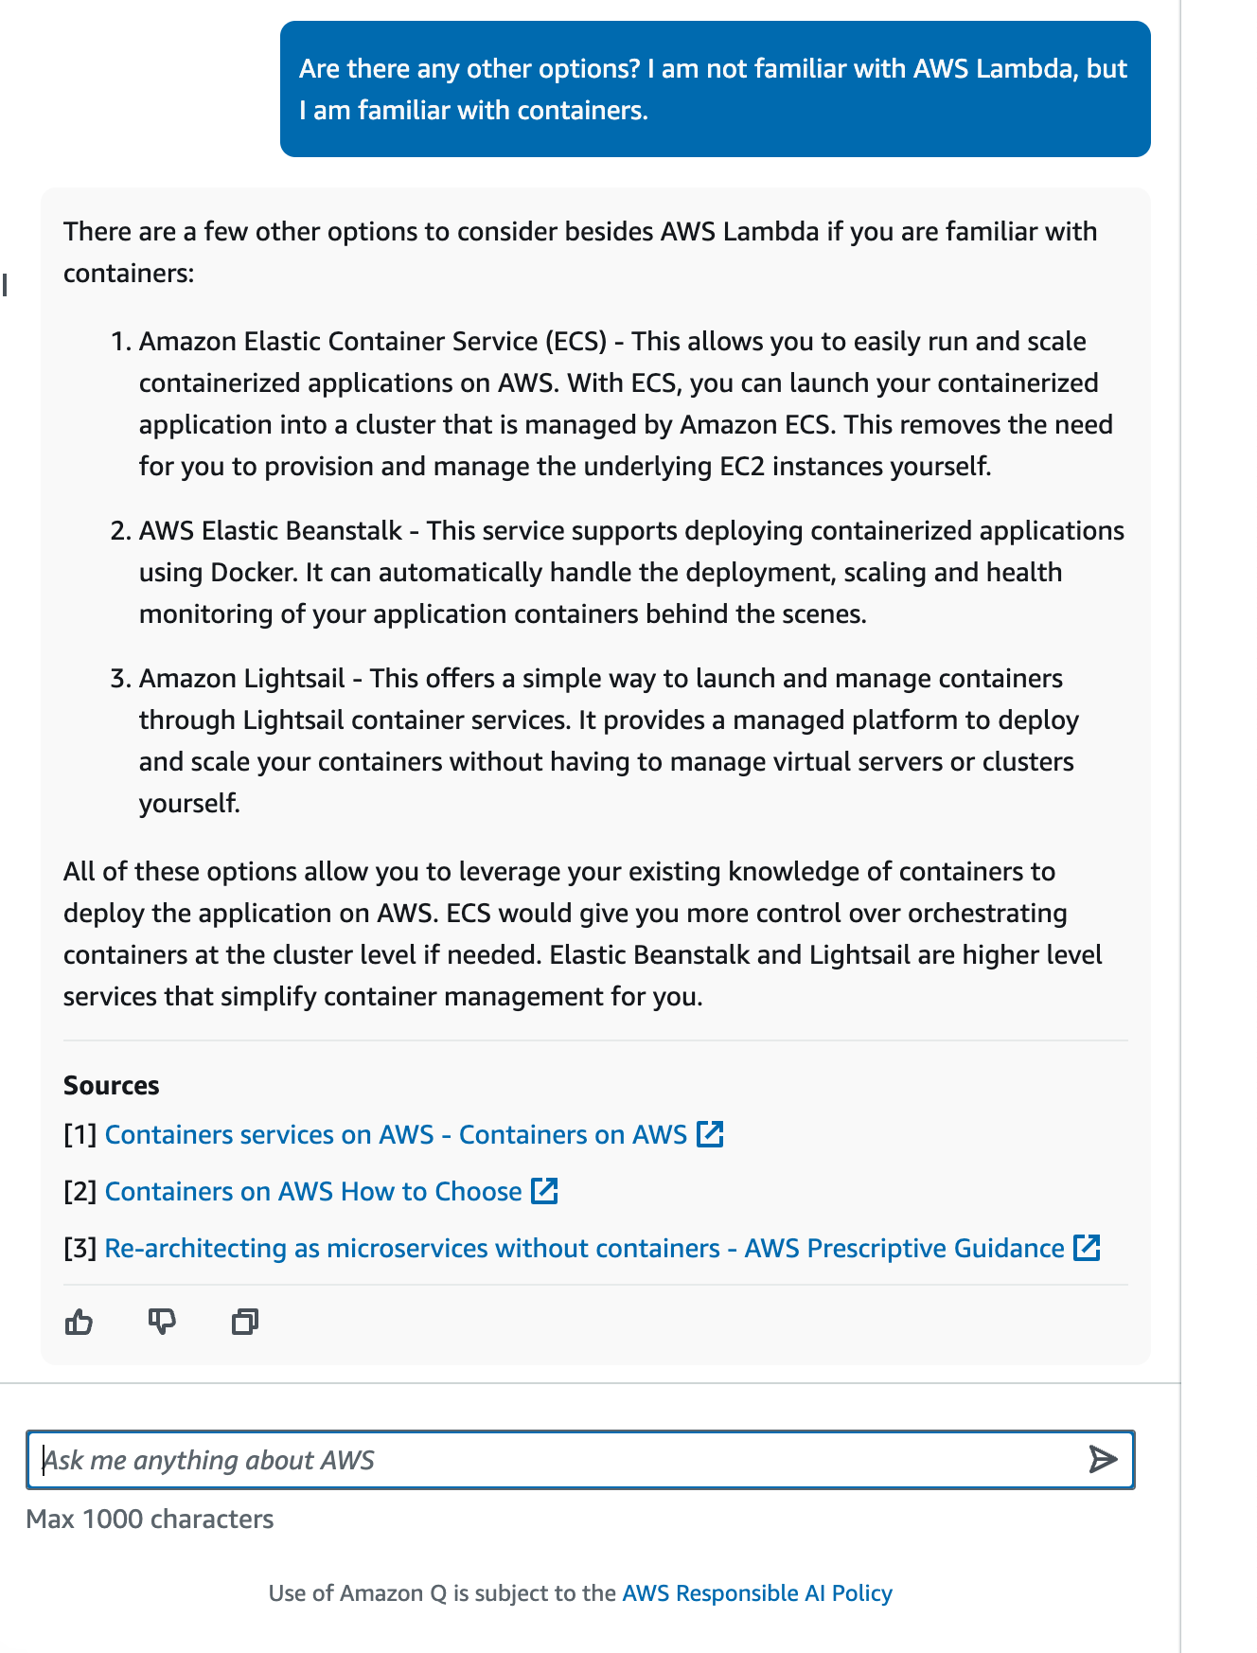
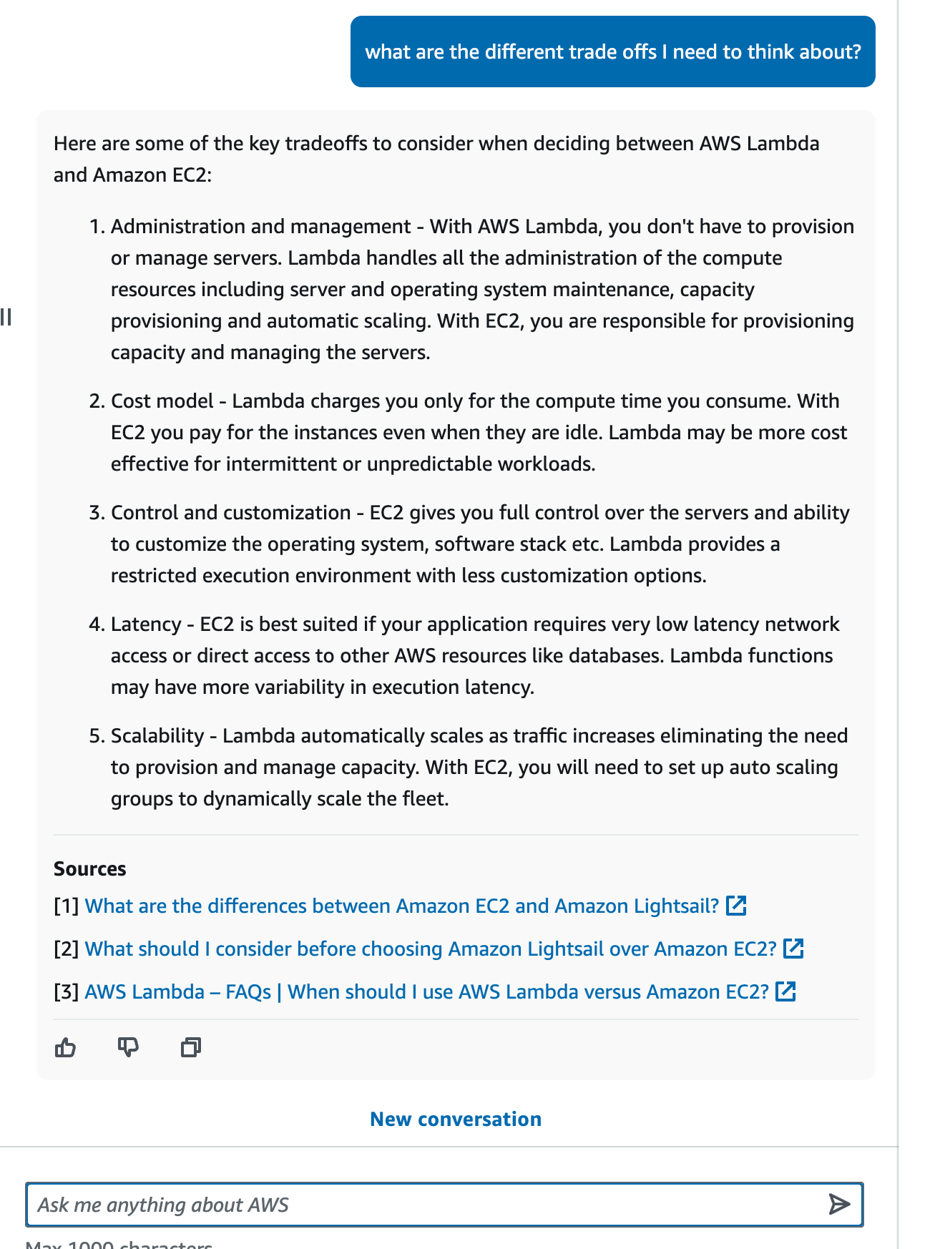
2
3
1
Notes:
In the previous examples, I used Amazon Q in the console. I can use generative AI tools like Amazon Q in the console, my personal AWS Expert, and start to ask some questions.
What does it recommend I use for the kind of application I am building
What other options does it recommend
Whare are the trade offs I need to think about.
<alternative slide to the previous two>

Slide 40
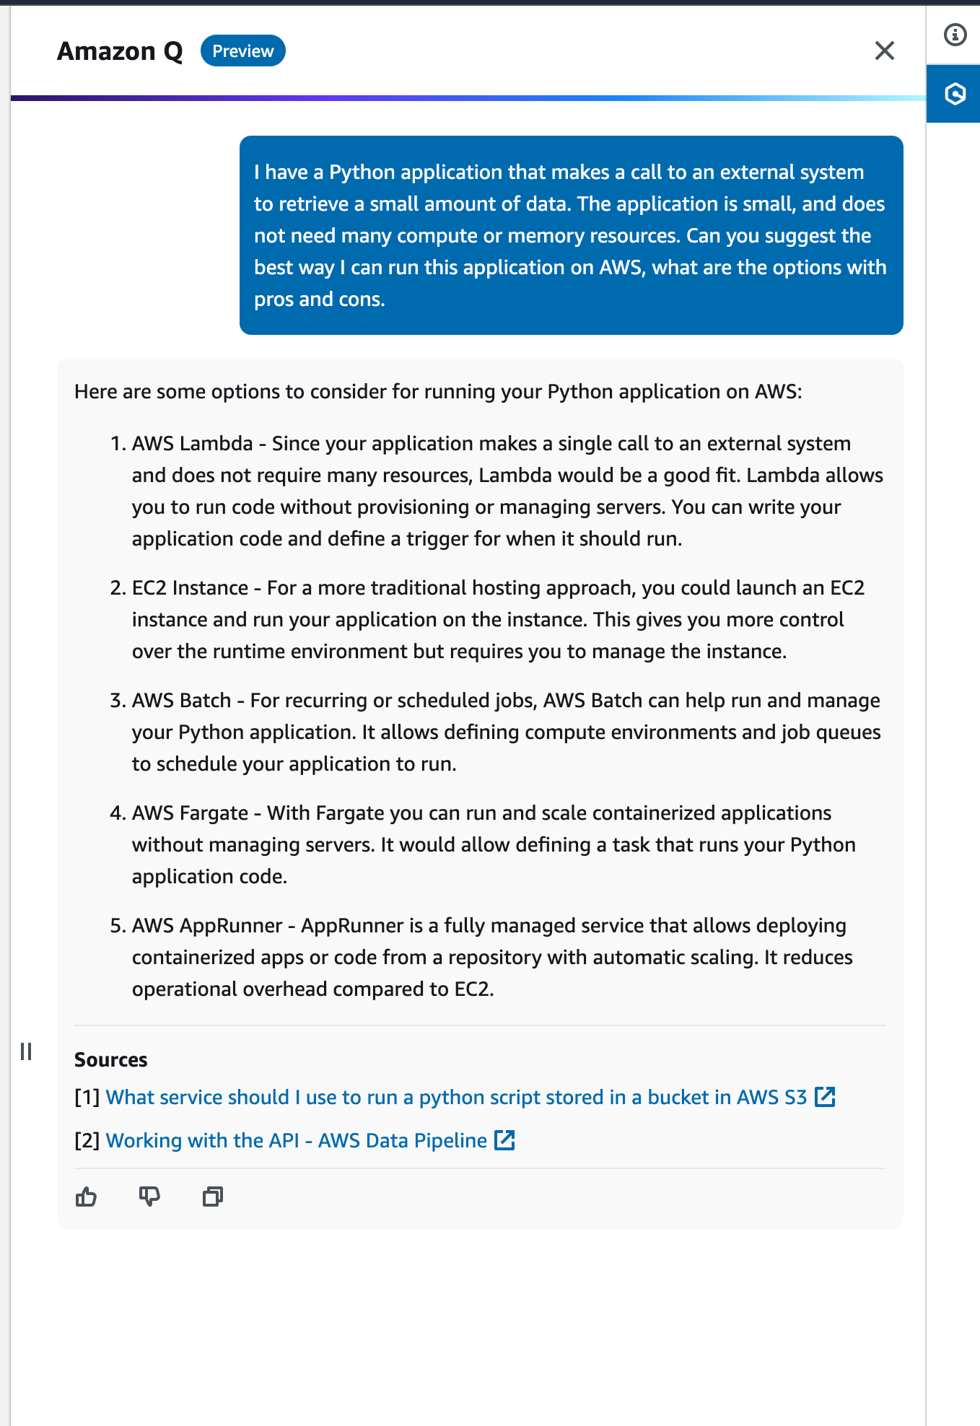
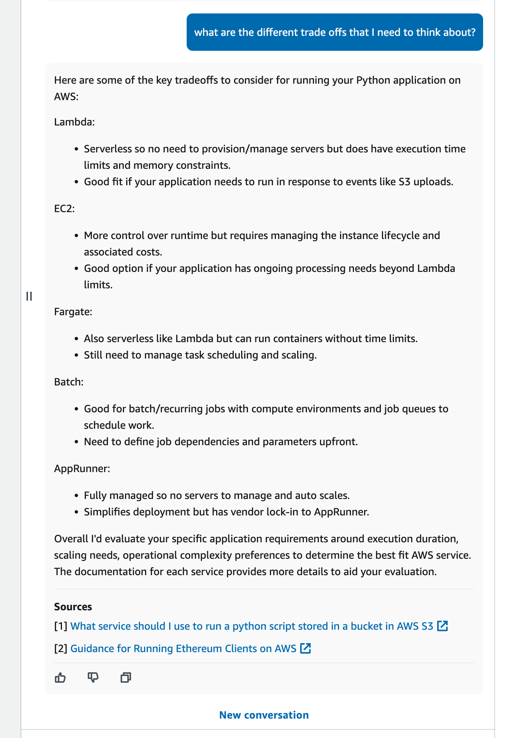
3
1
2
Notes:
The next stage in the software lifecycle is how we can use these tools to inform our design choices.
We might want to understand for example, what my options to deploy a specific workload on AWS is (1) and (2). And then we might want to further clarify the information we get.
Generative AI can help us better navigate “It depends” kinds of questions.

Slide 41
Develop
The ultimate reference guide and cheat sheet
Finding and fixing bugs
Shifting left with generative AI
Build new things
Notes:
Now we can move to the coding part.
As I move to the development phase, I can now begin to use these tools to start to write the code.
As I am a bit rusty with Java, and not familiar with the latest Spring Boot, these tools are going to help me keep up to speed and provide all the syntax and formatting I need.
As I code there will be issues. I will be able to use these tools to easily get answers and suggestions on how to resolve those. After all, who writes perfect code – that is so yesterday!
Finally, the more stuff I can get done during development, the less it will impact further down the line. Security is a big part of that, so I want to make sure the code I create does not have any known vulnerabilities or issues, so lets see how I can address that.
Lets take a look at this.

Slide 42

Notes:
[[VIDEO]] 7mins
Link - https://youtu.be/_BL1z2rc4Hw
Overview – Part 1
In this video we start off by asking Amazon Q Developer to help build a simple Spring Boot app that returns the last 10 projects when accessing /projects.
We walk through creating the code from the recommendation from Amazon Q Developer, and then ask us to provide more code when it doesn’t quite finish the task.
We then try and run the project, but it generates an error. We ask Amazon Q Developer how to fix the error, and we are provided with some additional code.

Slide 43
Notes:
[[VIDEO]] 8 mins
Link – https://youtu.be/OJ_Zm-9lY8k
Overview – Part 2
I spotted an error when debugging the app – it looks like I made a typo with the field name for full name – it should be full_name and not fullName. Lets see how Amazon Q Developer can help us with what we need to do and troubleshoot this issue.

Slide 44
Notes:
[[VIDEO]] 2 mins
Link – https://youtu.be/kXKu7SZJWkc
Overview – Part 3
Do you remember how to configure or set logging within your application – we can use Amazon Q Developer to help us answer this, without having to do an internet search.

Slide 45
Notes:
[[VIDEO]] 2 mins
Link – https://youtu.be/1mmADZD9XSI
Overview – Part 4
Time to add some documentation to our code – we are going to add some doc strings and see how Amazon Q Developer makes this super easy

Slide 46
Notes:
[[VIDEO]] 3.40 mins
Link – https://youtu.be/lCiqLJePVpU
Overview – Part 5
As developers we need to make sure that we keep our files in our source code repository. Lets see how Amazon Q Developer can help guide us as I am always forgetting the commands and steps.

Slide 47
Notes:
[[VIDEO]] 4.30 mins
Link – https://youtu.be/RaO8qH3DyZ0
Overview – Part 6
Lets now add a friendly home page to our project. Now that Amazon Q Developer has helped us do that, lets modify it to include a link to our /projects endpoint.

Slide 48
Notes:
[[VIDEO]] 3:20 mins
Link – https://youtu.be/Aledq0NUg88
Overview – Part 7
Now lets create a README for this project that will help other developers contribute to this project by helping them understand how it works and how to run it. We are going to use a feature of Amazon Q Developer called Feature Dev, which allows Amazon Q to not just suggest what you can do, but actually generate a plan and then write the code for you too.

Slide 49
Notes:
[[VIDEO]] 18 mins
Link - https://youtu.be/0vlTcDrUHIM
Overview – Part 8
Add a new feature that will take the output of this and upload it to an S3 bucket. We will use Amazon Q Developer Feature Dev and we will also use Amazon Q command line to help us with some command line work.

Slide 50
Notes:
[[VIDEO]] 4m 34 sec
Link - https://youtu.be/GQQ98NAant0
Overview – Part 9
I want to open source this project. I am new to open source, so first I will as Amazon Q Developer some questions, and then ask Amazon Q Developer to add a license file and modify source files as needed.

Slide 51
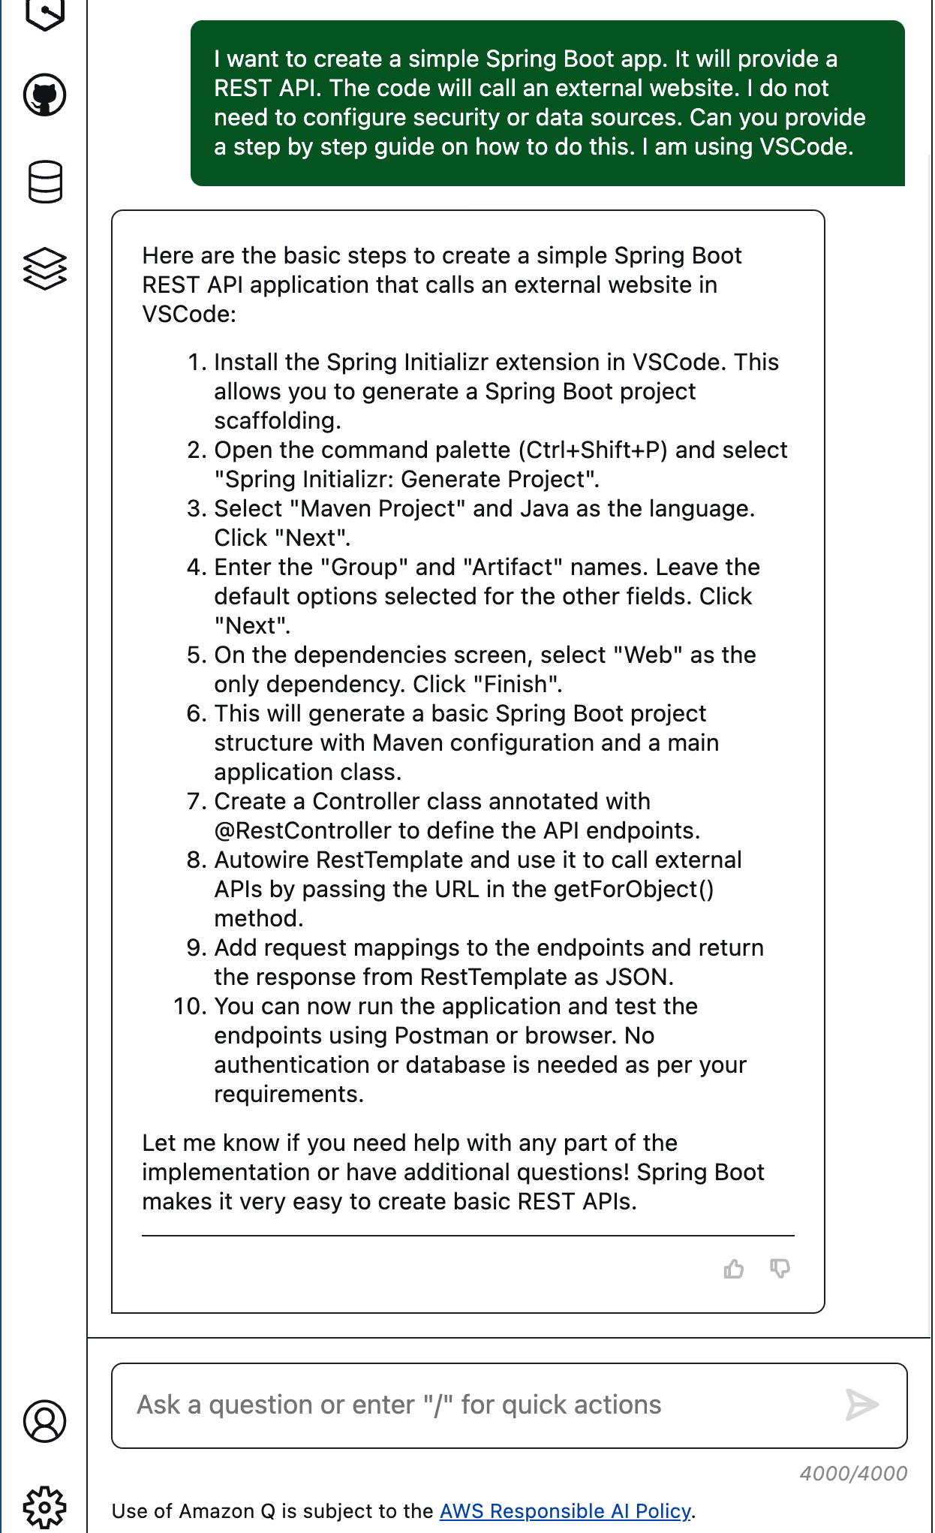
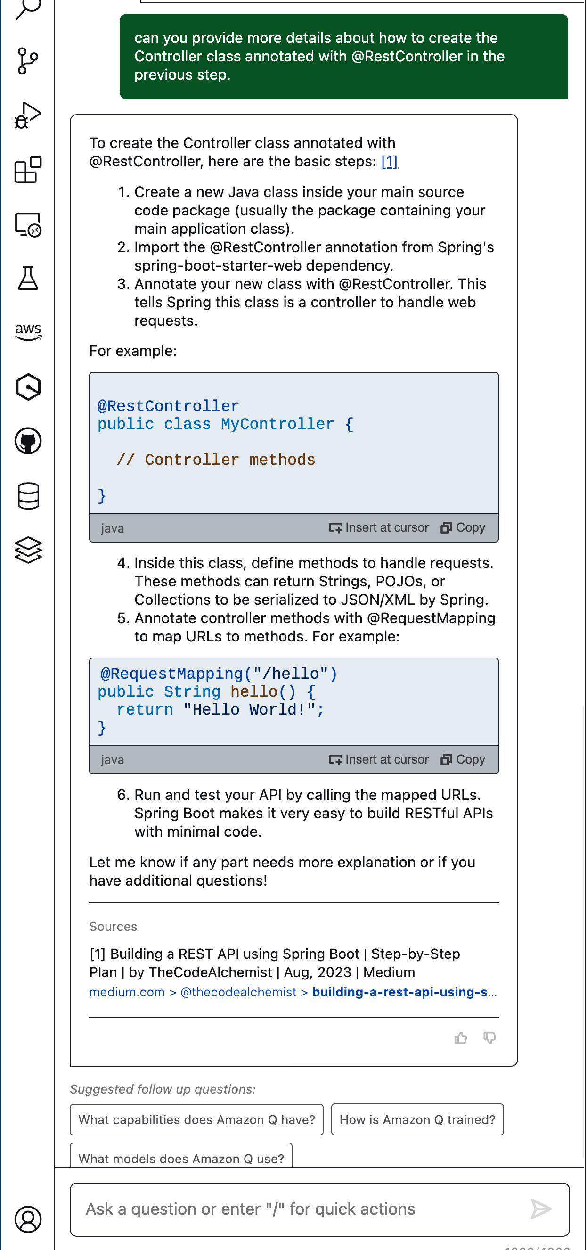
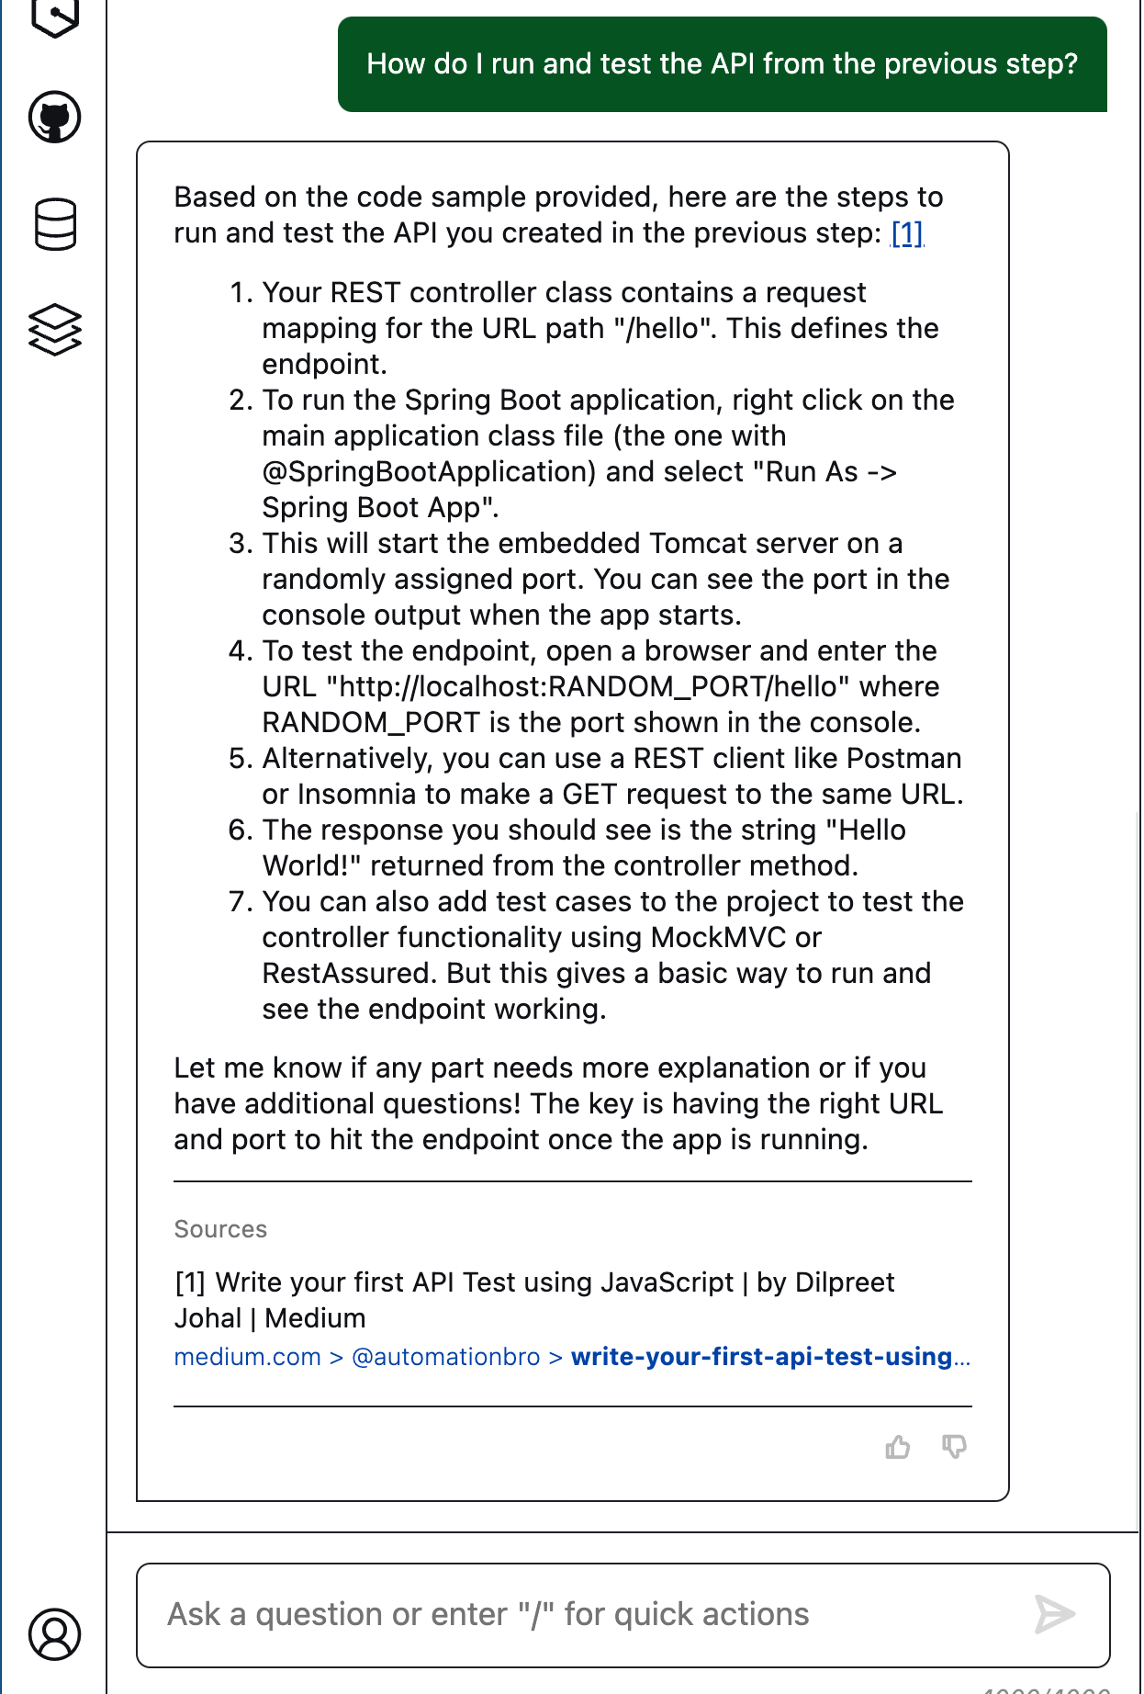
1
3
4
I want to create a simple Spring Boot app. It will provide a REST API. The code will call an external website. I do not need to configure security or data sources. Can you provide a step by step guide on how to do this. I am using VSCode.
Can you provide more details about how to create the Controller class annotated with @RestController in the previous step
2
How do I run and test the API from the previous step?
Notes:
[Learning New]
If I wanted to get started with a new Spring Boot application, and I am not familiar or just rusty with Java, I can get Q Developer to help guide me.
I can then refine to get more explicit results by asking clarification questions as I have done here in (3) and (4) where I ask it to tell me what files I need to change and then how to run and test the changes.

Slide 52

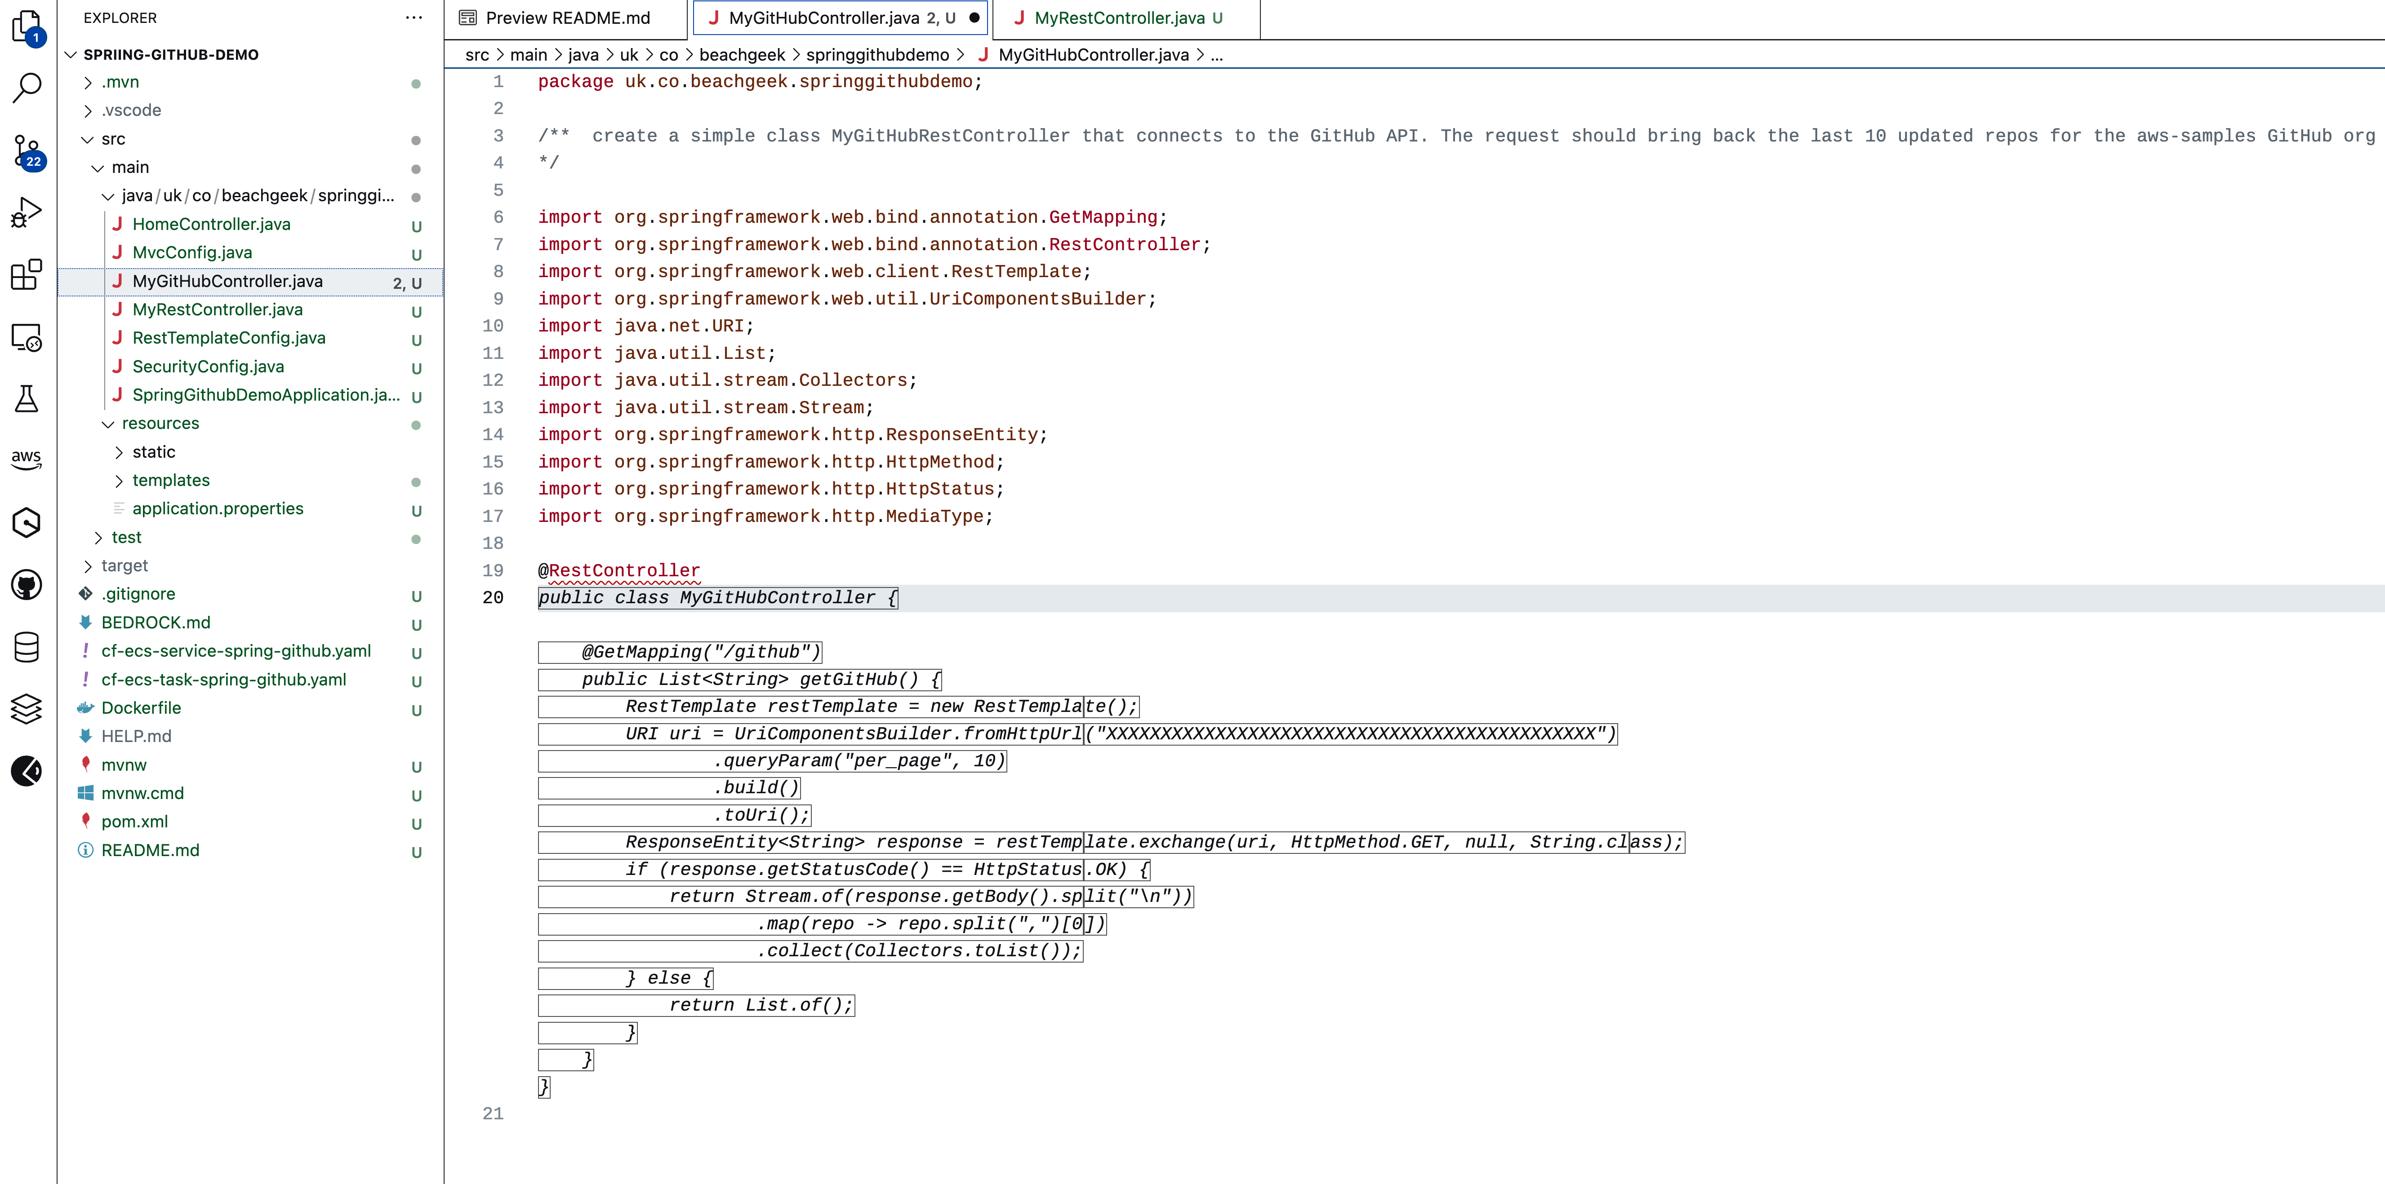
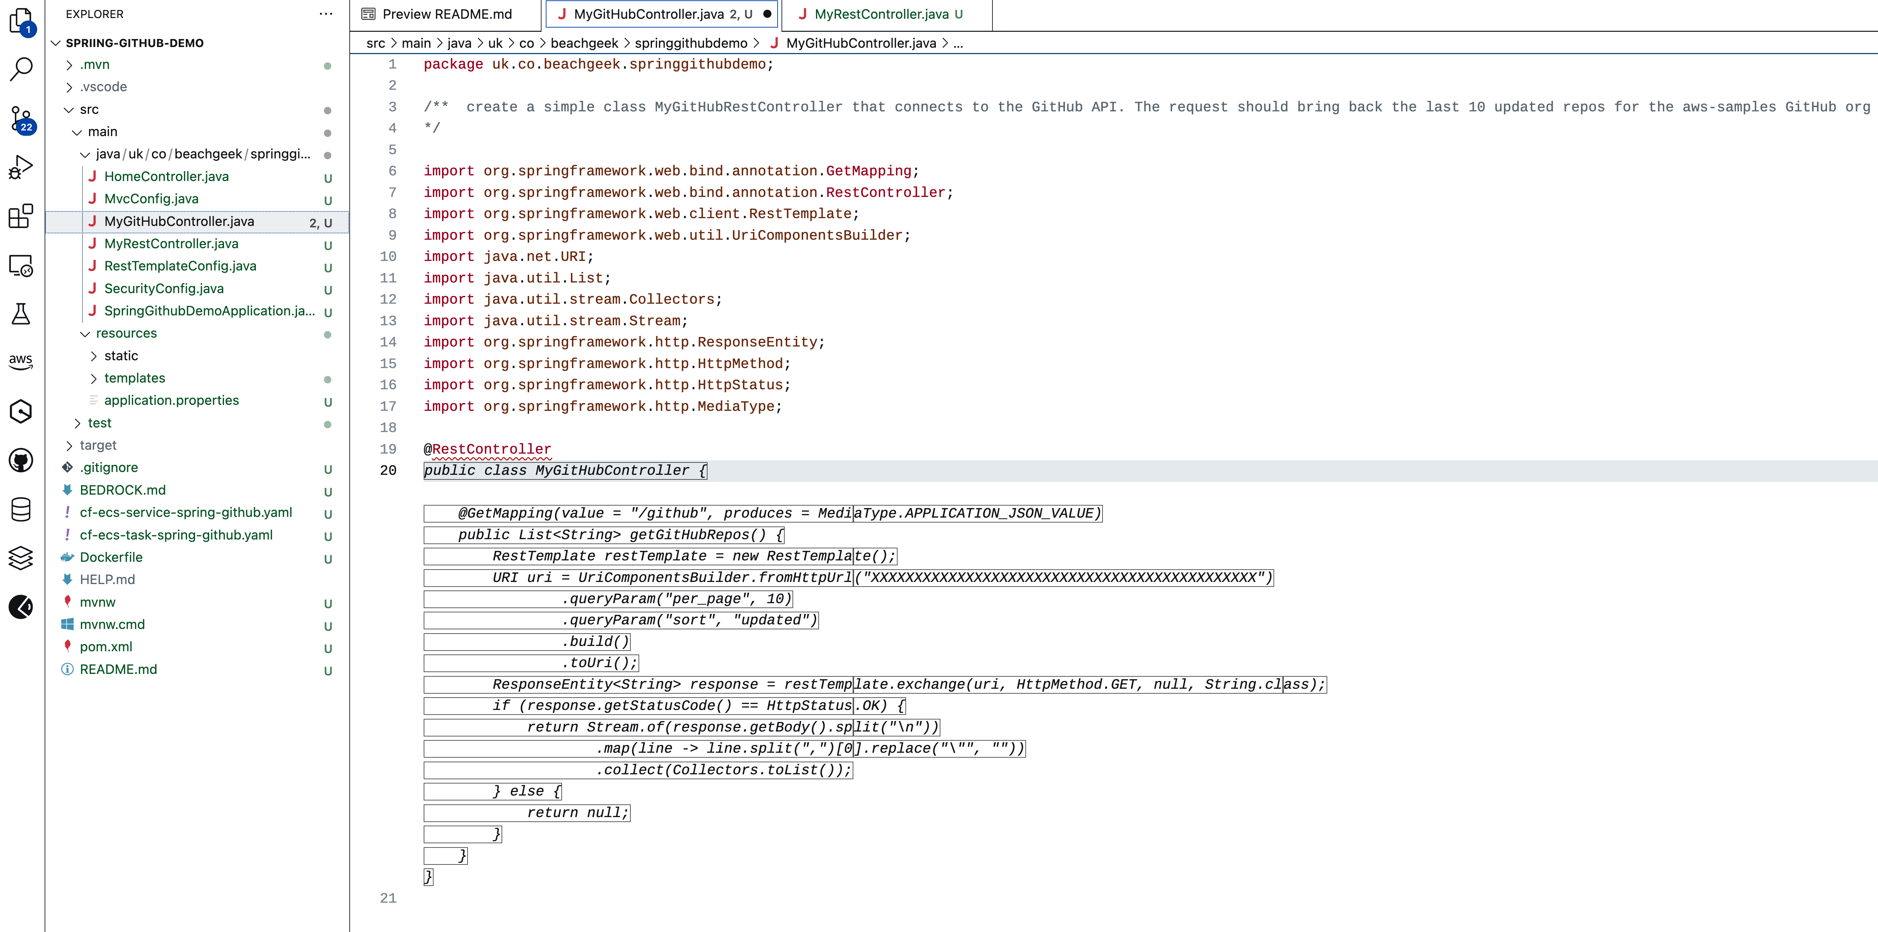
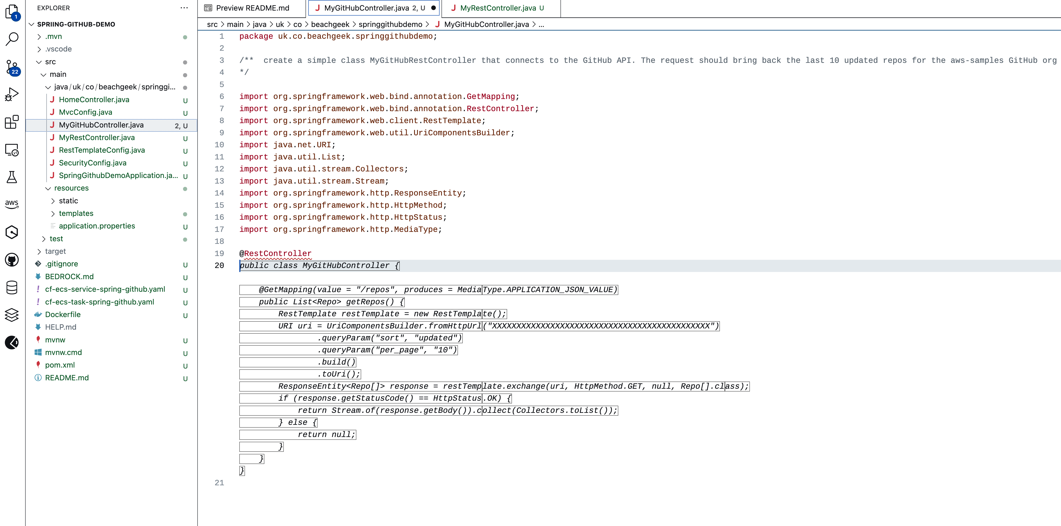
/** create a simple class MyGitHubRestController that connects to the GitHub API. The request should bring back the last 10 updated repos for the aws-samples GitHub org
*/
1
tab
3
2
4
Notes:
We can also do this directly in the IDE using Amazon Q Developer
Here we first add our new controller by adding a new java class, and then we prompt it by adding a comment (1).
After hitting return, Amazon Q Developer will then provide me with some suggested code. I can accept this by hitting TAB, or I can use the LEFT and RIGHT arrows to cycle between suggestions

Slide 53
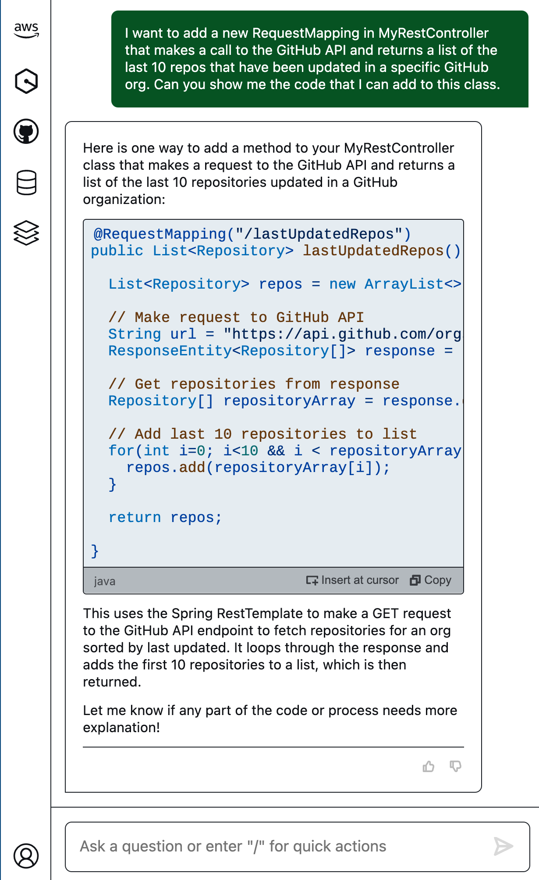
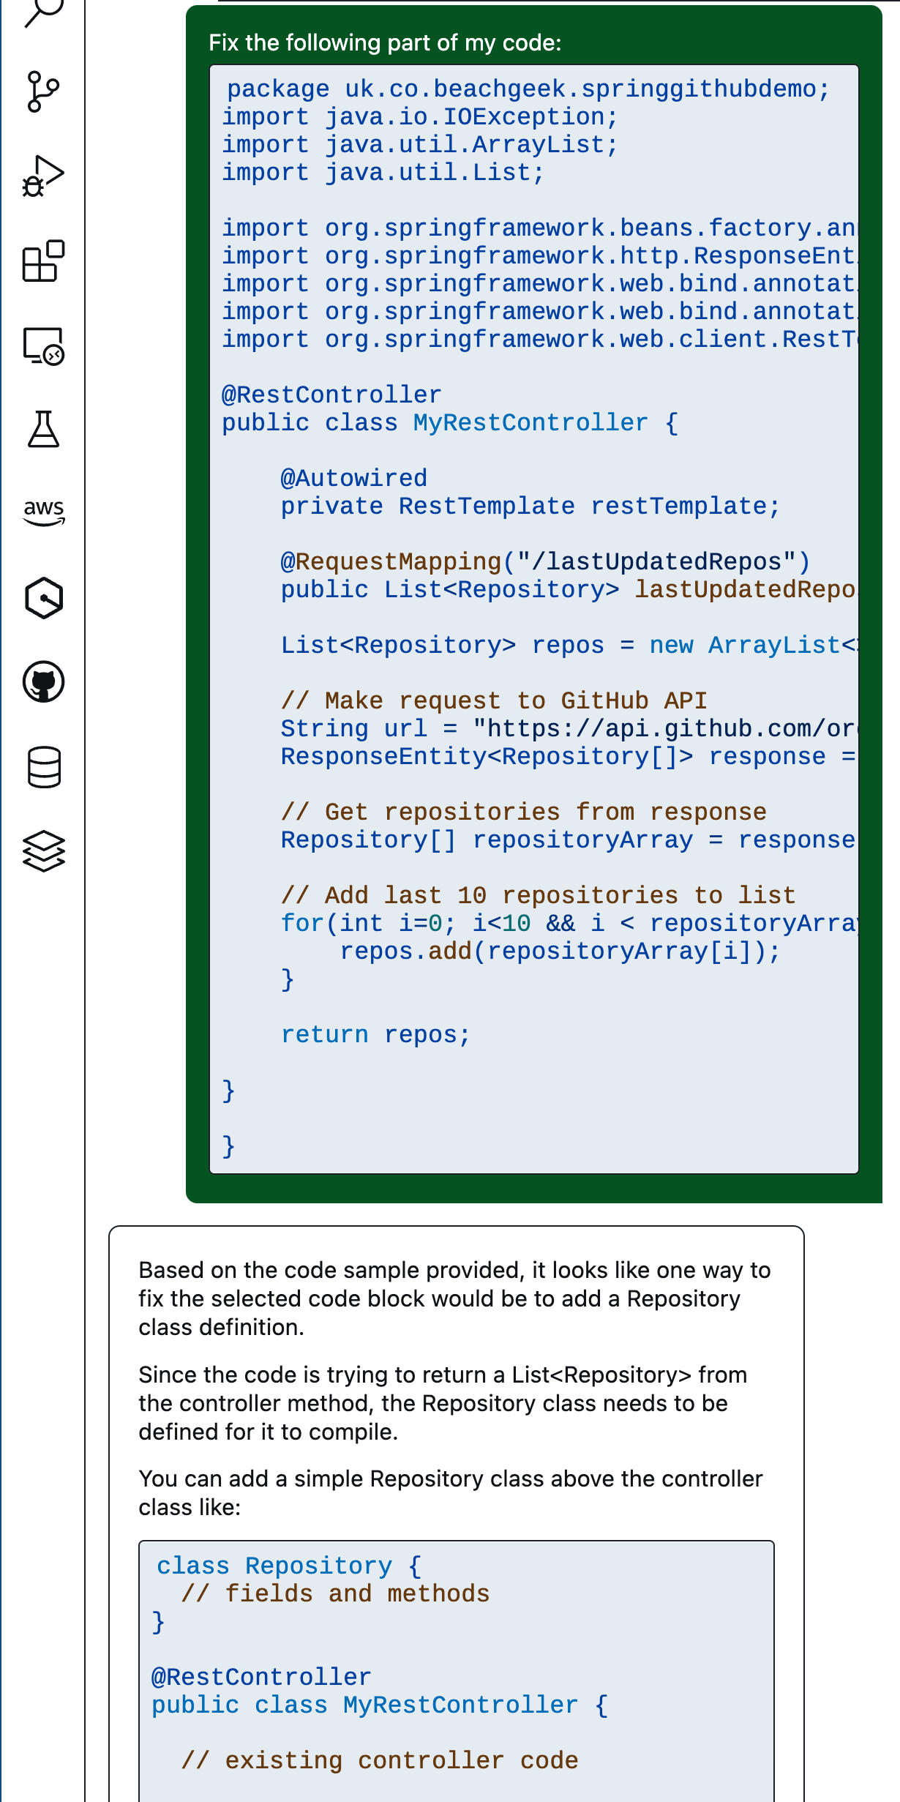
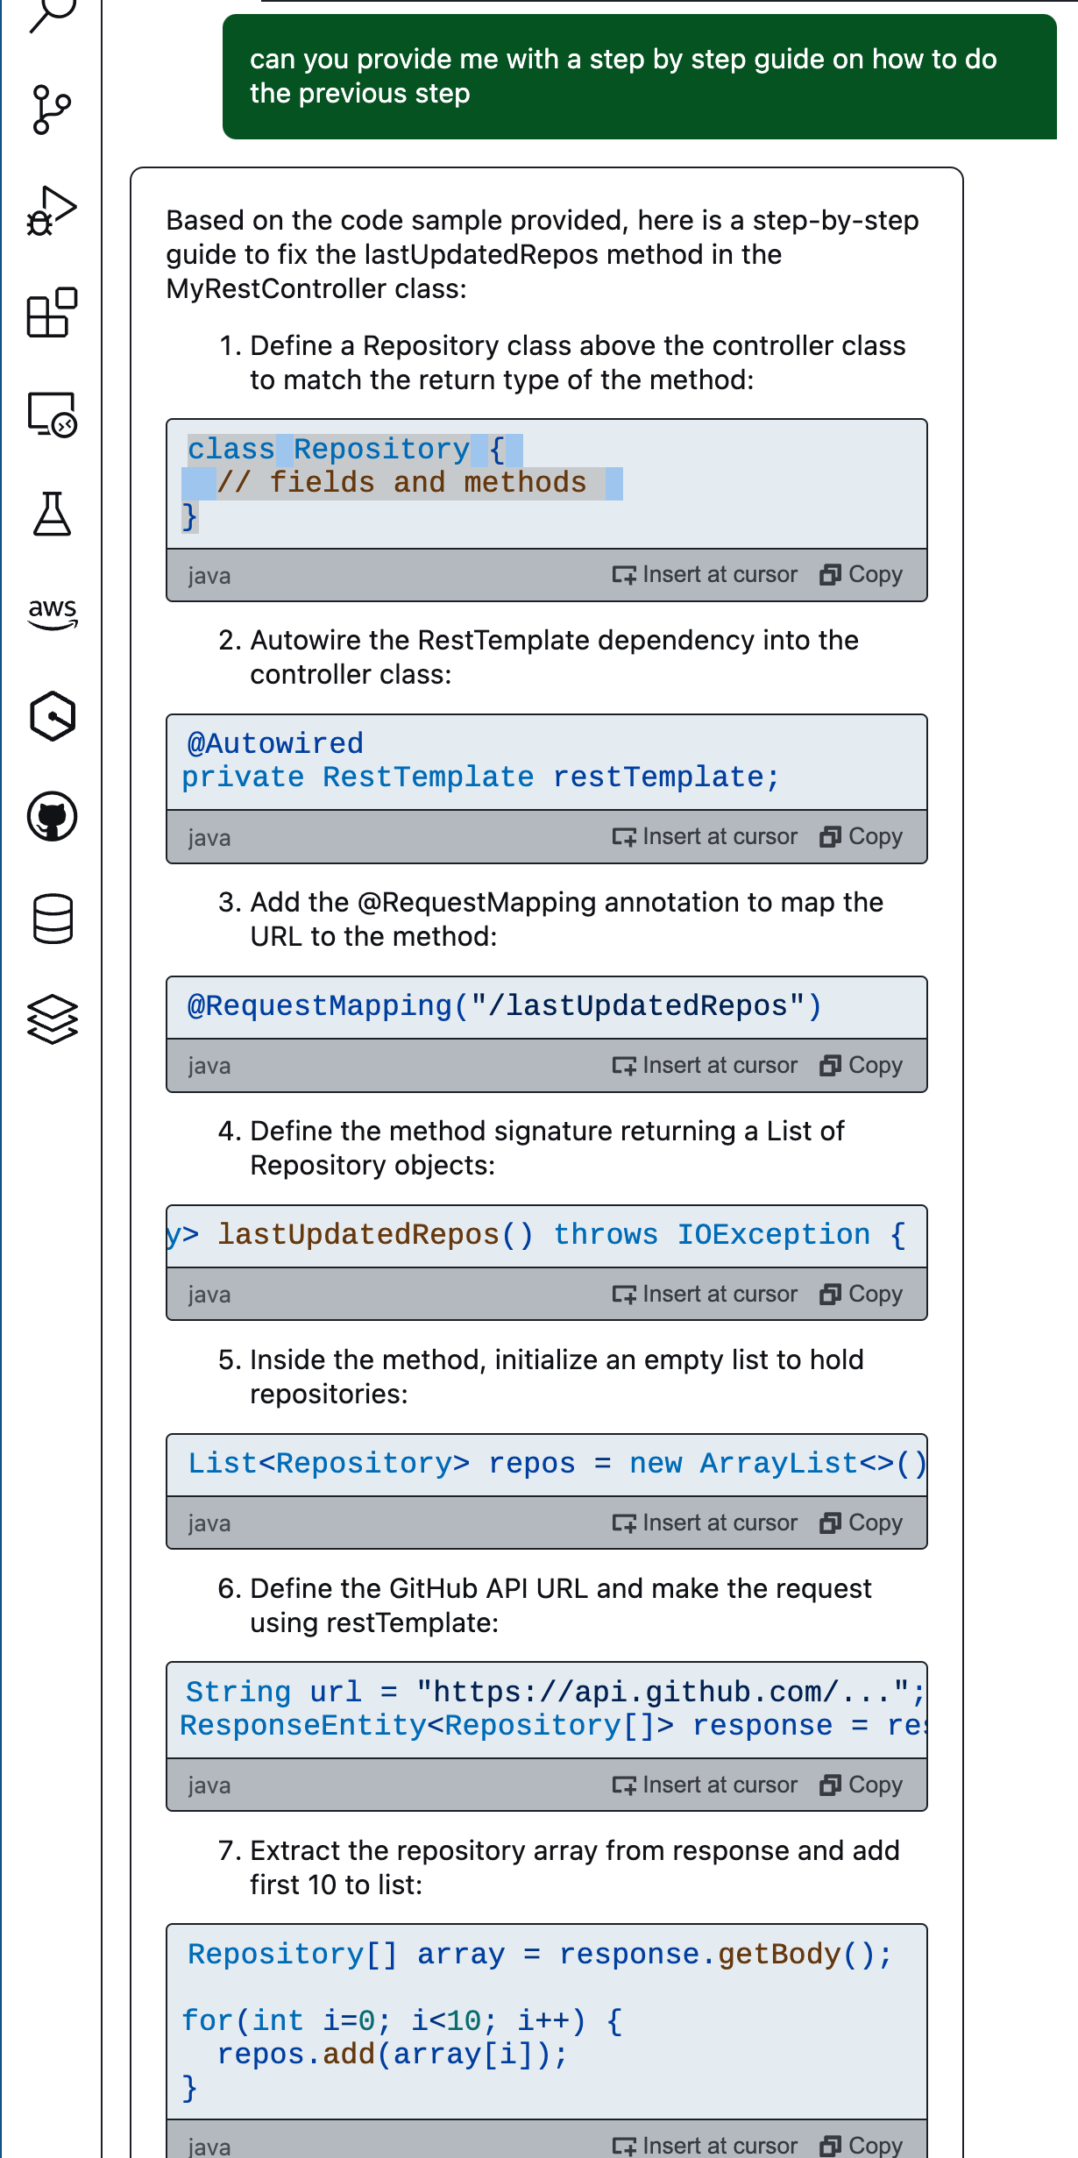
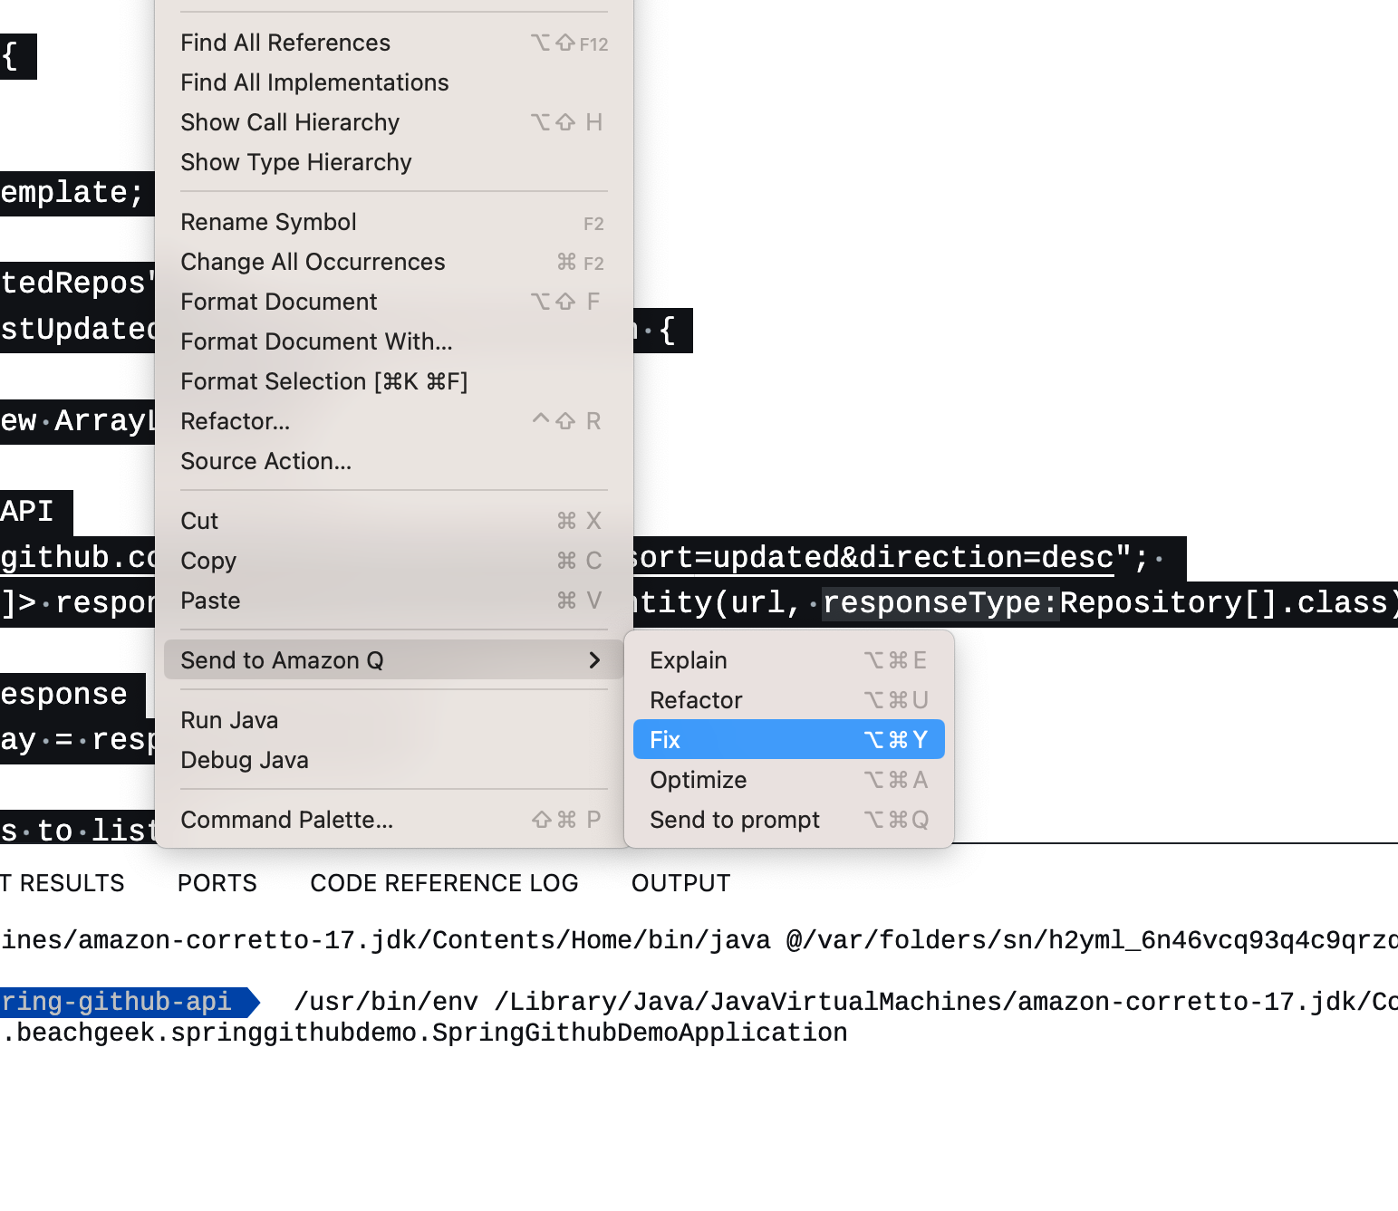
1
4
5
I want to add a new RequestMapping in my MyRestController that makes a call to the GitHub API and returns a list of the last 10 repos that have been updated in a specific GitHub org. Can you show me the code so I can add it to this class
Can you provide me with a step by step guide on how to do the previous step?
2
3
Notes:
[Debugging and Fixing]
<audience participation> how here codes and never makes mistakes?
As we code, we run into error and bugs, big and small. We can use these generative AI developer tools like Amazon Q Developer to make the process of fixing these much simpler.
In this example, I want to change my Java REST API to call the GitHub API and return a list of repos. I ask it for the code, and it helpfully suggests what to implement. When I try this however, I get errors.
From the IDE, I select the code, and send it to Amazon Q, using the FIX option. Amazon Q takes a look and suggests a fix (4). I can then ask for more specific step by step guidance as needed (5)
One of the great ways of using this is to detect typos – the amout of time I have just selected all and run Fix, just to see what it could find has helped me spot silly typos that I have made in my code.

Slide 54
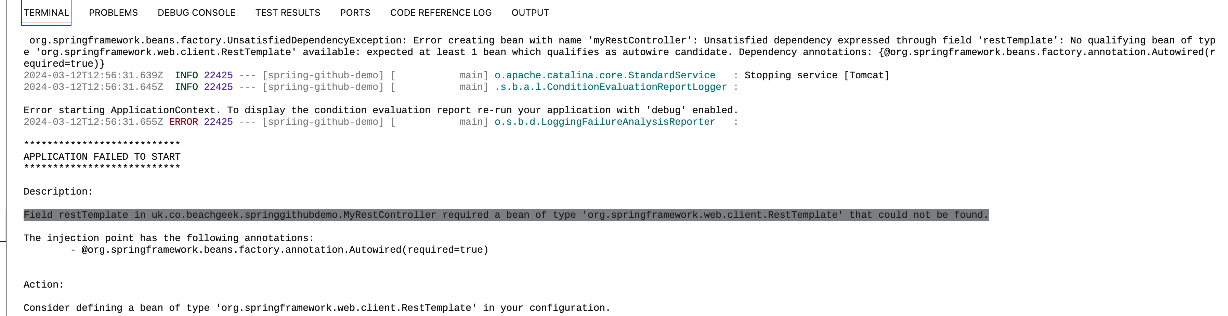
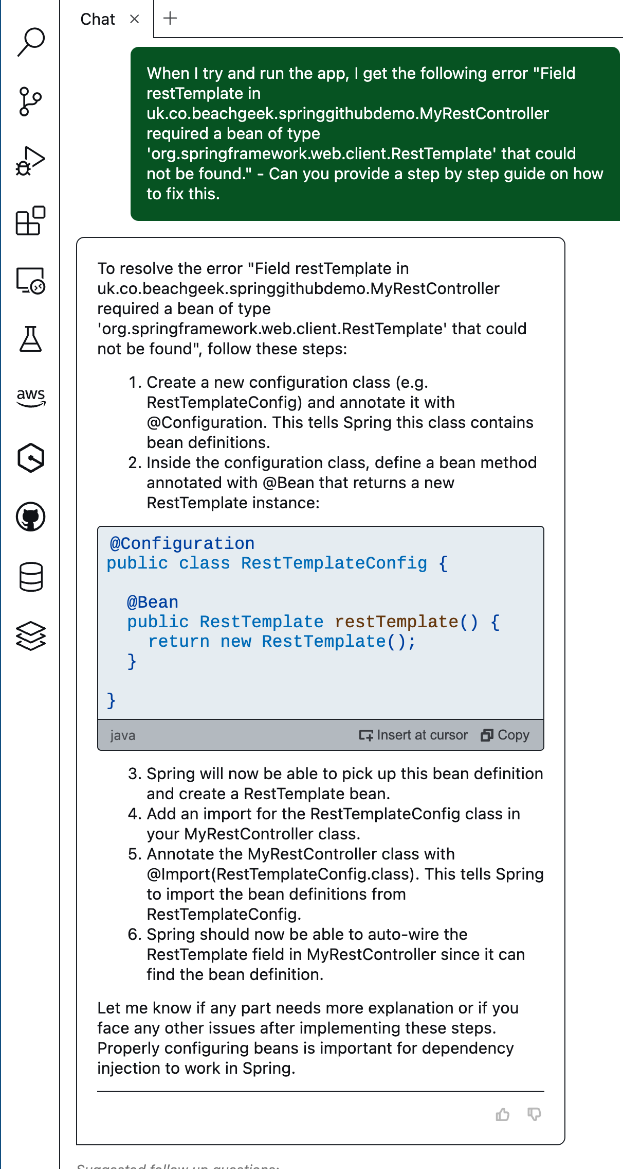
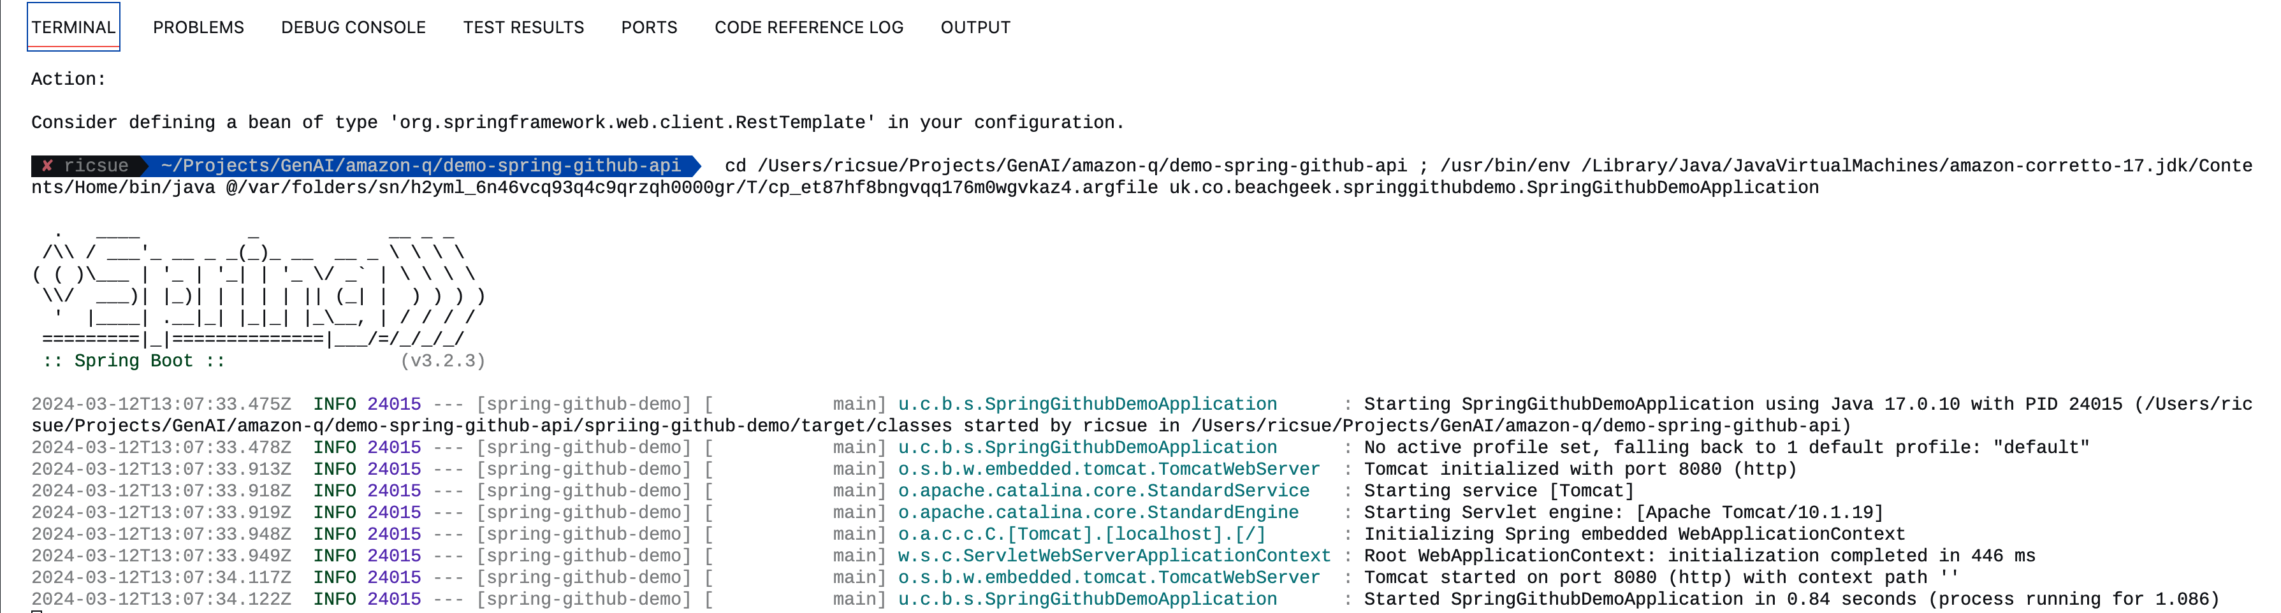
1
2
When I try and run the app I get the following error:
“Field restTemplate in uk.co.beachgeek.springgithubdemo.MyRestController required a bean of type ‘org.springframework.web.client.RestTemplate’ that could not be found”
Can you provide a step by step guide on how to fix that.
3
Notes:
It helps you fix runtime errors as well.
Here we see that I have now tried to run my new app but it has generated an error. It looks like I forgot to do something, which Q has told me how to fix. Once I have fixed this, I try again and success!

Slide 55
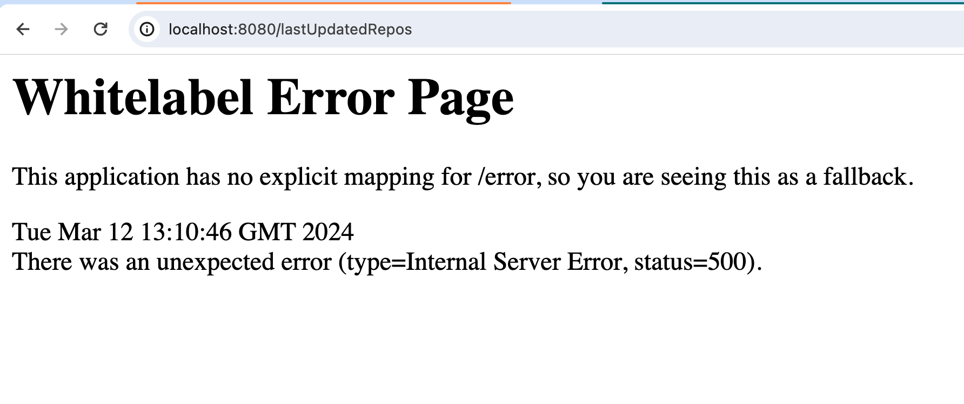
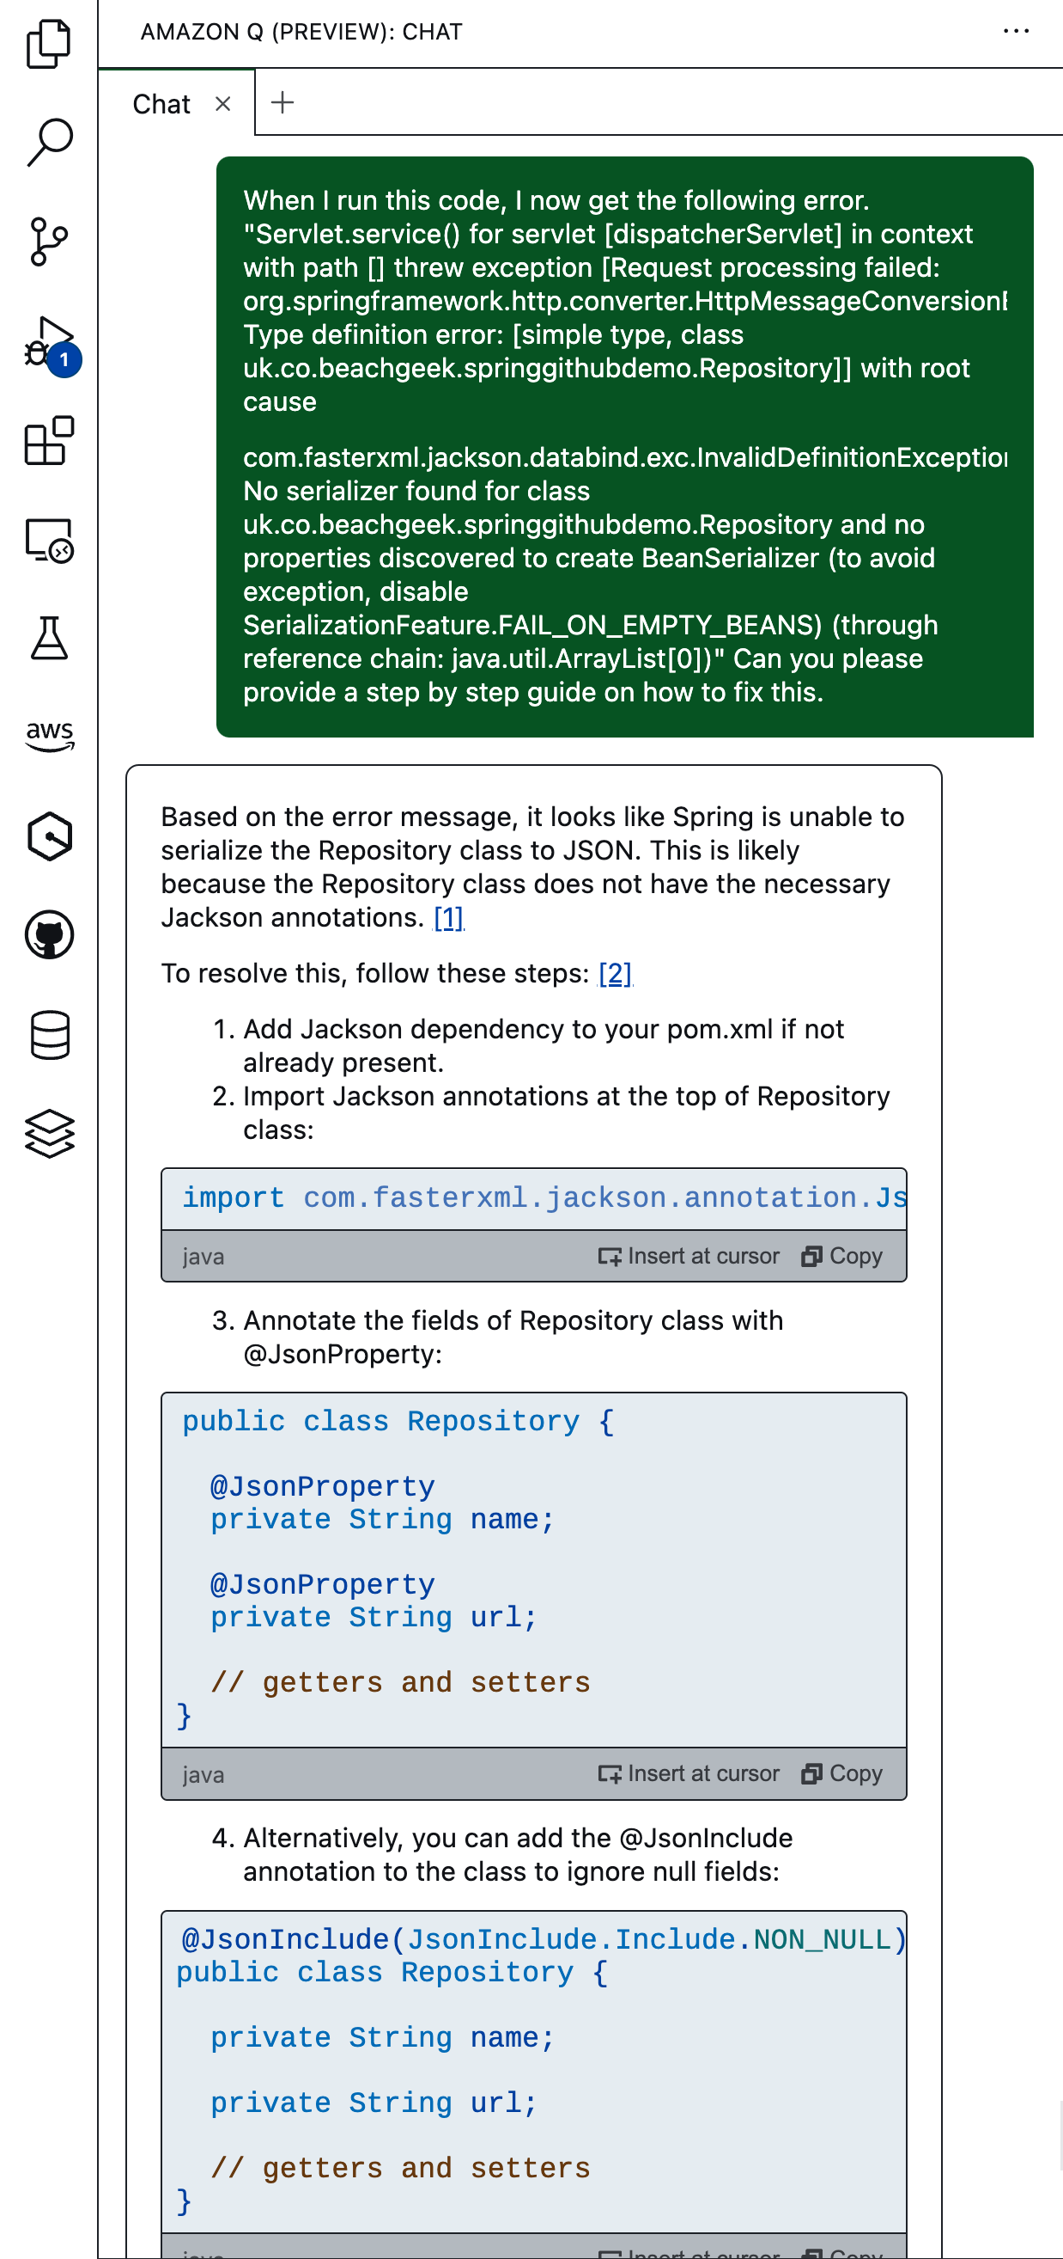
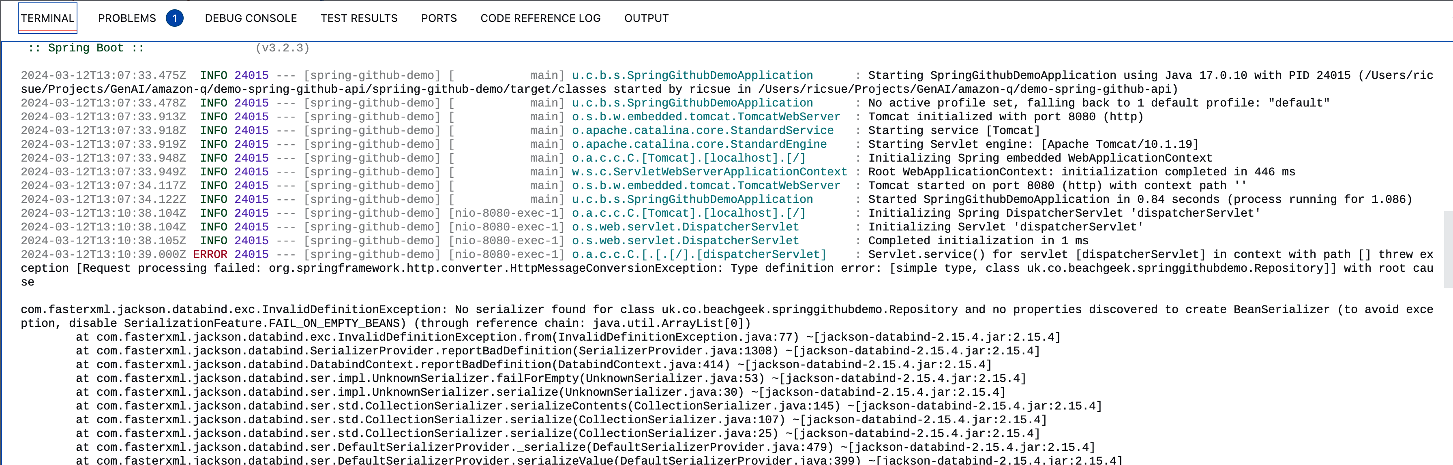
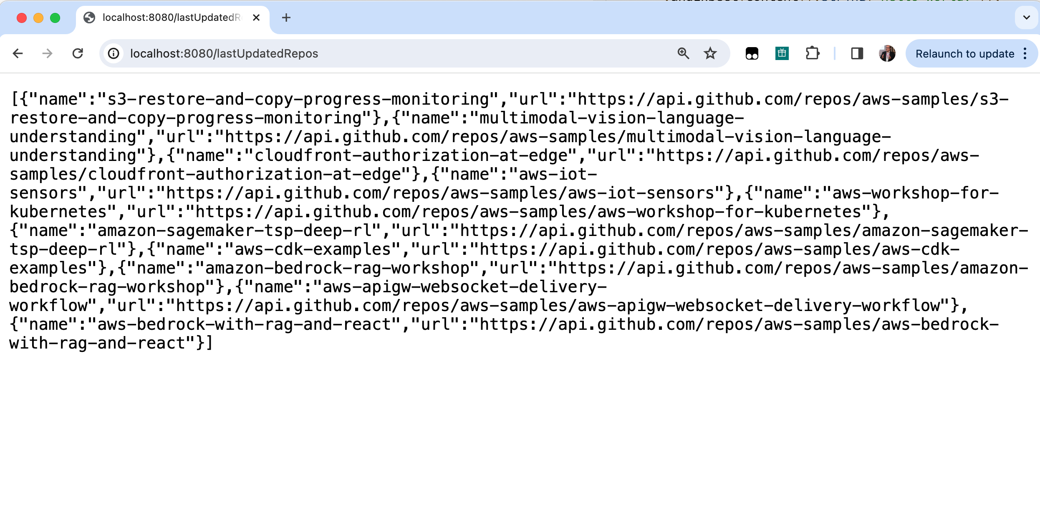
1
3
2
When I run this code I now get the following error:
“Servlet.service() for servlet [dispatcherServlet] in context with path[] threw exception [Request processing failed:……”
Can you please provide a step by step guide on how to fix this
4
Notes:
So I am not quite out the woods yet. Running the code generates a 500 error, which I can then see from the Spring Boot logs some more information. I turn to Q Developer to help me, and it provides a quick fix. After addressing the issues and re-running my code, success. Finally I have my working Spring Boot API. How quick was that!

Slide 56
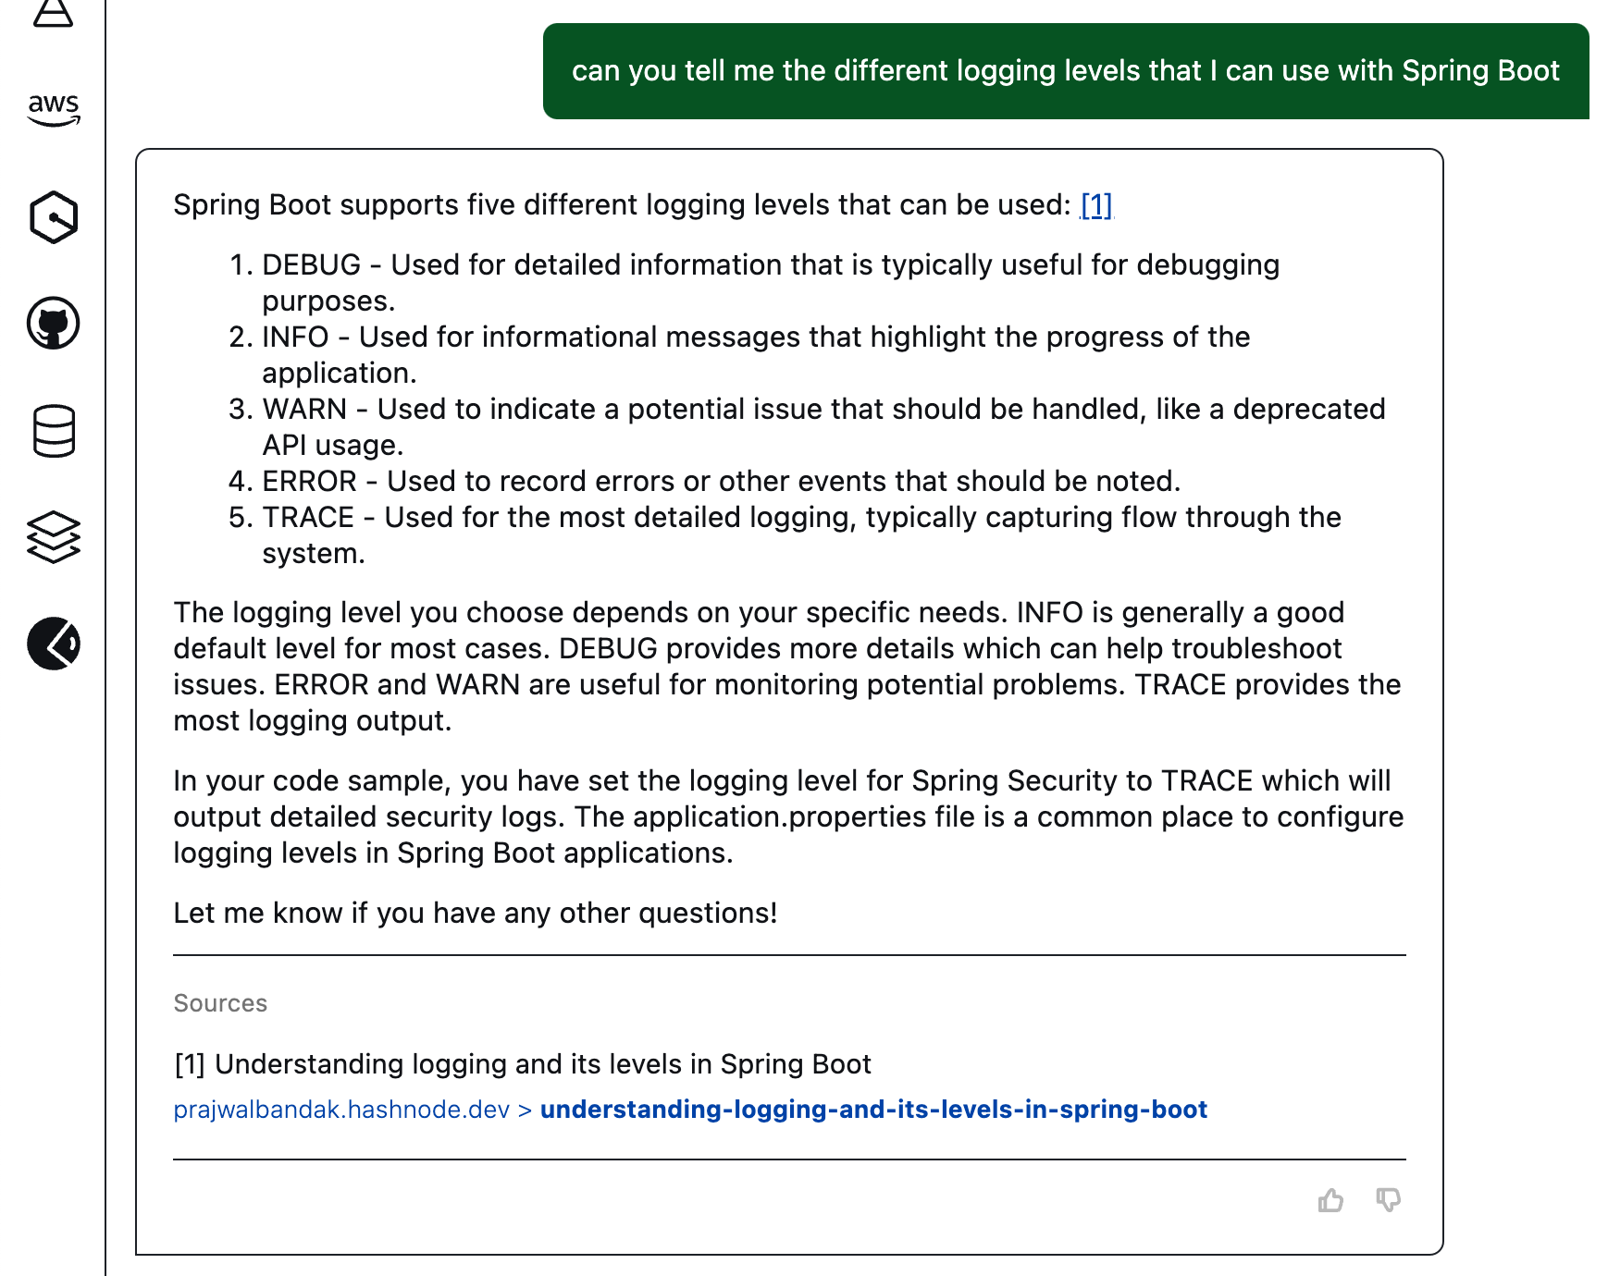
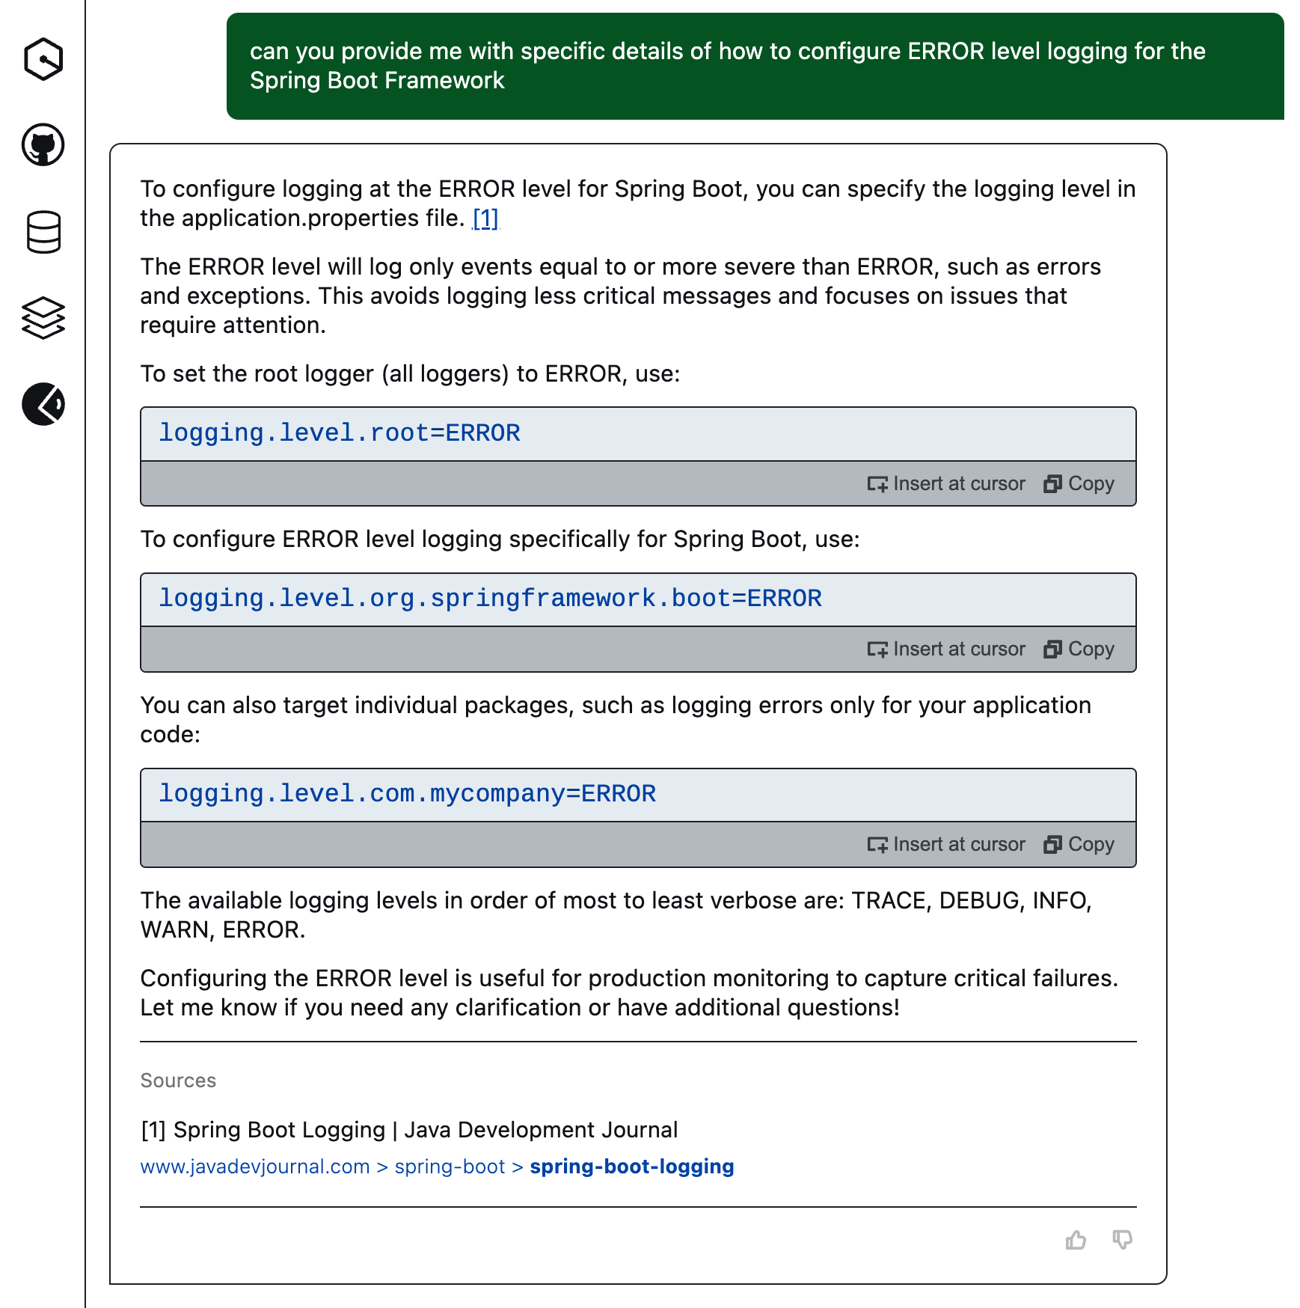
Can you tell me the different logging levels I can use with Spring Boot
Can you provide me with specific details of how to configure ERROR level logging for the Spring Boot framework
Notes:
I use Amazon Q Developer to help me find what logging levels Spring Boot supports and where I can set these. This is something I always had to search the web fore, now it is right at my finger tips.

Slide 57
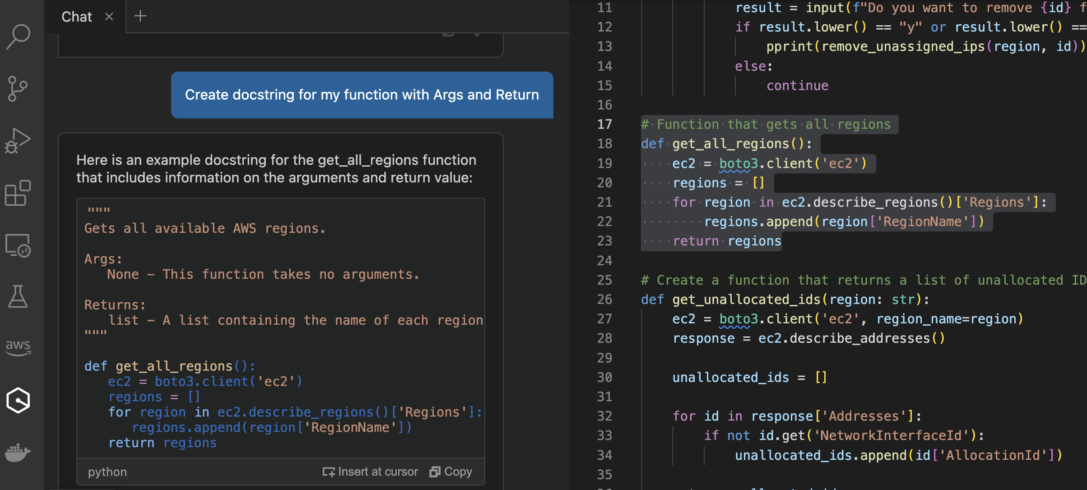
2
1
3
Notes:
We start off with some code, a typical function. Oh man, I don’t have time to document this, even though I know I need to.
Ok, lets see if Q Developer can help me here. Let me write a quick prompt.
Ah fantastic, this is exactly what I need, now let me paste this into the code – job done.

Slide 58
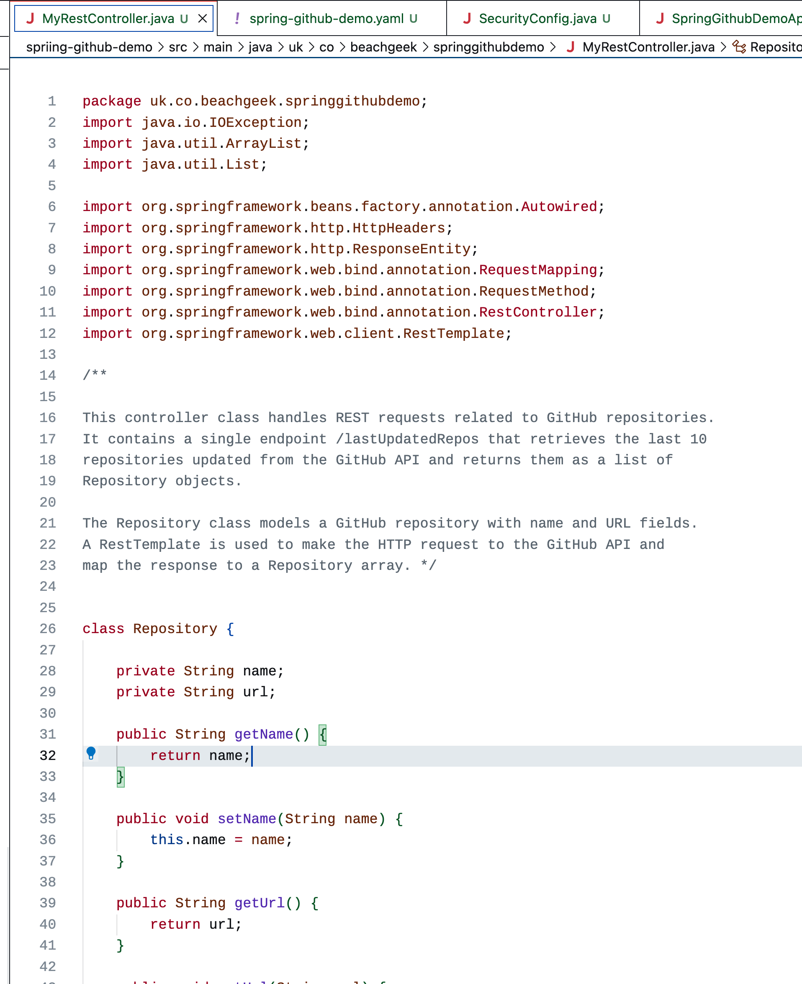
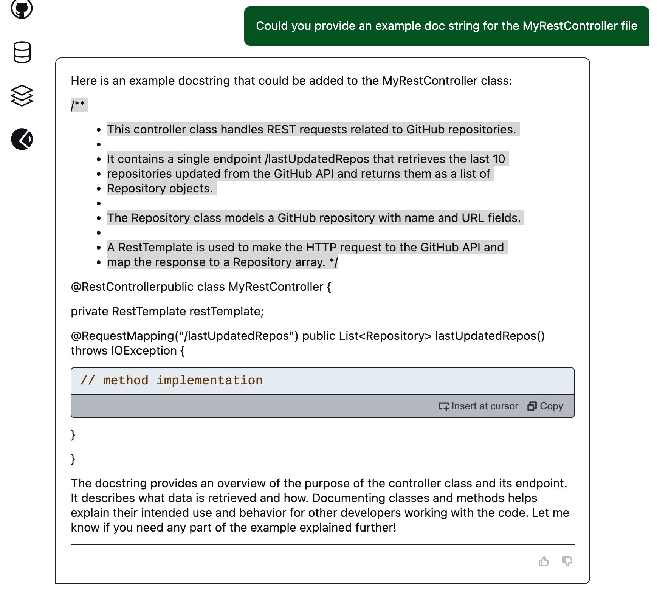
1
Can you provide an example doc string for the MyRestController class
Notes:
Like all good developers, we like to document our code as we go along. So lets use generative AI to help us here.
We ask Q Developer to generate doc strings for our Java files. (1)
Who knew documentation could be so easy and fun!

Slide 59
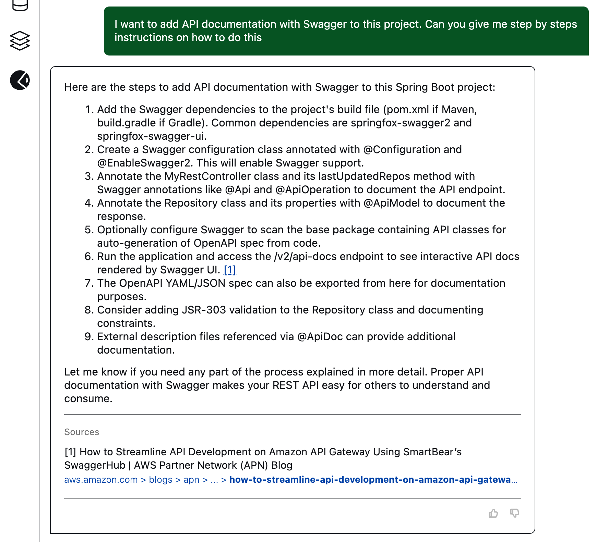
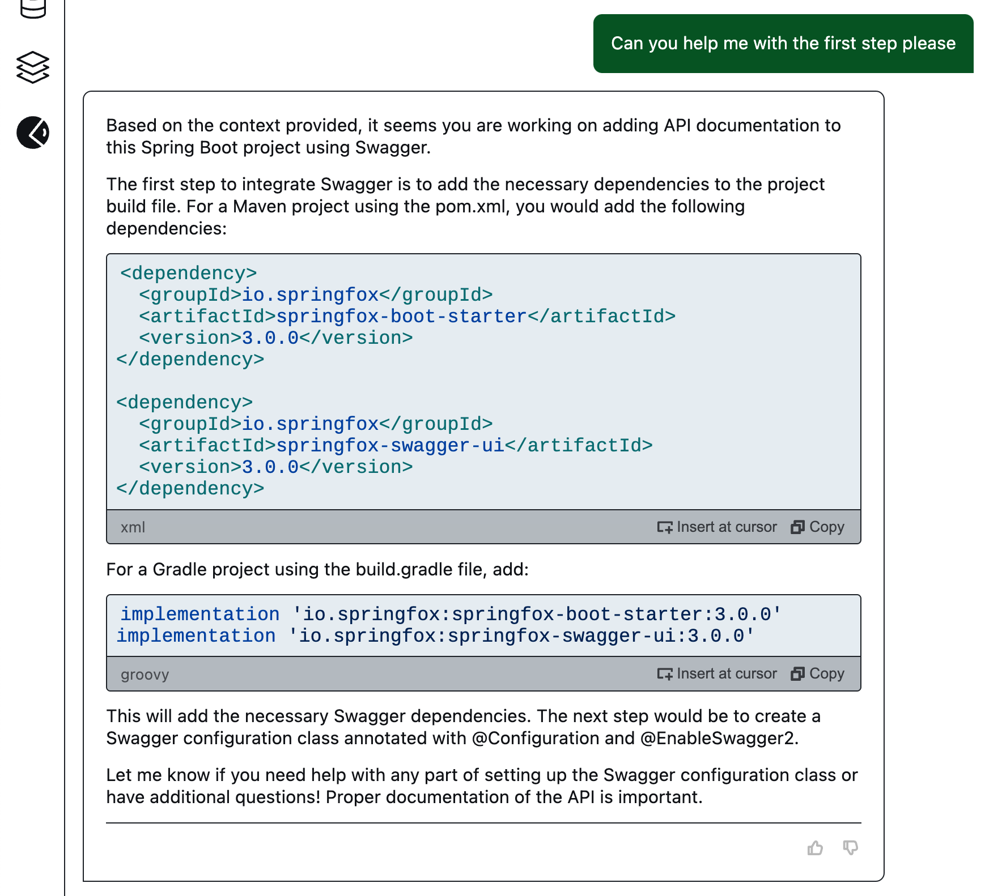
1
2
I want to add API documentation with Swagger to this project. Can you give me step by step instructions on how to do this.
Can you help me with the first step please.
Notes:
Looking at the README it suggested a few improvements we can make to this project. I like adding SWAGGER to better document the API. (1)
I am not sure about each of the steps, Q Developer already has the context (discussion) and so can help me with the specific steps I need. (2)

Slide 60
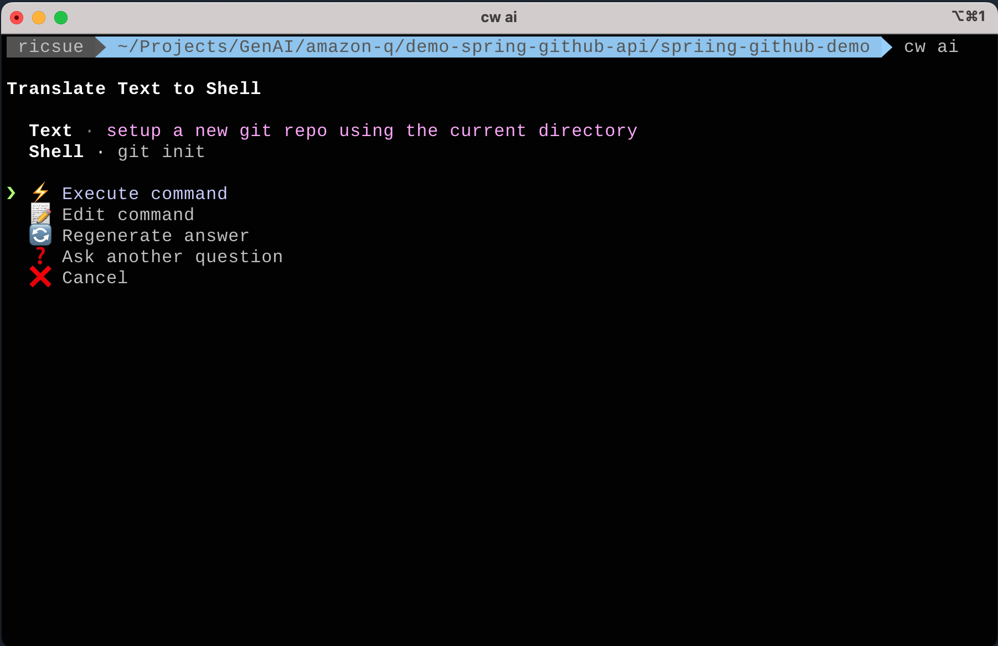
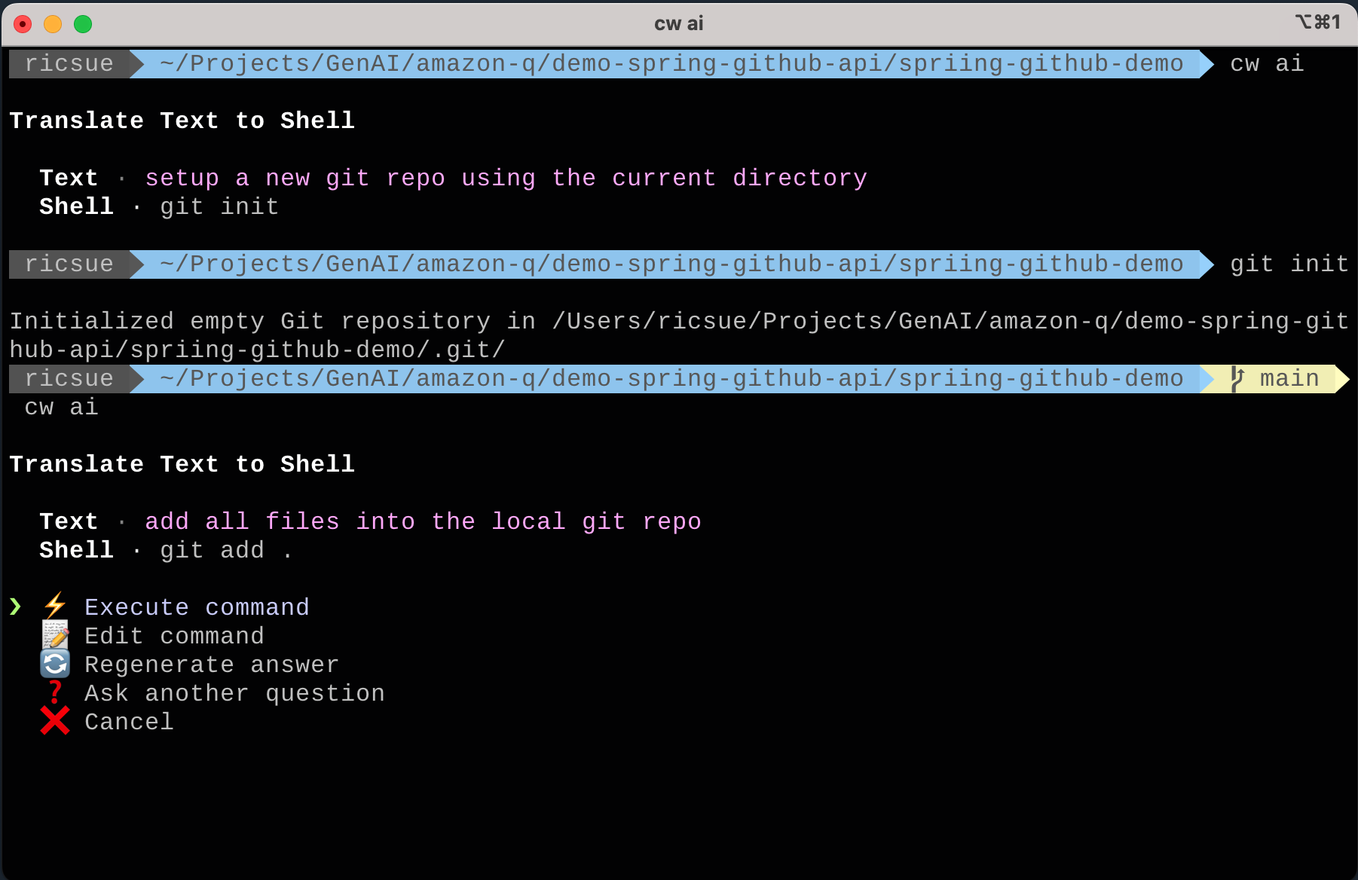
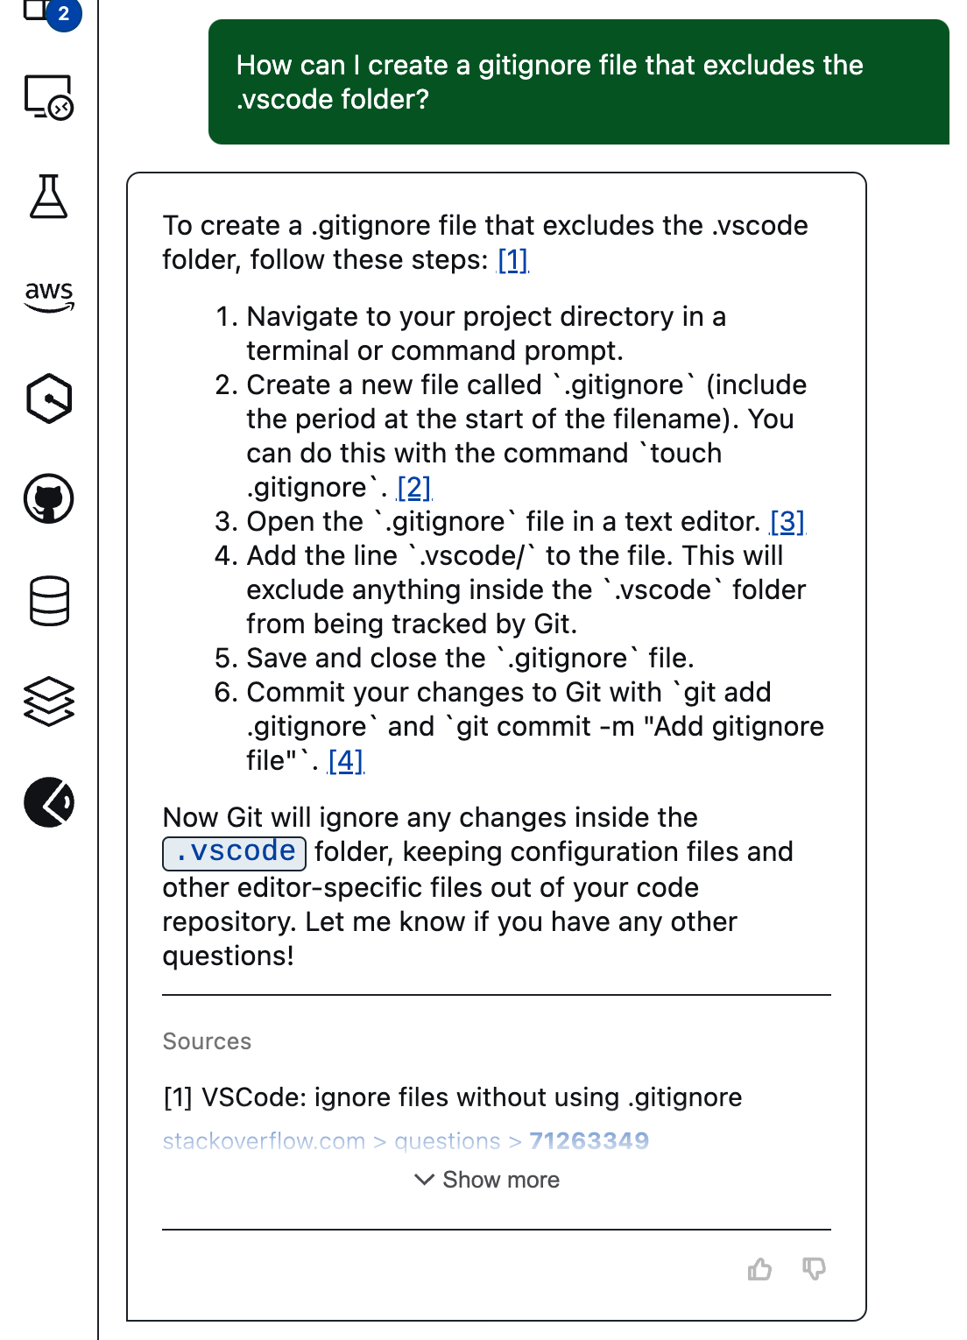
1
2
How can I create a gitignore file that excludes the .vscode folder
Setup a new git repo using the current directory
Notes:
Like all developers, we like to ensure that our code is stored in a github repo.
We can use Amazon Q cli to help us here to set this up.
We can also use Amazon Q in the IDE to make sure we do not include local folders – in my case, no one really needs my .vscode folder.

Slide 61
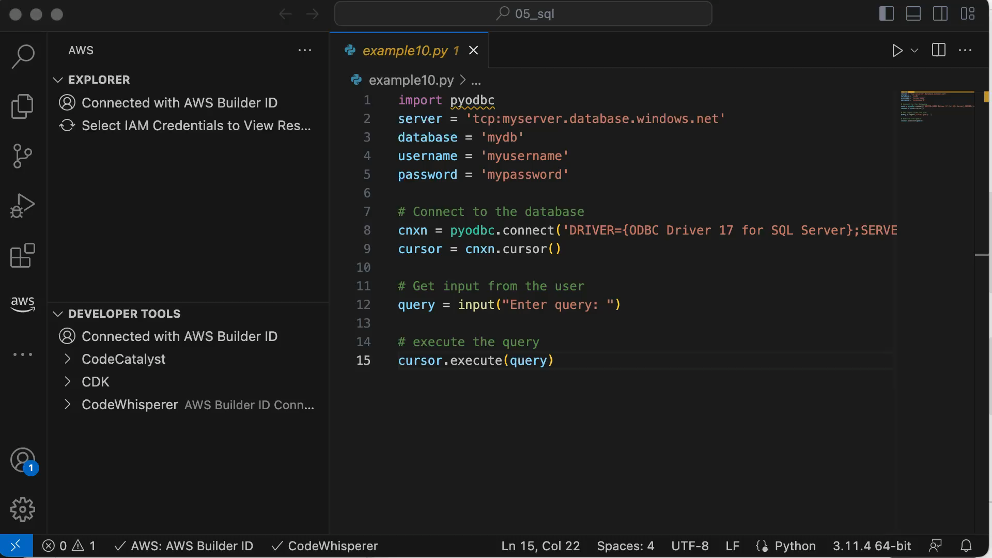

Slide 62
Test
Create unit tests for your applications
Generating synthetic data
Using testing tools
Build new things

Slide 63

Notes:
[[VIDEO]] 10:25 min
YT link - https://youtu.be/iDV0uSA-BdA
Testing 1 – Creating Unit Tests
We use Amazon Q Feature Dev to create simple unit tests for our projects, and then show how we can use the chat interface to help use fix any issues that come up form the generated code.

Slide 64
Notes:
[[VIDEO]] 6 mins
Link – https://youtu.be/AO5ShbfcayE
Overview – Part 2
We can also use Amazon Q Developer to ask for suggestions for creating unit tests and we can do it ourselves. When we run into issues, we can use the chat based interface to help us troubleshoot and fix issues.

Slide 65
Notes:
[[VIDEO]] 5:30 mins
Link – https://youtu.be/nUu0E4ulmXI
Overview – Now we can also use Amazon Q Developer to help us generate synthetic data for our application. In our simple application, lets ask it to generate synthetic project data and then display it. We will use Feature Dev so that the code will be created for us.

Slide 66
Notes:
[[VIDEO]] 6 mins
Link –
Overview –

Slide 67


1
3
What are the most important statements I need from the previous step to make this work
Can you create a unit test from the MyRestController.java class
2
Notes:
We can add tests to the code we have already created by asking Q Developer to help write it.
I needed to guide Q a little this time, asking it to help me with missing import statements. No biggie though, Q provided me with details of what needed to be done, and I now had a successful test for my class.

Slide 68



1
2
Security Scan completed for 5 files. 1 issue was found.
CWE-352 – Cross-site request forgery Detected by CodeWhisperer [Ln 42, col 1]
3
Notes:
We can also use generative AI tools to help us shift left with security.
Lets run a security scan. Whoops, look like we have found a known CWE. Lets see how Q Developer can help me here.

Slide 69

2
1
Notes:
I can click on the security findings to be taken directly to be code.
I have a single pane view of my security findings, and when I go into the actual code, I can get additional hints thanks to the integration of these tools with my IDE.(2)
With this information, I can now ask Q Developer for some help.

Slide 70



1
2
3
Can you tell me more about how to protect my Spring Boot application from CWE-352, and provide a step by step guide on what to do
Can you provide me with a step by step guide on how to configure Spring Security for this project
I am using Spring Security in my application. It is a simple http REST API. Do I need to worry about CWE-352 which has come up in a security scan?
Notes:
I can now use Q Developer to help me address this issue.
First I ask for some guidance on how I can protect my Spring Boot application against this. (1). I can then ask Q Developer to help me figure out how to configure Spring Security for this project.
I re-run the security scan. The warning still exists, so I can ask Q Developer whether I need to worry about this. (3)
Lets see how we can fix this now by going back into the code <next>
Additional Notes//
Using Q Developer we can find out that actually this is a low risk based on what this particular application is doing. The output from Q Developer goes on to say:
In Spring Security, CSRF protection is enabled by default for all incoming requests. However, there are scenarios where you might configure certain requests to not require CSRF protection. This can be done for several reasons, such as:
The request is read-only and does not change state on the server (e.g., GET requests).
The endpoint is used by clients that cannot support CSRF protection (e.g., some REST APIs).
You have other security mechanisms in place and have determined that CSRF protection is not necessary for specific endpoints.

Slide 71



2
1
How can I specify or limit the HTTP verb to just GET
Notes:
I ask my question, (1), make changes to my code as suggest (2), and then when I re-run my security scanning, I now have zero issues.

Slide 72


1
2
Notes:
Sometimes generative AI will automatically suggest a fix for me, in which case all I need to do is click on the APPLY FIX

Slide 73


1
Install hey
I want to load test my API using ”hey”. Run hey 100 times against localhost:8080/lastUpdateRepos
2
Notes:
If I want to try some quick cli tools to test my application, one of the problems I have is remembering the syntax.
Amazon Q Developer CLI can help me here – instead of having to remember the parameters for my tool, I just ask it how to load test using hey, and it will then make some suggestions. How cool is that – I know how generative AI at the command line too, (1)
If the tool I want is not available, I can also use it to help me know the best way to install the tool. (2)

Slide 74
Deploy
Deployment scripts and tools
Infrastructure as code
Documentation
Build new things
Notes:
command line, clickops, iac, documenting code - creating images for docs, creating architectural diagrams

Slide 75
Notes:
[[VIDEO]]

Slide 76



2
1
$ mvn package
Can you tell me how to run this Spring Boot application from the command line
$ java –jar target/demo-spring-github-0.0.1-SNAPSHOT.jar
3
Notes:
Lets run our application. We can ask Amazon Q Developer on how to do this. (1)
We run the suggested command to build the application (2)
And then we run it as suggested (3). When we now open a browser, hurrah, we now have our application up and running.

Slide 77


Can you tell me what the high level steps I need to do in order to deploy this spring boot application to Amazoin ECS
1
Package our application
Can you tell me what the high level steps I need to do to deploy this project to Amazon ECS. Simplify to just three steps in the correct order.
2
Upload to a container registry
3
Deploy on Amazon ECS
Notes:
No we have a working application, we can focus on the deployment stage.
During the design phase, we looked at a number of options. Using Containers was the approach I decided up, and Amazon ECS specifically.
Lets see what I need to do now. We can ask Q Developer to help simplify our approach by listing the steps. Don’t be afraid to ask the questions several times. I find that sometimes the first response needs to be more precise or specific, and I find that using words like ”simplify” or “summarise” can help provide better responses.

Slide 78



1
2
3
Does AWS have an OpenJDK distribution
How can I use Amazon Corretto to build a Docker file for my applicaiton
Can you create a Dockerfile for me that uses Amazon Corretto as the OpenJDK base image
Notes:
As I am going to containerize this application, I want to get some additional information I need to build my Dockerfile.
First we ask about whether AWS has an OpenJDK distributions (1). It provides a nice response about Amazon Corretto
<audience participation> have you heard about it anyone? <collect data point>
We can then ask for some more information about how to use Amazon Corretto when building our container image (2)
Finally, we can ask Amazon Q Developer to provide a sample Docker file on how we can build this. (3)

Slide 79


1
2
I want to use Finch to build my container image. Can you provide details of how I can do that with this project
In the previous example I do not have a build/libs/* directory. What is the correct command for my project
Notes:
For the eagle eyed out there, you will see that the instructions are not quite right. If we look at the folders created, we do mot have a build directory, so I ask Q Developer to help me out.
It tells me what I need to know, and now I can update my Dockerfile.(1)
Now I actually do not use Docker on my machine, as I have moved to Finch. An open source tool to help you build OCI compliant containers. I ask Q Developer for instructions on how I can use this. (2) And now I can build my container image.

Slide 80



1
$ finch build –t myapp .
2
http://localhost:8080/lastUpdatedRepos
$ finch run –p 8080:8080 myapp
3
Notes:
The container image builds (1) and then I can run it using Finch (2).
When I open up a browser, success! (3)
We have containerized our application. The cloud is one step nearer.

Slide 81


2
3
Amazon Bedrock using Claude v3
“Can you guide me on how to upload the container image to amazon ecr. I am using Finch instead of Docker. I am in the UK, can you use an AWS region that is closest to me. My project is called spring-github-api, and I want you to use this for the container image and repository. Please provide all instructions that work on the command line”
1
Tell me more about how to upload the container image to Amazon ECR?
Notes:
Now that I have a working docker image, I need to package up my local docker image now and deploy this to a container repository. Lets ask Developer Q what I need to do.
Ok this is good, but I would like more details. (1)
I am going to switch to using Amazon Bedrock now, and Anthropic Claud v3 Haiku, which was announced this week. This is the very latest model, and we can see here we get a much more detailed output of the steps I need to follow.
I have highlighted a few things of interest here.
1/ I have specified I want command line output, and so I have been given commands I can run
2/ As in previous steps, I am using Finch instead of Docker, so update the commands accordingly
3/ I have not specified an AWS region, I have just told it where I am located, and for it to figure it out – when you look at the output, you can see that it has correctly used eu-west-2, London.
4/ I have given it some specific name I want it to use and this has come through in the steps that follow
BUT//
Be careful – always check the information these tools give you.

Slide 82




1
2
3
4
Notes:
We can now start working through the instructions.
We enter the first command (1) and it successfully creates. When we go into the AWS console, we can confirm that the correct name was used and the location (2)
We then complete the rest of the steps to push our container image to Amazon ECR (3) – our little spring boot application is now in the clouds. (4)
We are going to need that information in the next step (the container image reference) so lets get to it.

Slide 83



1
2
What is the recommended way to deploy a containerised Spring Boot application to AWS using infrastructure as code?
Can you provide me with a starter Cloudformation template that will allow me to deploy this application to Amazon ECS
3
Notes:
Ok so now we have our application packaged as a container image, and published to a container repository. We have pretty much got everything ready, we can now figure out how to deploy this to AWS.
We can use infrastructure as code to help us automate this and create a consistent and repeatable way to do this. I ask my AWS Assistant, Q Developer in the console for some general guidance on this (1). I then go back to my Q Developer IDE and ask Q to provide me with a starter template. This looks promising. (2) I create a new file in the root folder of my project (cf-ecs-spring-github.yaml) and then use the paste at curser option. The code now appears in my file, and all I have to do is modify it to point to the container image I created and updated in the previous steps (2)

Slide 84


1
3
When I run this command I get the following error
“An error occurred (ValidationError) when calling CreateChangeSet operation. Parameters: [Subnets, Vpcid, SecurityGroup] must have values”
How do I fix this?
Provide me with the command line to deploy the Cloudformation template in this project
2
Notes:
We ask Q Developer how to deploy through the command line, and it helpfully provides everything we need (1). However, when we try this, we get an error (2). Lets see what Q Developer thinks about this (3)

Slide 85


1
3
How do I fix the error:
“An error occurred (insuffucientCapabilitiesException) when calling the CreateChangeSet operation: Requires capabilities: [CAPABILITY_IAM]”
Provide a code example of adding a VPC to the current Cloudformation template
2
Notes:
One step forward. I ask Q Deverlop to provide code to modify the existing cloudformation template and create a VPC.(1) When I re-run this, I get a new error (2), but this looks like a simple fix, I just need to add an additional command line switch when I use the deploy command (3)

Slide 86

How do I deploy a cloudformation template called cf-ecs-task-spring-github to eu-west-2
Notes:
Of course, I can also have done this via Amazon Q Developer in the cli

Slide 87


1
2
$ aws cloudformation deploy –template-file cf-ecs-spring-github.yaml –stack-name q-spring-github –region=eu-west-2 –capabilities CAPABILITY_IAM
3
http://35.178.180.204:8080/lastUpdateRepos
Notes:
Now we are deploying our application (1), and we can see progress in the cloudformation console (2)
When it completes, we can now access out spring boot api via the web

Slide 88


1
2
I need to amend the cloudformation template to use an aarch64 runtime
This is failing in ECS with the following error “exec /usr/bin/java: exec format error”
Notes:
Troubleshooting…
So whilst it deployed, my application did not work. When I look at the logs, I see an error
/exec /usr/bin/java
Now I actually know what this error is and of course, on my mac (Arm based processor architecture) when I created and built my container image, the runtime is expecting that. By default it uses an amd64.
No problem, Q Developer can help me by telling me how to update the CloudFormation template.
I now redeploy, and cross my fingers.

Slide 89


Notes:
We have pretty much got everything ready, we can now figure out how to deploy this to AWS.
We can use infrastructure as code to help us automate this and create a consistent and repeatable way to do this.
//Note – CDK on Java is probably a bad idea as there is not that much examples out there. Leaving it here for folk to pursue if the want to complete the steps

Slide 90


1
2
Notes:
Back to Amazon Q Developer in the command line – I can never remember the syntax for creating CDK apps, so lets ask Q (1)
Sure enough, it tells me the right command, I can then ask it to run the command, and voila, my project is created (2)

Slide 91

1
Can you create a README document for this project that explains how this project works and how to run it
More work for me to do!
Notes:
We also ask it to create a README file that explains what this application does (2)
Who knew documentation could be so easy and fun!

Slide 92



Notes:
We can also use other generative AI tools, such as Amazon Bedrock to help us document our architecture or code.
Source/
https://aws.amazon.com/blogs/database/diagram-as-code-using-generative-ai-to-build-a-data-model-for-amazon-neptune/

Slide 93
Demo
Notes:
You should now go out of the presentation and take a look at this in action.
You can use sample code in the repo (see first page for link to repo)
<audience>
You can joke about never working with children and animals, should now add generative ai

Slide 94
Adding new features to existing applications using generative AI
Notes:
Another aspect of new development is where we are asked to add a new feature into an existing application

Slide 95
Develop
Understanding existing application
xx
xxx
Build new things

Slide 96
Test
xxx
xxx
xxx
Build new things

Slide 97
Deploy
Deployment scripts and tools
Infrastructure as code
Documentation
Build new things

Slide 98
Finding and fixing my application bugs

Slide 99
Analysis
Fix things
Notes:
We will show you a few demos that show how these generative AI developer tools can help you with the tasks you have to do when you are working on.

Slide 100
Design
Fix things
Notes:
We will show you a few demos that show how these generative AI developer tools can help you with the tasks you have to do when you are working on.

Slide 101
Develop
Fix things
Notes:
We will show you a few demos that show how these generative AI developer tools can help you with the tasks you have to do when you are working on.

Slide 102
Test
Fix things
Notes:
We will show you a few demos that show how these generative AI developer tools can help you with the tasks you have to do when you are working on.

Slide 103
Deploy
Fix things
Notes:
We will show you a few demos that show how these generative AI developer tools can help you with the tasks you have to do when you are working on.

Slide 104
Maintain
Fix things
Notes:
We will show you a few demos that show how these generative AI developer tools can help you with the tasks you have to do when you are working on.

Slide 105
Demo

Slide 106
Updating, Upgrading, and making changes to my applications

Slide 107
Maintaining applications

Slide 108
Analysis
Maintain things
Notes:
We will show you a few demos that show how these generative AI developer tools can help you with the tasks you have to do when you are working on.

Slide 109
Design
Maintain things
Notes:
We will show you a few demos that show how these generative AI developer tools can help you with the tasks you have to do when you are working on.

Slide 110
Develop
Maintain things
Notes:
We will show you a few demos that show how these generative AI developer tools can help you with the tasks you have to do when you are working on.

Slide 111
Test
Maintain things
Notes:
We will show you a few demos that show how these generative AI developer tools can help you with the tasks you have to do when you are working on.

Slide 112
Deploy
Maintain things
Notes:
We will show you a few demos that show how these generative AI developer tools can help you with the tasks you have to do when you are working on.

Slide 113
Maintain
Understanding code bases
Managing changes to your code base
Troubleshooting
Maintain things
Notes:
Learning code bases - When I move into the design phase, I need to plan out my approach to a task. For that, I need to deeply understand my codebase and my applications’ architecture to understand the changes I need to make. I might need to ramp up on a codebase and a programming language that are new to me.
Documenting - I am seeing a lot of architectural diagram generation at the moment - this could be a super interesting one, although I don't think Amazon Q Developer do this today.
Migrate and upgrade

Slide 114

2
1
Can you EXPLAIN this code
Notes:
I have been given this dodgy looking code. Someone wants me to update it, they want me to change the number of items that are returned, and clean up the formatting.
From the code, I select ALL and then I as Q Developer to explain. (1)
After a few minutes, It provides me with a detailed description of how this code works (2) – great, one less thing for me to think about.

Slide 115


How can I modify my SpringGitHubDemoApplication class to output a line to the console that prints the version of the Spring Security library
Looking at this project, can you tell me which version of Spring Boot this project is using?
Notes:
We can use it to find out version of libraries and classes we are using, or help it to modify the code so that it outputs useful information to better understand our applications.

Slide 116


Look at the code and suggest OPTIMISATIONS
Look at the code and FIX
1
2
Notes:
We can take an existing code and then get Q Developer to suggest ways we can FIX (1) or OPTIMISE (2) the code base we have to work with.

Slide 117

You can use a Stream to map the response body to the Repository objects instead of a for loop
Consider using the Repository constructor to set the name and url of separate getters
You can autowire the RestTemplate as a bean instead of instantiating it in the controller
1
2
3
Notes:
Here we can see some of the suggestions on how we can optimize this code.

Slide 118

Notes:
Once you understand the code base, there are all sorts of questions you can ask about your application such as how to work with different AWS APIs or best practices for optimizing your application.
For example, you can ask Q which EC2 instance will improve your application performance, and Q automatically understands the context of your code in your IDE and gives you intelligent answers without any need for you to explain what you’re working on.
You can also ask it to do work on your behalf. You can ask Q to generate tests and it will, and then can add them to your application with just a click.
We think this is really going to speed up development and help you focus on creative tasks.

Slide 119
Demo

Slide 120
Migrating and modernizing applications

Slide 121
Analysis
Migrate and modernise things
Notes:
We will show you a few demos that show how these generative AI developer tools can help you with the tasks you have to do when you are working on.

Slide 122


1
1
2
2
Notes:
Imagine we have a Java application that we want to move to AWS.
We can ask Q Developer to provide some guidance – what are the right questions I should be asking the developers of the application. What are a set of useful functional and non functional requirements.
I have done this from within Q Developer in the AWS console, so these answers will be from a corpus that has been training on 17 years of AWS knowledge.
We can try on a more generalized model by trying the same questions in Q Developer in the IDE.

Slide 123



1
3
1
2
2
Notes:
Here I run similar questions right from within my IDE – no need to switch out to a different tool.
You can further refine the responses you get back more specific details – (3) This is a technique that you will need to hone to improve the responses you get from generative AI tools.
<speaker notes>
I am not focusing on the accuracy of these screenshots – if you get challenges on this, then you can say that the important thing here is that 1/ as models improve and get updates, the responses will become refined, 2/ as you get better and knowing how to speak with them via better prompts, you will get more specific and useful results. This is an ever moving landscape.
Further speaking topics – you can seed the thought around creating their own developer knowledge bases based on your companies own corpus – using techniques like fine tuning or RAG, you can create super specific responses that are tailored to your specific tech standards and guidance.

Slide 124
Design
Migrate and modernise things
Notes:
We will show you a few demos that show how these generative AI developer tools can help you with the tasks you have to do when you are working on.

Slide 125
Develop
Migrate and modernise things
Notes:
We will show you a few demos that show how these generative AI developer tools can help you with the tasks you have to do when you are working on.

Slide 126
Test
Migrate and modernise things
Notes:
We will show you a few demos that show how these generative AI developer tools can help you with the tasks you have to do when you are working on.

Slide 127
Deploy
Migrate and modernise things
Notes:
We will show you a few demos that show how these generative AI developer tools can help you with the tasks you have to do when you are working on.

Slide 128
Maintain
Migrate and modernise things
Notes:
We will show you a few demos that show how these generative AI developer tools can help you with the tasks you have to do when you are working on.

Slide 129
Demo

Slide 130
Getting the best from generative AI

Slide 131
Amazon Q Developer transforms
the developer experience
Notes:
In the demos you could see that we were able to take a huge leap forward in developer productivity using Amazon Q
Q will transform the daily experience of developers. It will transform how we do our work, and how we build with AWS. It will transform how quickly developers can onboard to new teams and become productive, and how quickly we can build powerful applications.
I believe that Q will become part of every aspect of how we complete development tasks. Across Research, Design, Develop, Test, and Maintain. From how we find the information we need and how we understand code, to writing the actual code and figuring out bugs, all the way to doing our code reviews. Q will even brainstorm with us about how we can improve our applications. With Q, we can spend more time building, innovating, and experimenting.
But like all new tools, we need to learn how to get the best of them.

Slide 132




Notes:
How do you get access to amazon Q?
Easy, Amazon Q Developer is already in the AWS Console so there is nothing for you to setup.
If you want to use Amazon Q Developer in your developer tools, then it could not be simpler.
1. Install the AWS Toolkit for your IDE (currently VSCode and Jetbrains)
2. Login using either a Builder ID (if you do not have an AWS account), or if you want to access some of the more advanced features, login using AWS Identity Centre (AWS SSO).

Slide 133

Notes:
Setup for InteliJ

Slide 134

Notes:
Setup for VSCode

Slide 135

1
Are you using the most effective generative AI tool for your task?
2
Prompt Ninja
Be specific and detailed in what you want
3
Context is key
Notes:
Like all tools, we need to practice and understand how to get the best of them. These new generative AI tools are no different at all. I want to share with you how I approach using these as I am using them, which I find, helps me maximise my productivity.
There are a broad range of generative AI developer tools, so the first thing to think about is for the task you are doing, which is the right one. Amazon Q Builder, is a general purpose developer tool that can help you get answers to generalized developer and development questions. Amazon Q in the Console is trained on 17 years of AWS documentation, and is focused on being your essential AWS Assistant. If I want to do stuff in the command line, then using Amazon Q Developer cli which has been training on hundreds of command line tools, will most likely give you the best results.
Interacting with

Slide 136

1
Which version is it anyway
2
Same words, different order
3
Be explicit
4
Trust but ALWAYS verify
Notes:
Gotchas that you should be thinking about
You should provide additional context on which version of a library or tool you are using – Q Developer does try and get context automatically, but sometimes providing explicit version numbers can help especially whene you are dealing with libraries that have major updates with breaking changes. If you see deprecation warnings in the code suggestions, dive deeper into this.
Sometimes asking the same question a different way give you better results – so experiment
Be explicit – it might only give you partial information and you need to fill in the blanks
Finally, whilst I do trust the output I am getting from these generative AI tools, you should get into the habbit of checking them to validate these are not going to cause you issues. This is especially important when you are making destructive changes. I have found in some examples, that it might give me the incorrect link to a tool (the tool exists, but because of reasons such as it uses a common name, I get sent an incorrect link)

Slide 137


Amazon Q helps developers avoid bias by filtering out code suggestions that might be considered biased and unfair
Notes:
Bias, toxicity, and hallucinations.
One final thing to think about is how the tools you are looking at do not implement code that is harmful. This can take many forms. With its toxicity filtering and bias avoidance capabilities, Amazon Q Developer helps flag and remove problematic code that might be considered biased or unfair.
More info:
https://www.amazon.science/blog/responsible-ai-in-the-generative-era (public)
https://d1.awsstatic.com/responsible-machine-learning/responsible-use-of-machine-learning-guide.pdf (public)
https://aws.highspot.com/items/6462465165d1f2fe43846430?lfrm=srp.0#2 (internal)

Slide 138
The craft of the developer… recalibrated

Slide 139
A new capability in the developer toolbox
Notes:
To conclude.
Developers have always used new tools and new levels of abstractions to help them be more productive. Generative AI tools like Amazon Q are just a natural evolution of this. It is a new set of capabilities in our developer toolbox.

Slide 140
Critical Thinker
Notes:
With the less interesting stuff that developers have to do made simpler, this will leave room and space for developers to focus and hone their problem solving skills.
Developers have always been critical thinkers. Using these generative AI tools puts more of emphasis on that skill, not less.

Slide 141
Artificial Intelligence
Assisted Intelligence
Notes:
You can think of the AI in these tools as Assistive Intelligence. They are there as a companion to help you, to remove the repetitive parts of development, to flatten the learning curve when looking at new technologies, and in general make you as a developer more productive and happier. Much happier.

Slide 142

https://tidyfirst.substack.com/p/90-of-my-skills-are-now-worth-0
Notes:
I really like this quote from Kent Beck (go read his blog post) which suggests that as developers, we need to focus on where we bring the most value across the craft of development.

Slide 143
“Some tools of thought are so blunt that they are almost useless; others are so sharp that they are dangerous. But the wise man will have the use of both kinds.”
~ Gregory Bateson
Stuff that generative AI developer tools can do better than me
Things that generative AI developer tools will help me do better
Things that developers will always do best
Notes:
We need to start recalibrating the work we do, and the tools we use to get them done, and find out where along this new continuum we operate.
As we shift ore of the toil work to the left, this will provide space and time for the parts of the developer job that makes us most happy.
Learning new technologies.
Solving the right problems
Doing things properly.
Development as a craft.
Who is Greg Bateson -> https://en.wikipedia.org/wiki/Gregory_Bateson

Slide 144


Get started using Amazon Q Developer today
Join the community
https://community.aws/
https://aws.amazon.com/q
Notes:
You can find code resources used during the demos here
Join other developers in the community to discover and learn more about how to use these developer tools
Finally, you can get started today and try Amazon Q from your VSCode or IntelliJ browsers, even if you do not have an AWS Account. This will also allow you to use Amazon Q Developer

Slide 145

Share your feedback about the session and generative AI services
1 min Community Survey
Notes:
Dear speaker: we would really appreciate if you keep this slide and get attendees to answer it. It takes less than 1 minute, and it will help us a lot support the community better and addressing their feedback.
Thanks a lot.
AWS Community team

